Slide 1
Interconnect Fault Template Notes
June 2020
David McNulty
Product Manager Interconnect circuits
Notes:
Security classification options:
– Public
– Internal
– Confidential
– Highly Confidential

Slide 2
Introduction
In October 2019 the Interconnect Link & Network fault templates were updated to
version 5. The templates were updated to ensure that all the necessary information required
to direct faults to the appropriate team(s) is captured within the fault report.
The overall objective is to reduce handling time and provide quicker fault resolution.
Link faults can be raised :-
  eCo repair
    eCo repair does not capture all of the information required so please ensure additional information from the template is included in the “Fault description” and “Additional Information” fields as shown in next slide.
    Template can also be emailed to provide additional detail for fault raised on eCo repair.
  Emailing the link faults template to i.c.repair@bt.com
Interconnect Network faults can only be be raised :-
  Emailing the Network faults template to i.c.repair@bt.com
The latest version of the templates can be found at Interconnect-faults-templates please download the latest copies of the templates as fault(s) may not be accepted if submitted with out of date template(s).

Slide 3
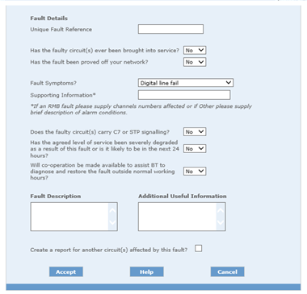
Submitting Interconnect link faults on eCo repair
Interconnect Link Fault Template
Questions not requested on eCo repair
8 | Has the fault been proved off your network? (You will be required to prove the fault off your network, i.e. to the point of connection (POC), indicating what tests have been done to localise the fault? before passing it to BT.) | To continue with the fault report, the answer here should be YES Notes:
9 | When did the fault / incident occur? | Date. Time.
11 | Is the fault limited to a specific time of the day? (Intermittent time stamps?)
12 | Is this fault affecting all calls, or a specific percentage of calls? (which channels are you experiencing issues with?)
13 | Have you any other useful information? * If an RMB fault please supply channels numbers affected. ** If 'Other' please supply description of alarm conditions.

