Slide 1

How to raise a fault on Business Zone
BT Wholesale Online
V1
LEGAL NOTICE: The information contained in this briefing is confidential information as per your terms and conditions with BT. Please do not forward, republish or permit unauthorised access. The content is accurate at the time of writing and is subject to change.

Slide 2
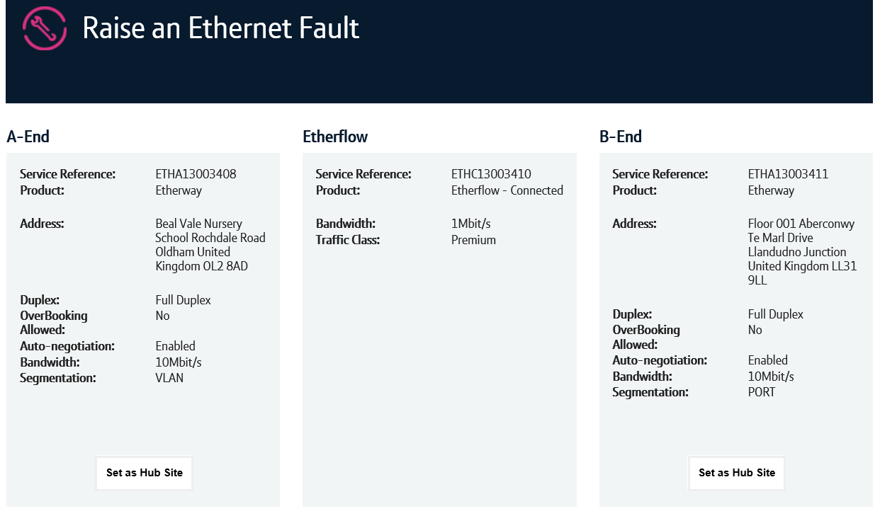
Contents
What’s in this User Guide?
p3 - Version Control
p4 – Prior to raising a fault on Business Zone
p5 – How to launch the journey
p13 – How to raise a fault

Slide 3
Version Control
Date | Change | Version
11/03/18 | User Guide Published. | 1
10/05/18 | Updated screenshots to match changes to cosmetics | 1.1

Slide 4
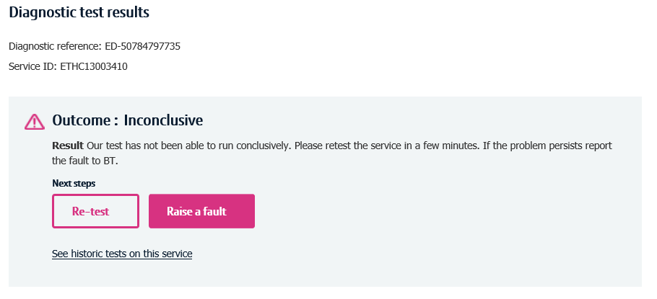
Prior to raising a fault on Business Zone
Pre-requisites
To raise a fault on Business Zone, you must first have access to Business Zone with the correct faulting role. Instructions on how to do this can be viewed on the Transformed Ethernet diagnostics and faulting page.
Before raising a fault, you must have ran a standalone diagnostic test on the circuit within the last 2 hrs.
Once a test has been ran, there’s multiple ways you can launch the fault journey.

Slide 5
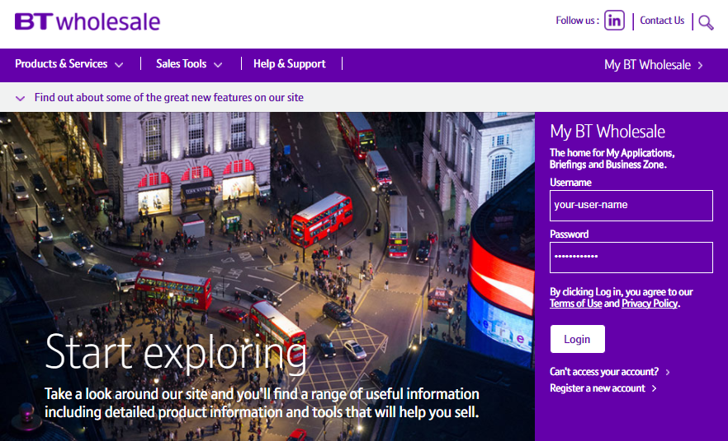
How to launch the raise a fault journey
Step 1. Login to BT Wholesale.com
To launch the raise a fault journey, go to www.btwholesale.com and login using your username and password.

Slide 6
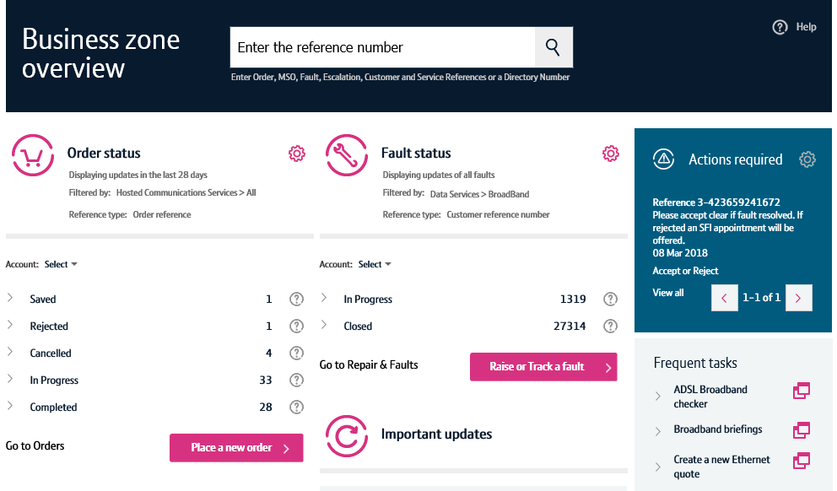
How to launch the raise a fault journey
Step 2. Search for your circuit
You’ll now see the Business Zone dashboard.
Please note, if you don’t see the Business Zone dashboard, you’ll need to contact your company administrator for access.
There are multiple ways to search for a circuit, but the easiest way is to enter the service ID (e.g. ETHC12345678) in the search field at the top of the screen.

Slide 7
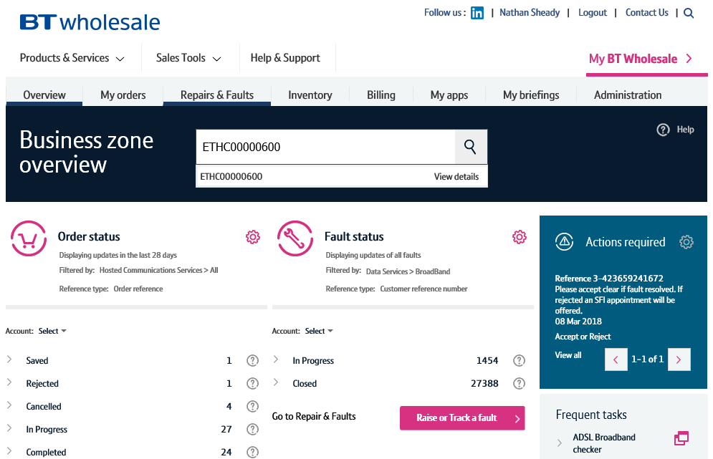
How to launch the raise a fault journey
Step 2. Search for your circuit
As you’re typing in the reference, the search will provide a list of assets matching your criteria.
Clicking the reference will show you the service quickview.
The view details option will take you to the view asset screen where you can see in-depth details of your service.
Clicking the magnifying glass will take you to the search results on Business Zone.
The fastest and easiest way to raise a fault accessing the option from the quickview. So simply click on the reference.
3
1
2

Slide 8
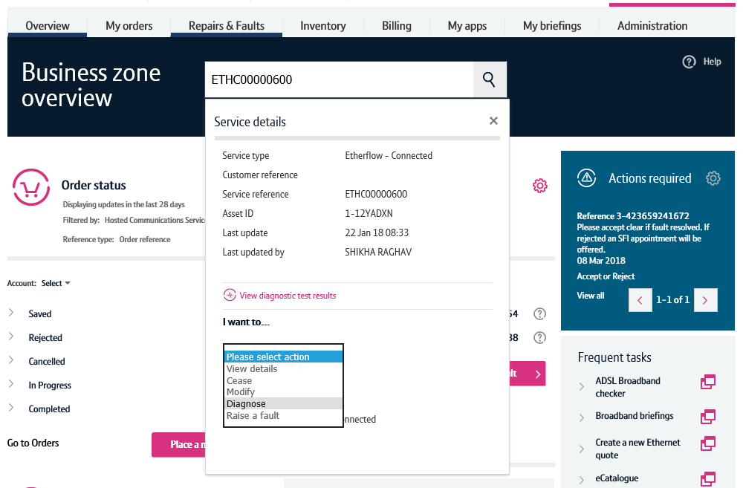
How to launch the raise a fault journey
Step 3. Raise a fault action
Once the quickview is displayed, select ‘Raise a fault’ from the dropdown.
If a diagnostics test has been ran on this circuit within the last 2 hrs, this will now launch the raise a fault journey.

Slide 9
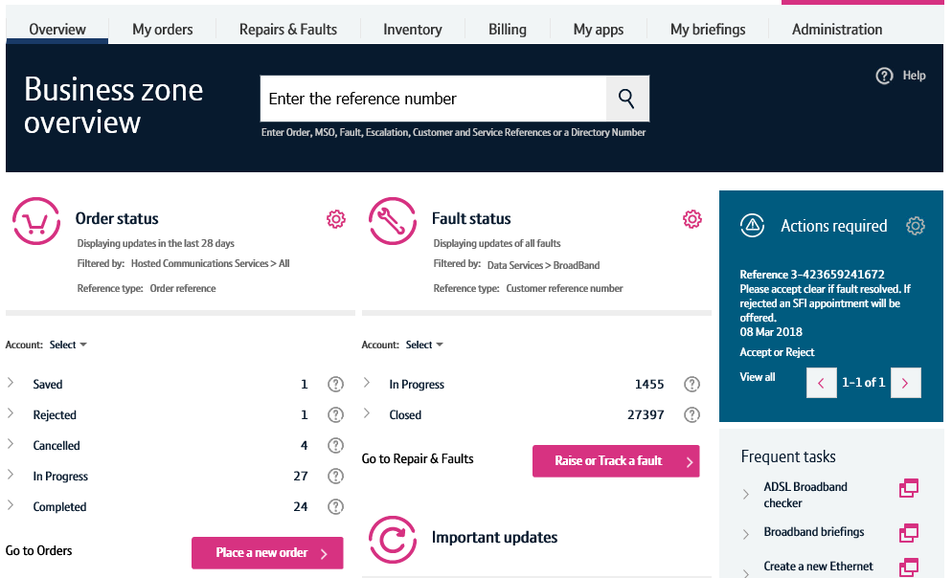
How to launch the raise a fault journey – alternative route
Step 1. Raise or Track a fault
An alternative way to launch the raise a fault journey can be carried out by clicking the ‘Raise or Track a fault’ button on the Business Zone overview page.

Slide 10
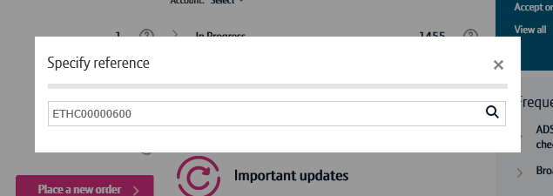
How to launch the raise a fault journey – alternative route
Step 2. Search for your service
Enter the service reference in the search field, then click the magnifying glass.

Slide 11
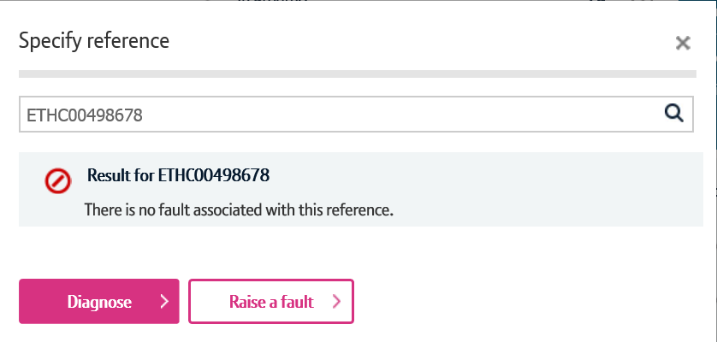
How to launch the raise a fault journey – alternative route
Step 3. Diagnose
Business Zone will now check to see if there’s any open faults on your service.
If there are, you’ll be presented with the fault reference and a shortcut to see the fault details.
We’ll also show you details of recent faults raised on your service to help you diagnose repeat faults.
If you wish to raise a fault on your service, click raise a fault.

Slide 12
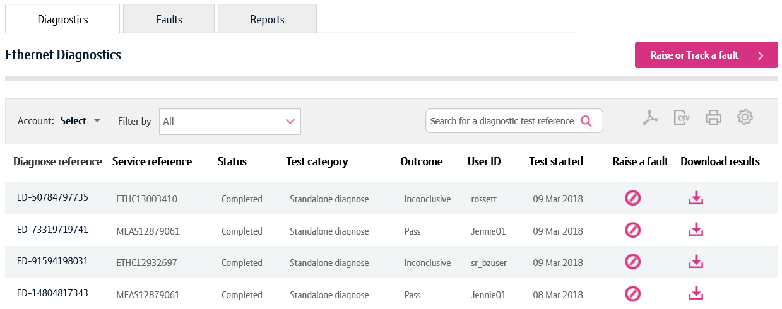
Other ways you can start the raise a fault journey
There are two other ways you can start the raise a fault journey.
You can click the raise a fault button on the diagnostic test result.
You can click the raise a fault icon on the diagnostic table
1
2

Slide 13
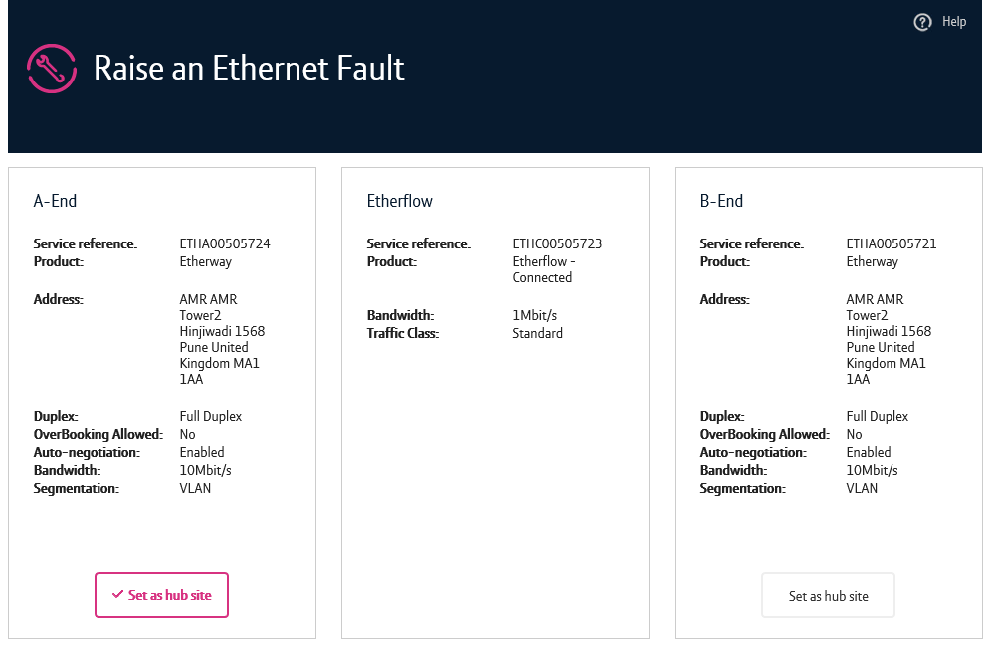
How to raise a fault
Step 1. Help us understand the problem
Once the fault journey has been launched, you’ll be able to see how your Etherways and Etherflows are setup. This will help you carry out checks with your setup and service.
There’s a option to tell us if one of the faulty Etherways is a hub site. This information will be passed to our agents so for awareness.
1

Slide 14
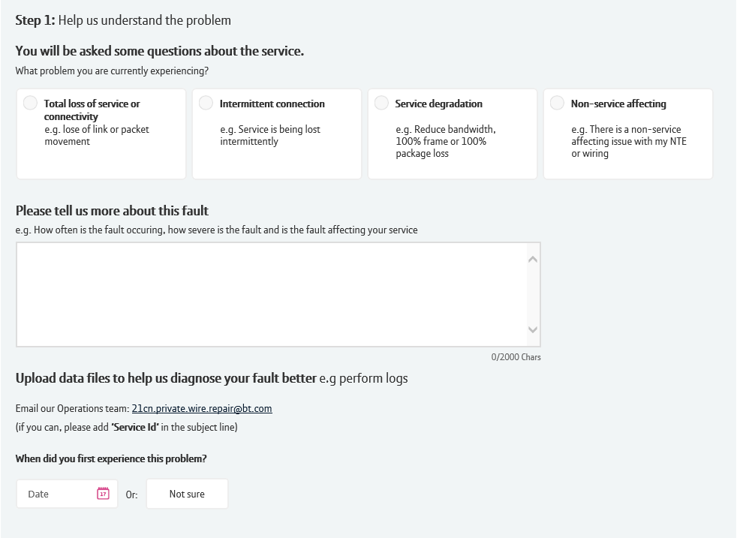
How to raise a fault
Step 1. Help us understand the problem cont.
You’ll now need to tell us details of the fault.
Select the type of fault you wish to raise with us. Examples are shown within the option.
Now, you can tell us further details of the fault. This information is really important as our agents will use this to help diagnose your fault further.
If you wish to send us supporting documentation, e.g. performance logs, instructions are shown telling you how to do so
You’ll now need to tell us when you first experienced the problem.
1
2
3
4

Slide 15
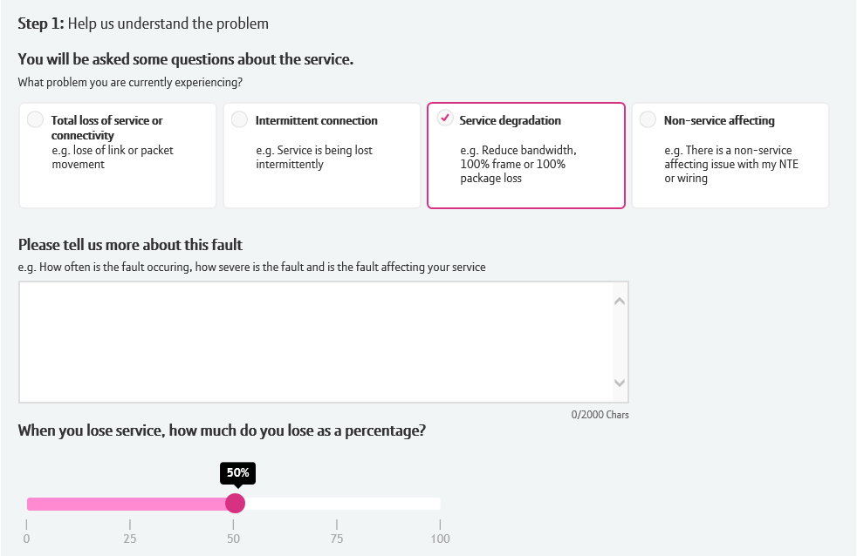
How to raise a fault – service degradation
Step 1. Help us understand the problem cont.
If you’re reporting a service degradation fault, an additional question will be asked in this section.
Use the slider to tell us how much service you lose when your service degrades.
1

Slide 16
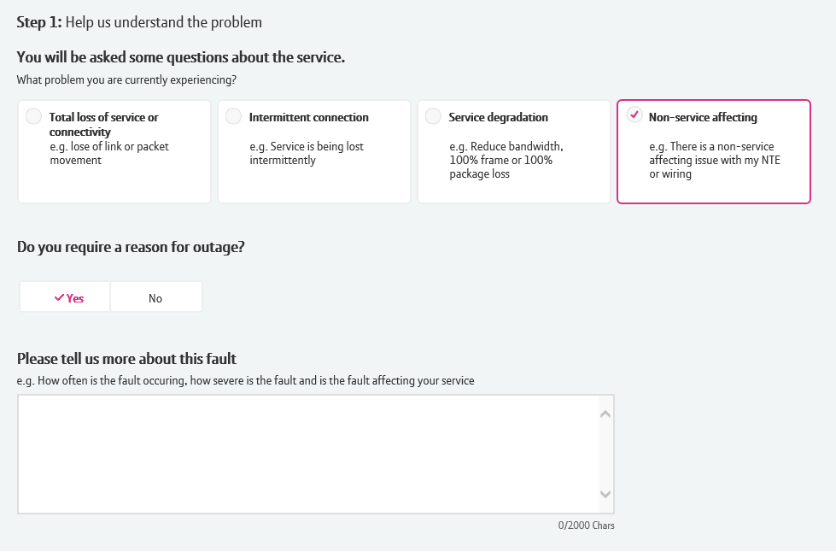
How to raise a fault – reason for outage
Step 1. Help us understand the problem cont.
If you’re requesting a reason for outage, you need to select ‘Non-service affecting’
An additional option will be displayed asking if you request a reason for outage. Select yes, enter the details you require in the freeform text field and submit your fault.
1

Slide 17
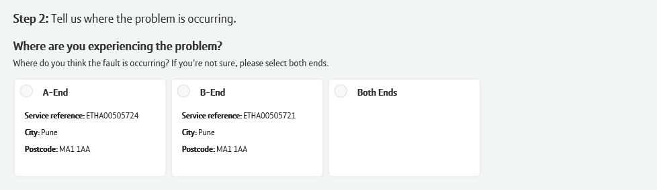
How to raise a fault
Step 2. Tell us where the problem is occurring
You now need to tell us the location of your fault.
Select the Etherway where the fault is occurring. If you aren’t sure, click both ends
Please note, following questions will be asked associated with the end you’re reporting the fault on.
1

Slide 18
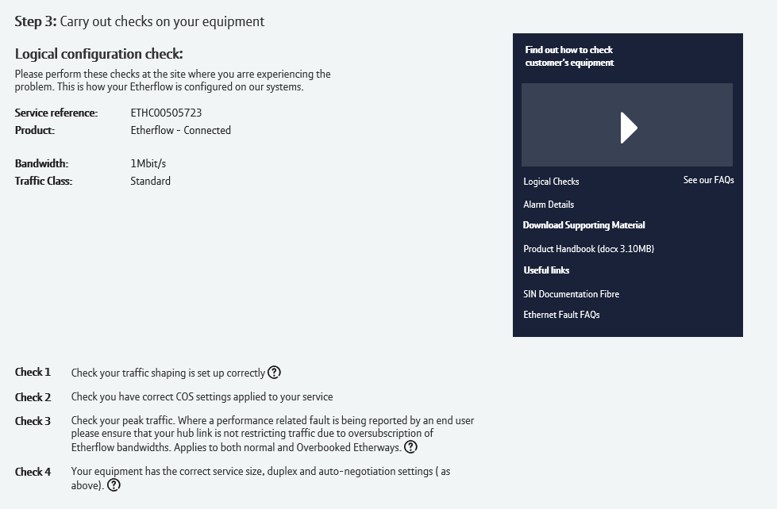
How to raise a fault
Step 3. Carry out checks on your equipment
You now need to check your equipment and setup
This section provides you a list of checks to carry out, and also features video content showing you how to carry out these checks.

Slide 19
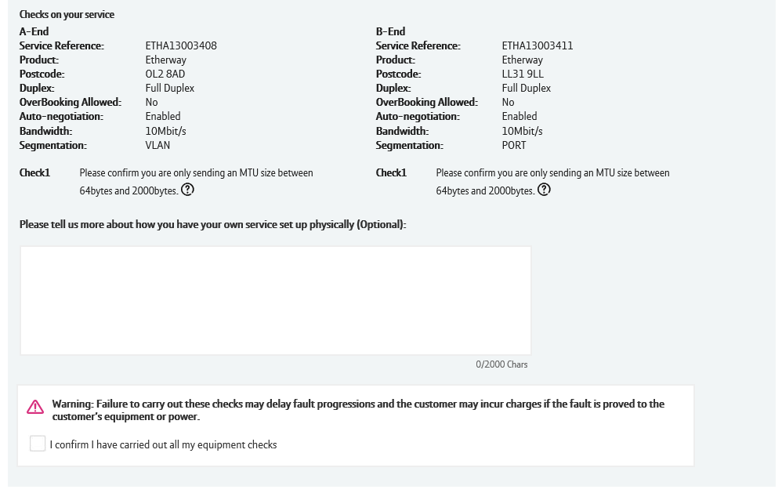
How to raise a fault
Step 3. Carry out checks on your equipment
Scrolling down, we’ll show you specific checks related to the service you’re raising the fault against.
We also provide you the option to tell us any details related to the check’s you’ve carried out or how you’ve got your service setup.
Once you’ve carried out the checks, click confirm and continue.
1
2

Slide 20
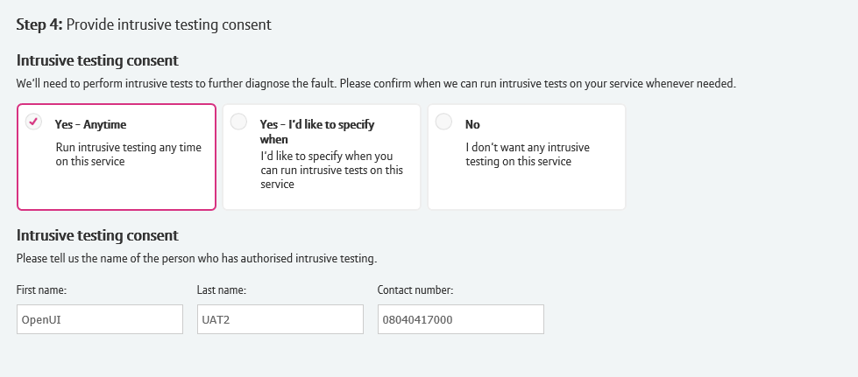
How to raise a fault
Step 4. Intrusion consent
You now need to tell us when we can run intrusive testing on your service.
Please note, if you’re reporting a total loss of service fault, this question won’t be asked.
If you click yes – anytime, you’ll be asked to provide the name and contact number for the person in your organisation who authorises this.
Selecting yes – I’d like to specify when will give you the option to select times when intrusive testing can be carried out.
Clicking No will take you to the next section.

Slide 21
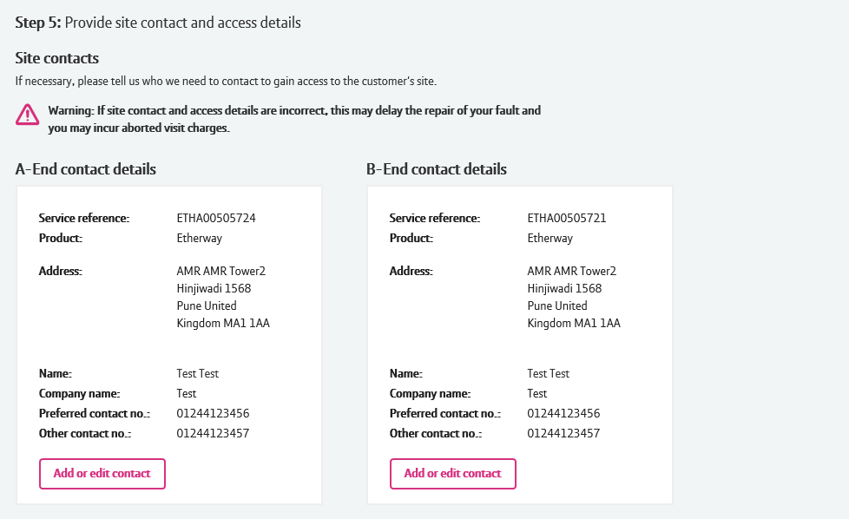
How to raise a fault
Step 5. Provide site contact and access details
You will now need to provide us the A and B end contact information.
If you’ve raised a fault with us previously for this service, the details will be auto-populated with the option to edit.
Click add or edit contact to provide these details.
1

Slide 22
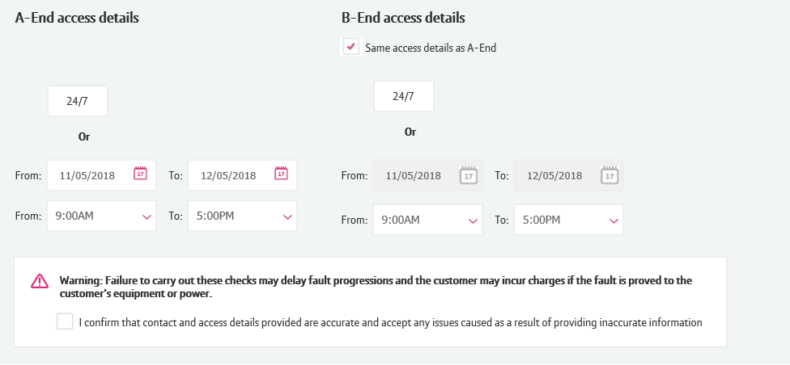
How to raise a fault
Step 5. Provide site contact and access details
Now you need to tell us when we can gain access to the site.
If we can gain access 24/7, select this option
If you want to specify a date and time, select the from and to date and times
If you’re raising a fault on both ends, and both sites have the same access details, you can select this checkbox to copy the details over.
Once you’ve added this data, click the confirmation message to continue.
3
1
2
4

Slide 23
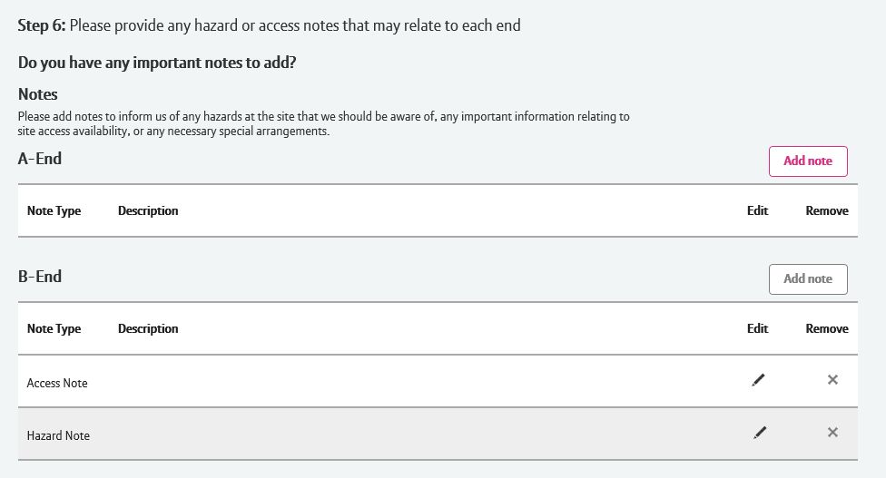
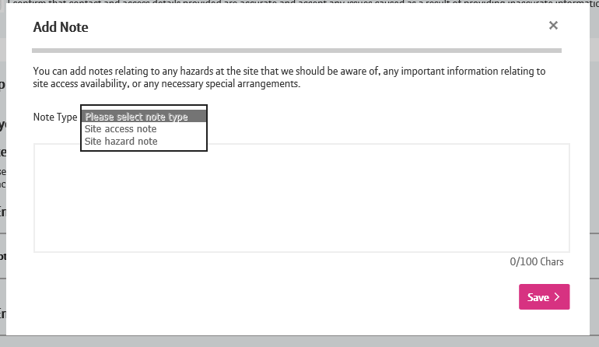
How to raise a fault
Step 6. Hazard and site access notes
You now have the option to tell us details of any hazards on site or provide instructions on how to gain access to the site.
If you’ve raised a fault on this service before, we’ll pre-populate these fields with previous notes used.
Click add note to the end which you want to add the notes for
Select the type of note you want to add
Enter the note
Click the save button
Once added, notes can be edited and deleted using the edit and remove options.
1
2
3
4

Slide 24
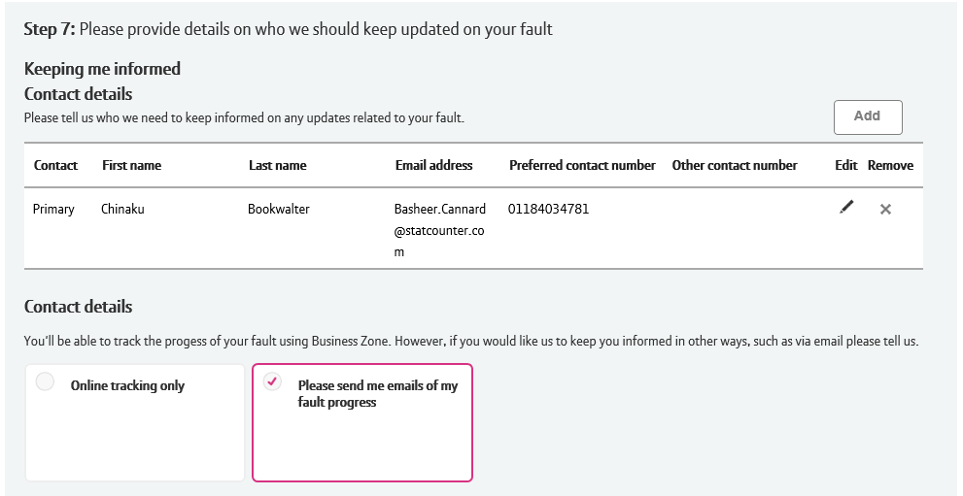
How to raise a fault
Step 7. KCI details
The final section allows you to nominate who needs to be kept informed of the progress of the fault and how you’d like them to be informed.
Click add to submit the details of the person you wish to receive updates of the fault, or edit if you wish to change pre-populated details.
Select the appropriate method in keeping them informed. Online tracking only will prevent regular update emails being sent to the nominated KCI.
Please note: Telephone numbers are not currently validated, so please make sure you enter the details correctly.
1
2
4

Slide 25
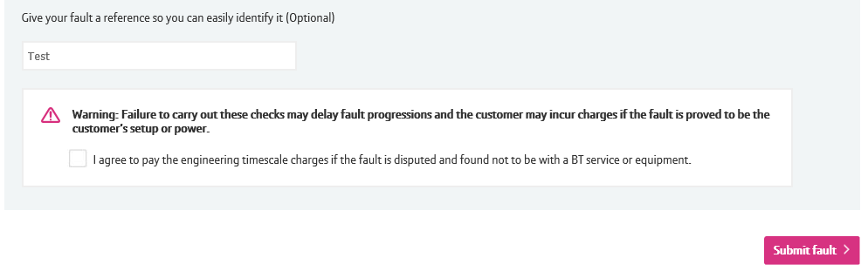
How to raise a fault
Step 8. Submit your fault
You now have the option to give your fault a reference that you can search for on Business Zone. Leaving this blank will default to the BT Fault number.
Before submitting the fault, you will need to agree to our terms and conditions.
Once you’ve entered all the relevant information and agreed to the terms and conditions, click the submit fault button to submit the fault.
1
2
3

Slide 26
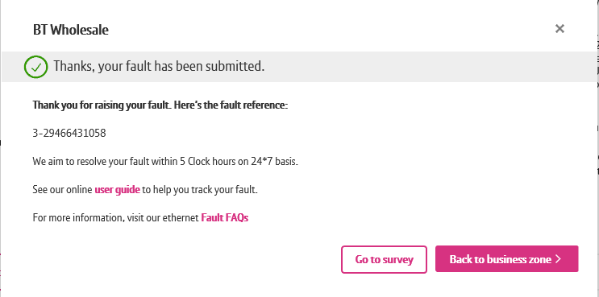
How to raise a fault
Step 8. Submit your fault
You’ll now see confirmation that your fault has been submitted.
You also have an option to provide feedback of how easy or difficult you found the fault journey by clicking ‘Go to survey’.
Once finished, click ‘Back to business zone’.
1
2

