Slide 1

How to apply and remove a loop back
BT Wholesale Online
V1
LEGAL NOTICE: The information contained in this briefing is confidential information as per your terms and conditions with BT. Please do not forward, republish or permit unauthorised access. The content is accurate at the time of writing and is subject to change.

Slide 2
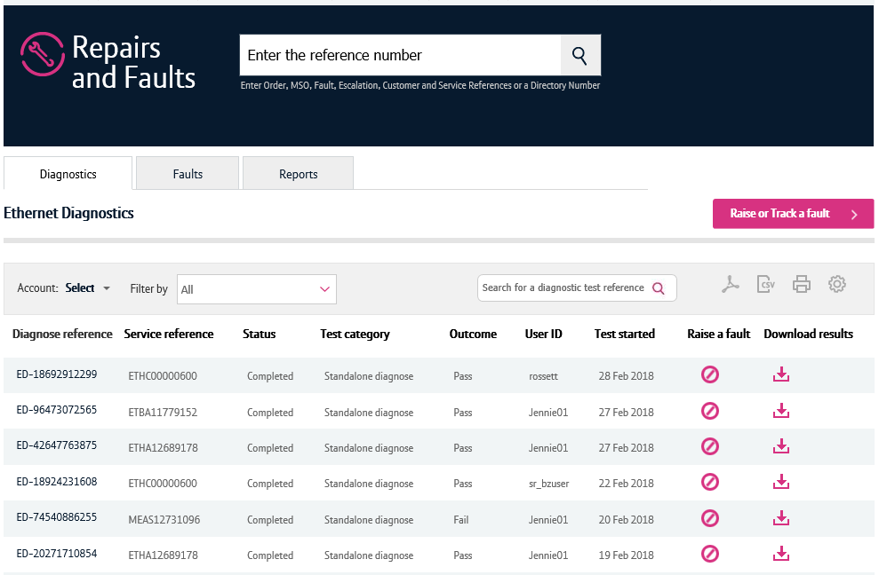
Contents
What’s in this User Guide?
p3 - Version Control
p4 - Introduction
p5 – How to launch the journey
p12 Applying and removing a loopback
p20 Removing a loopback

Slide 3
Version Control
Date | Change | Version
15/03/18 | User Guide Published. | 1
10/05/18 | Added Loopback scenarios for open fault | 1.1

Slide 4
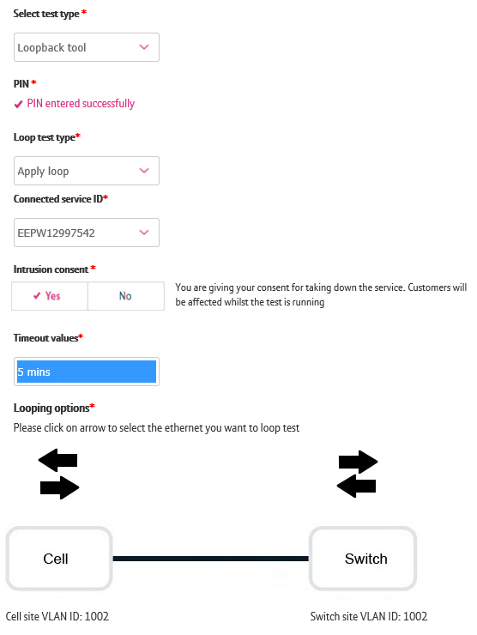
Introduction
Loopback
You can apply and remove a loopback to help you diagnose and fault your service from the new Business Zone journey. This can only be done for Ethernet cirscuits with EAD, Wholesale Mobile Connect circuits and only if there’s no open faults on your service.
This is an intrusive action that allows you to apply a loop at a port or on a VLAN to send and receive traffic towards or from the BT network. This will help you identify if the root cause of the fault exists on the BT Network or with your equipment / setup.
Please note, by applying a loopback you will disconnect the service for your end Customer. As such, ONLY users with a PIN can apply loopbacks.
Once you apply the loop you need to also remove it to resume your end Customers service. This can also be done via the new diagnostics journey.

Slide 5
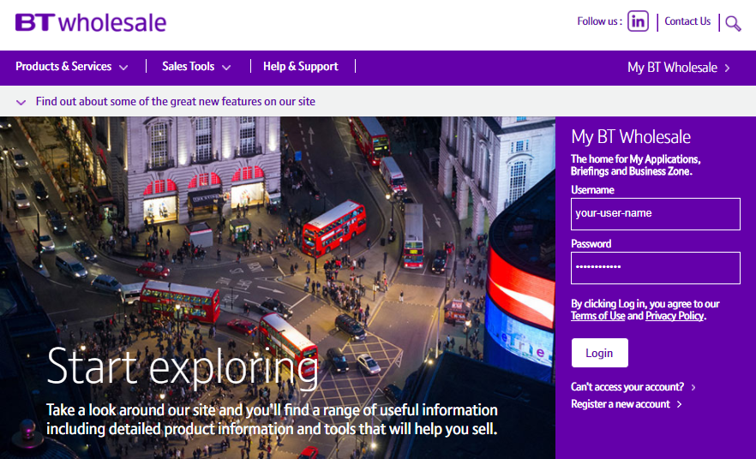
How to launch the diagnostics journey
Step 1. Login to BT Wholesale.com
To launch the diagnostics journey, go to www.btwholesale.com and login using your username and password.

Slide 6
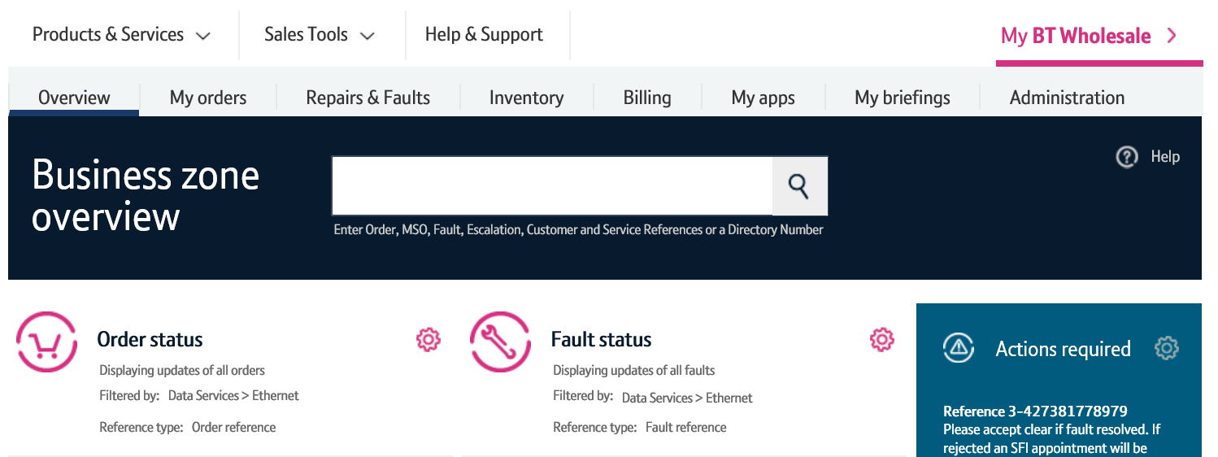
How to launch the diagnostics journey
Step 2. Search for your circuit
You’ll now see the Business Zone dashboard.
Please note, if you don’t see the Business Zone dashboard, you’ll need to contact your company administrator for access.
There are multiple ways to search for a circuit, but the easiest way is to enter the service ID (e.g. ETHC12345678) in the search field at the top of the screen.

Slide 7
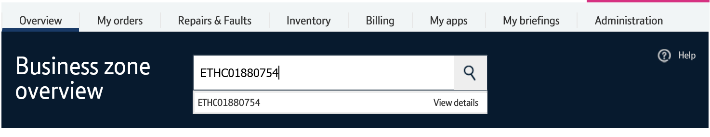
How to launch the diagnostics journey
Step 2. Search for your circuit
As you’re typing in the reference, the search will provide a list of assets matching your criteria.
Clicking the reference will show you the service quickview.
The view details option will take you to the view asset screen where you can see in-depth details of your service.
Clicking the magnifying glass will take you to the search results on Business Zone.
The fastest and easiest way to begin diagnosing a fault accessing the option from the quickview. So simply click on the reference.
3
1
2

Slide 8
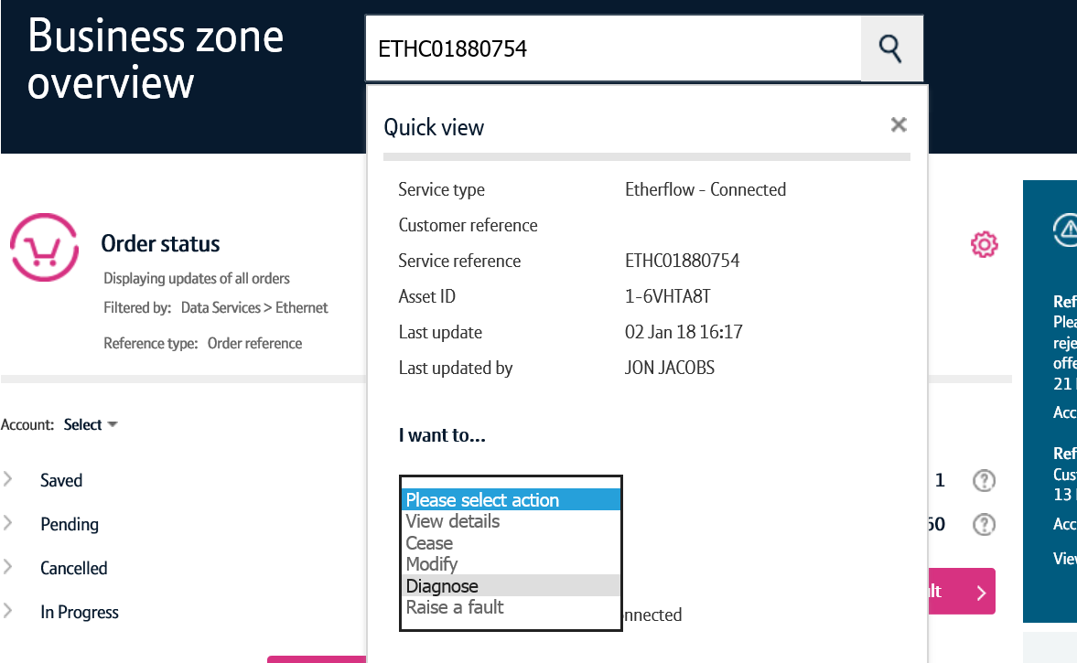
How to launch the diagnostics journey
Step 3. Diagnose action
Once the quickview is displayed, select ‘Diagnose’ from the dropdown.
This will now launch the diagnostics journey for this service.

Slide 9
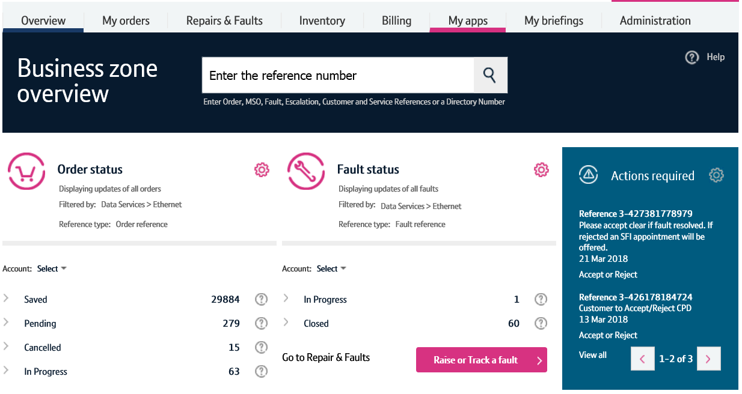
How to launch the diagnostics journey – alternative route
Step 1. Raise or Track a fault
An alternative way to launch the diagnostics journey can be carried out by clicking the ‘Raise or Track a fault’ button on the Business Zone overview page.

Slide 10
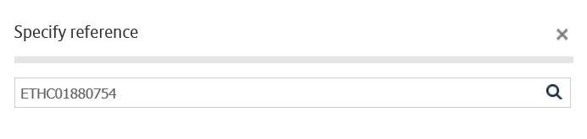
How to launch the diagnostics journey – alternative route
Step 2. Search for your service
Enter the service reference in the search field, then click the magnifying glass.

Slide 11
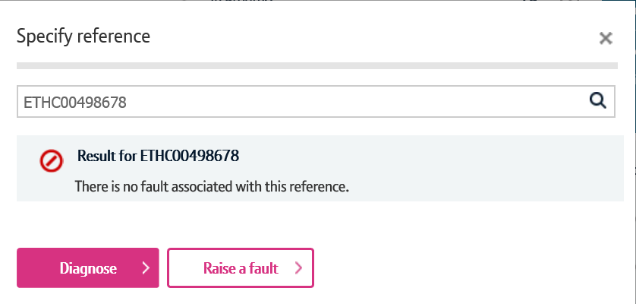
How to launch the diagnostics journey – alternative route
Step 3. Diagnose
Business Zone will now check to see if there’s any open faults on your service.
If there are, you’ll be presented with the fault reference and a shortcut to see the fault details.
We’ll also show you details of recent faults raised on your service to help you diagnose repeat faults.
If you wish to diagnose your service further, click the diagnose button.

Slide 12
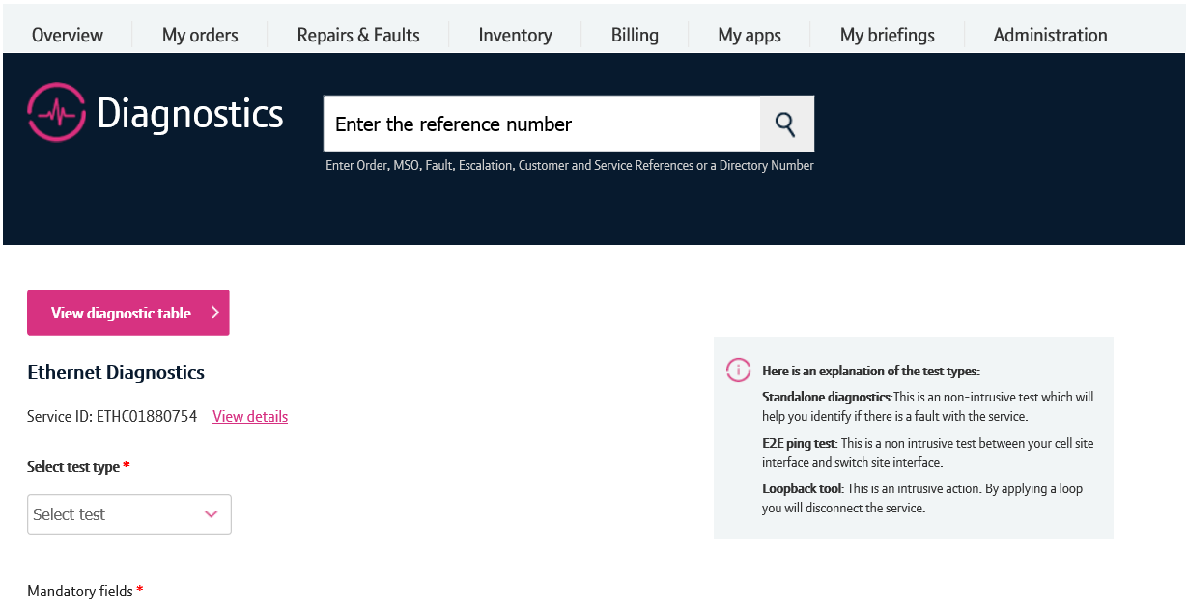
Applying a loopback
There’s a number of features on the diagnostics screen.
The view diagnostic table button will take you to the page where all your diagnostic tests are displayed.
The view details option will show you details for the circuit such as the from and to address.
To apply a loopback, first select loopback from the dropdown.
Note, if you don’t have the loopback option, contact your company administrator to request access.
1
2
3

Slide 13
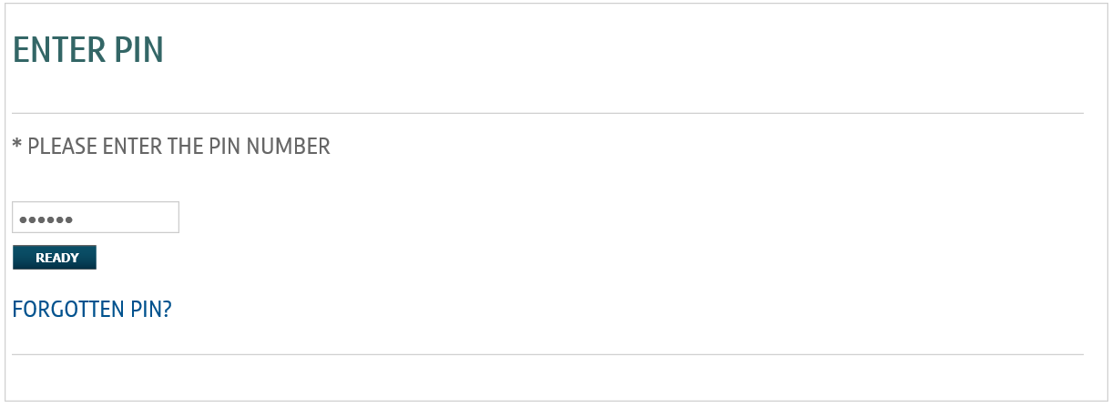
Applying a loopback
As the loopback feature is intrusive, you’ll need to enter your PIN number at this stage.
Enter your PIN and click ready.
If you don’t have a PIN, please contact your company administrator.

Slide 14
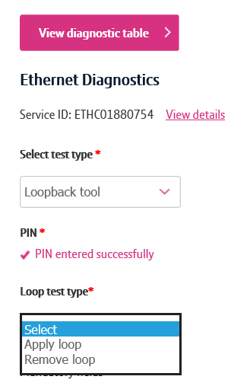
Applying a loopback
Once you’ve entered your PIN, you’ll be returned to the diagnostics screen.
From here, select apply loop from the loop test type dropdown.
A check will now be ran to see if there are any open faults. If there are, you will be told and you won’t be allowed to apply the loopback.

Slide 15
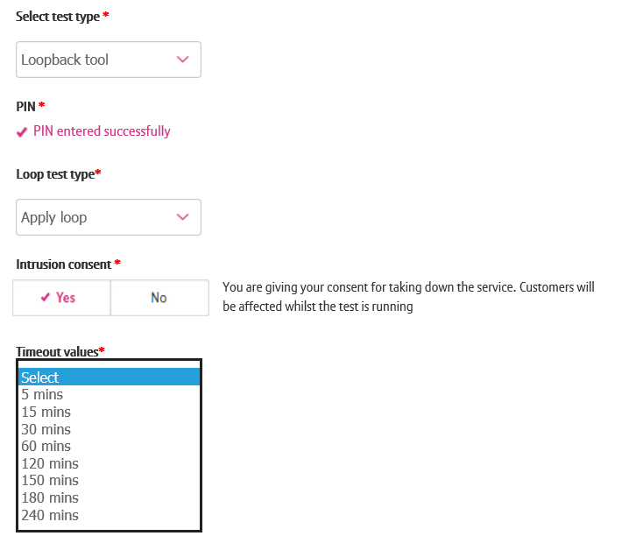
Applying a loopback
You now need to provide intrusion consent and set the timeout parameters.
Make sure you inform your customer and receive intrusion consent first. If you have consent, click yes.
Select the timeout value from the dropdown. This will be the amount of time the loop will be applied before it’s automatically removed.
1
2

Slide 16
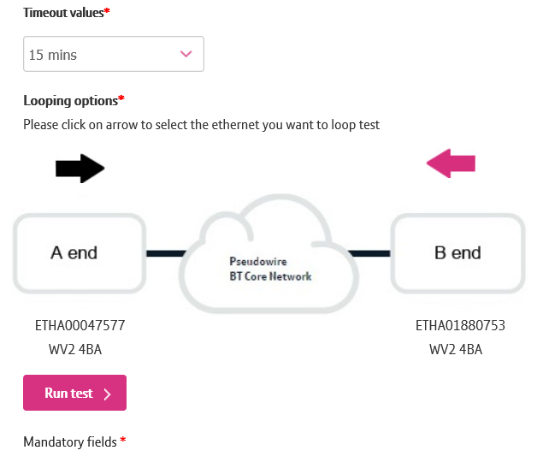
Applying a loopback
Click the arrow to indicate which direction you want the loop applied. The arrow will turn pink when selected.
Click run test.
1
2

Slide 17
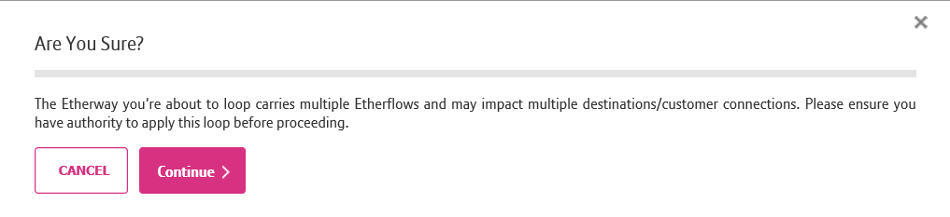
Applying a loopback
A final warning message will be displayed telling you that the loopback will affect your end user’s service.
If you have permission, click continue.

Slide 18
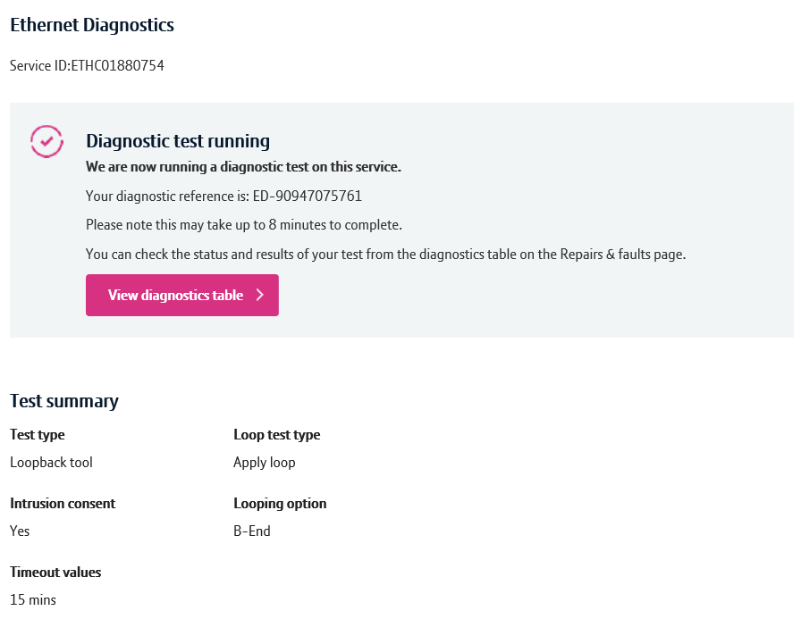
Applying a loopback
You’ll now be taken to a screen confirming that the test is running.
Click on the view diagnostics table to see the test status.

Slide 19
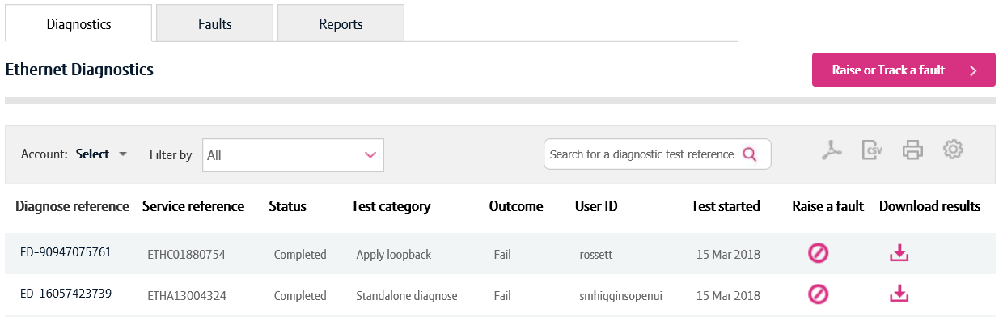
Applying a loopback
Within the diagnostics table, you can see that the loopback was applied successfully.

Slide 20
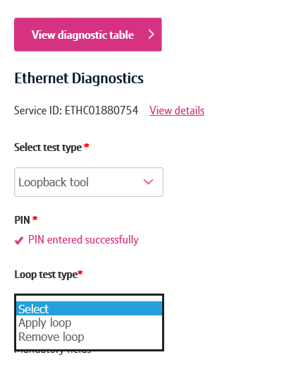
Removing a loopback
To remove a loopback, follow the steps in the previous example, but select remove loop in loop test type dropdown.

Slide 21
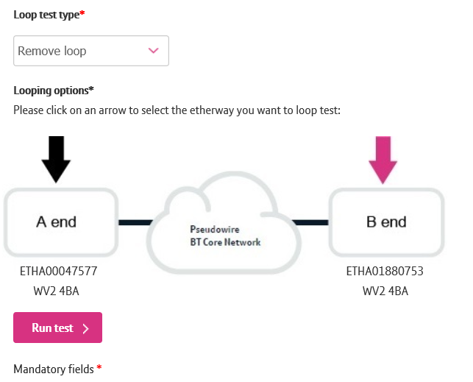
Removing a loopback
Select the arrow on the end where you’d like to remove the loop. The arrow will turn pink when selected.
Click run test.
1
2

Slide 22
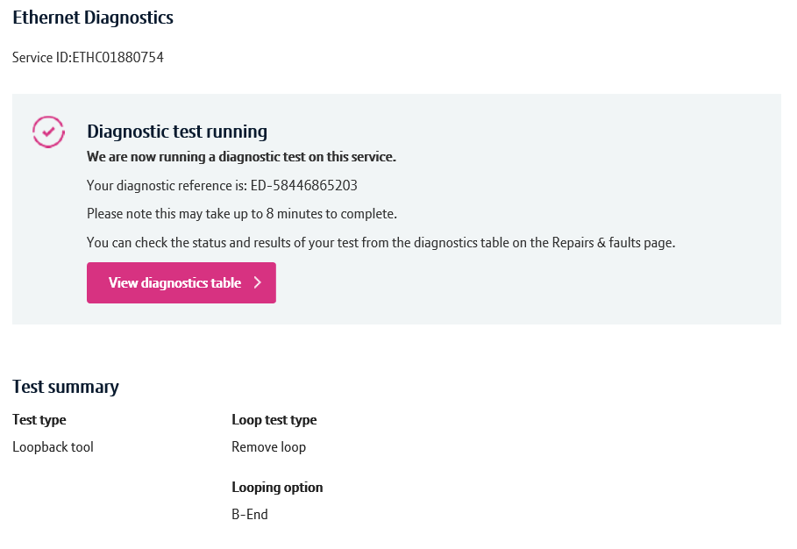
Removing a loopback
You’ll now be taken to a screen confirming that the test is running.
Click on the view diagnostics table to see the test status.

Slide 23
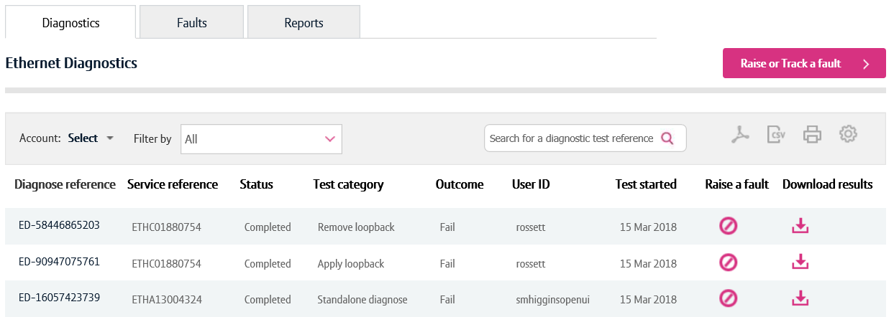


Removing a loopback
Within the diagnostics table, you can see that the loopback was removed successfully.

