Slide 1

An Introduction to the Business Zone Ethernet Diagnostic and Fault Journeys
BT Wholesale Online
V1
LEGAL NOTICE: The information contained in this briefing is confidential information as per your terms and conditions with BT. Please do not forward, republish or permit unauthorised access. The content is accurate at the time of writing and is subject to change.

Slide 2
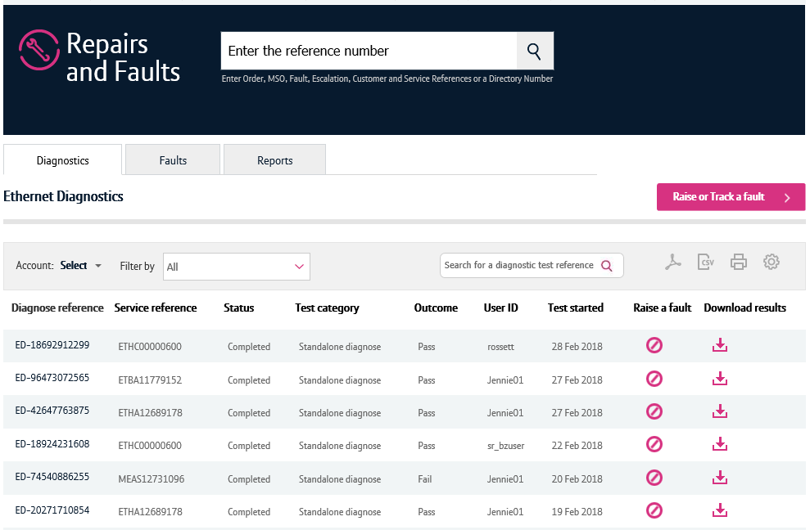
Contents
What’s in this User Guide?
p3 - Version Control
p4 - Introduction
p5 – What are the benefits?
p6 – Available journeys
p7 - Pre-requisites
p8 – Known issues

Slide 3
Version Control
Date | Change | Version
11/03/18 | User Guide Published. | 1

Slide 4
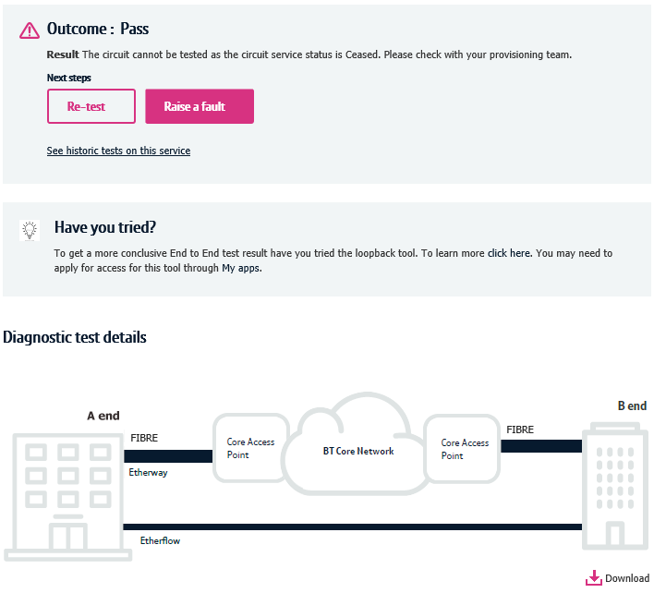
Introduction
What is the Business Zone Ethernet Diagnostic and Fault Journey?
We’re replacing Eco Plus with a new improved online diagnostic and fault journey for Ethernet.
Accessed via Business Zone, the new journey will allow you to diagnose and raise Ethernet faults faster and easier.
The new journeys are compatible with modern browsers, is more logical and removes many of the irritants experienced on Eco Plus.
We’ll be introducing further changes to the Ethernet fault journeys, giving you a great online experience.

Slide 5
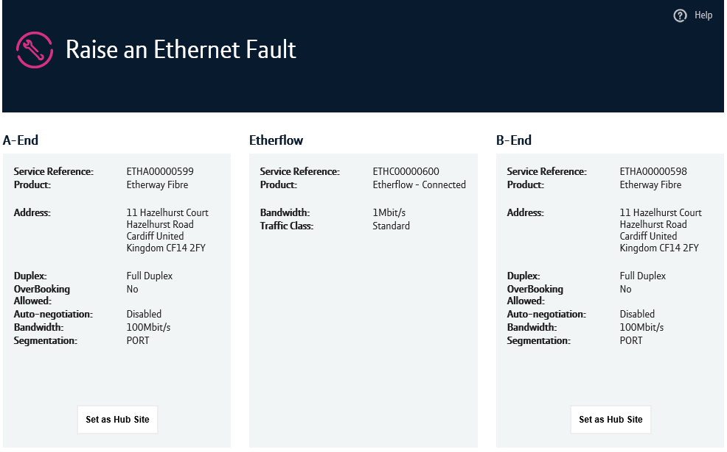
Introduction - continued
What are the benefits?
Diagnosing and raising Ethernet faults online is much easier
It provides a more intuitive experience
Diagnostic results can be downloaded, and provide details of the location of the fault
You can access historic diagnostic results that are up to two weeks old via a new dashboard
Information on how your service is configured is provided up-front helping you carry out your checks
Common options are pre-populated
There’s fewer questions and pages to navigate, providing a real simple faulting experience
All of the above contributes to you being able to diagnose and raise faults faster than doing so via Eco Plus

Slide 6
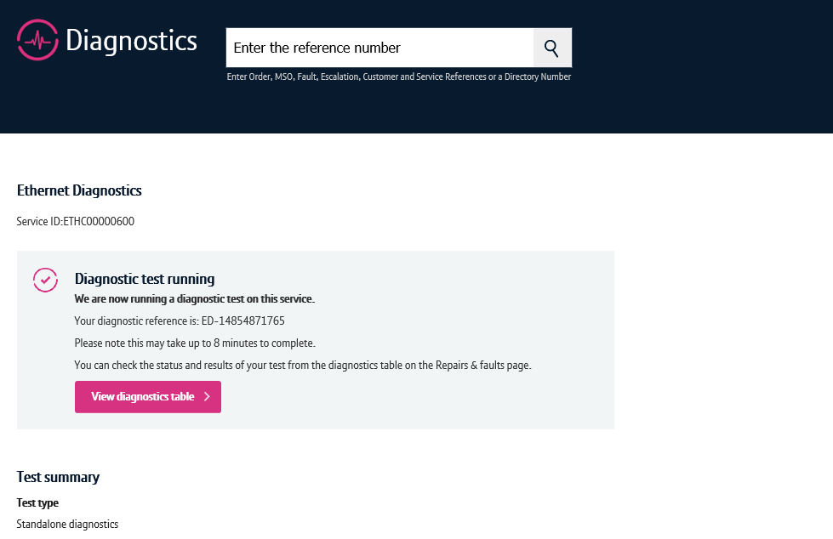
Available Journeys
We’re creating new fault journeys for Ethernet throughout 2018-2019.
Please visit our Transformed Ethernet Diagnostic and Faulting page to learn more about the available journeys and functionality.

Slide 7
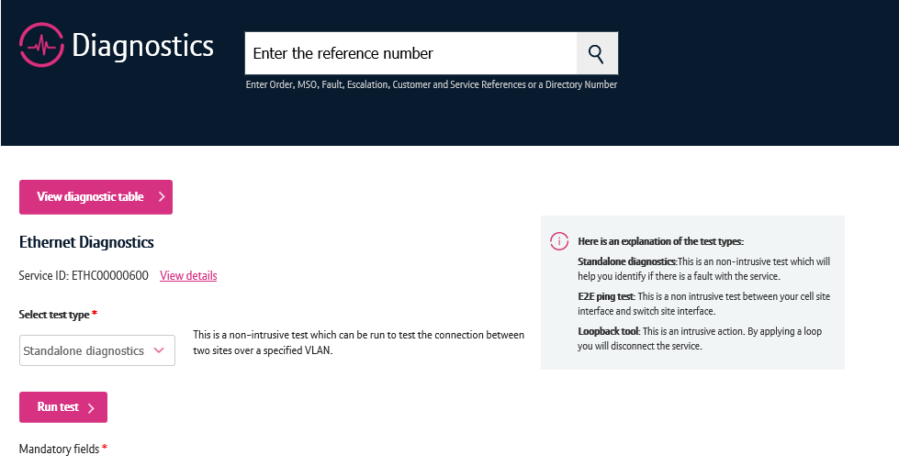
Pre-Requisites
What do you need to diagnose and raise an Ethernet fault via the new journey?
You need correct access and privileges, including My BT Wholesale (Business zone). If you don’t have this, please contact your company administrator to action.
You must be using a Windows machine and using the latest version of Internet Explorer, Chrome or Firefox.
Mobile devices, Mac and Safari are not supported.

Slide 8
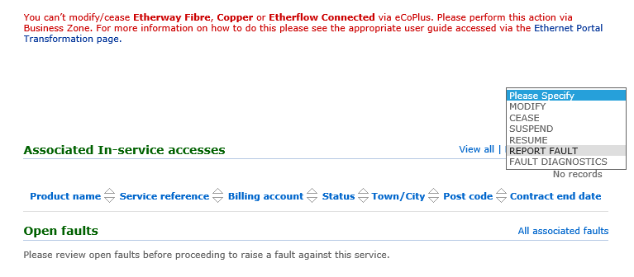
What are the known issues?
Switching Between Eco Plus and the new diagnostic and fault journeys
Until all the journeys become available on Business Zone, you will need to carry out functions, such as cancelling and amending faults, on Eco Plus.
A timeline of what journeys will become available for which products can be viewed on our Transformed Ethernet Diagnostic and Faulting page.

