Slide 1

Ethernet diagnostic journey explained
BT Wholesale Online
V1
LEGAL NOTICE: The information contained in this briefing is confidential information as per your terms and conditions with BT. Please do not forward, republish or permit unauthorised access. The content is accurate at the time of writing and is subject to change.

Slide 2
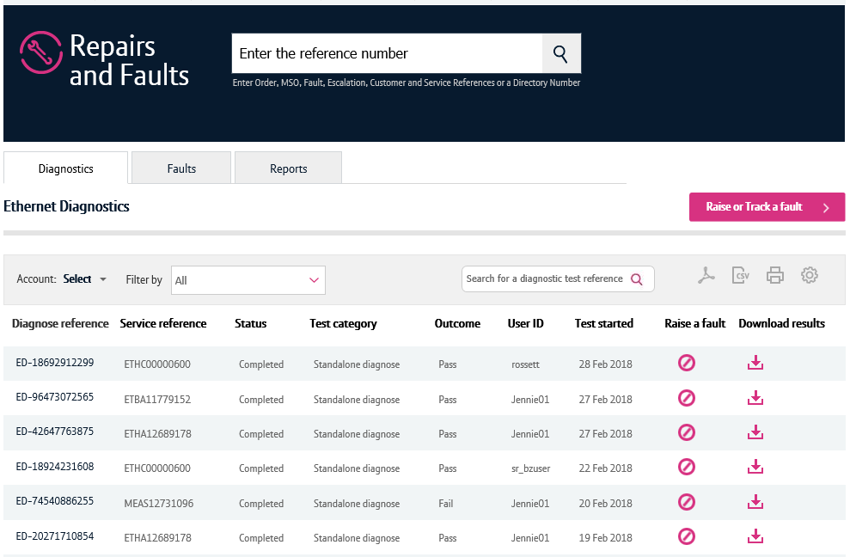
Contents
What’s in this User Guide?
p3 - Version Control
p4 - Introduction
p5 – What diagnostics tests are available?
p9 – How to launch the journey
p16 Viewing your diagnostic tests

Slide 3
Version Control
Date | Change | Version
11/03/18 | User Guide Published. | 1
10/05/18 | Updated screenshots to match changes to cosmetics | 1.1

Slide 4
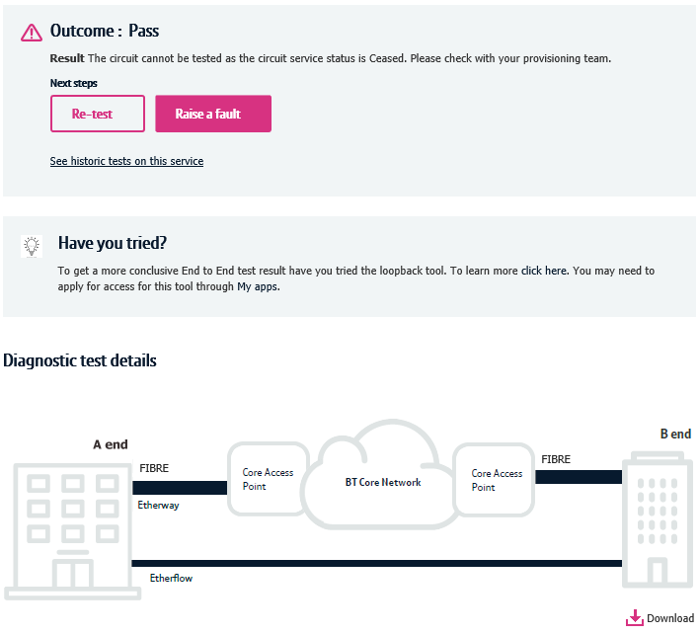
Introduction
What is the Business Zone Ethernet Diagnostic Journey?
We’re replacing Eco Plus with a new improved online diagnostic journey for Ethernet.
Accessed via Business Zone, the new journey will allow you to diagnose and raise Ethernet faults faster and easier.
In addition to this, we’re improving the Repair and Faults section on Business Zone to show you all the diagnostic tests ran within the last two weeks with an option to download the results as a PDF.

Slide 5
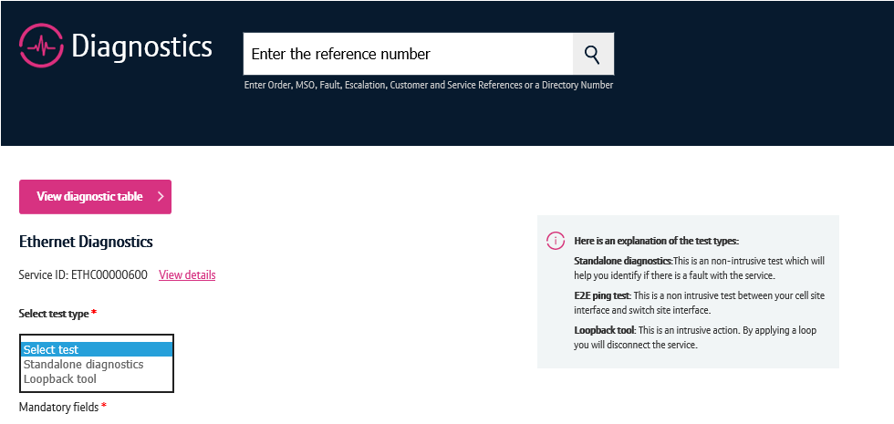
What diagnostic tests are available?
What diagnostic tests are available?
The new diagnostic tests are available for Ethernet and Mobile Ethernet circuits.
Tests available for Ethernet and Mobile Ethernet:
Standalone diagnostics
Applying and removing loop back
Tests available for Mobile Ethernet only:
E2E ping test

Slide 6
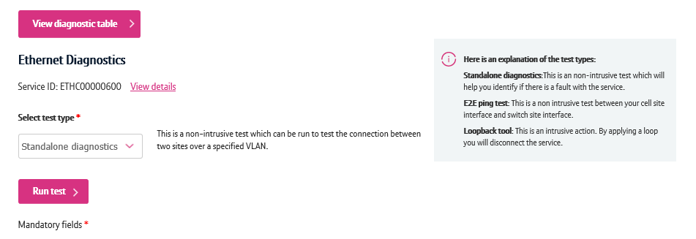
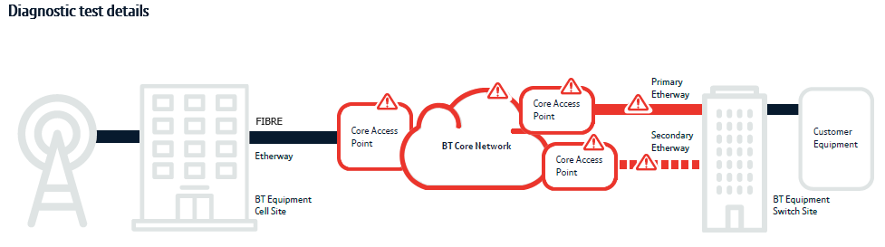
What diagnostic tests are available?
Standalone diagnostics
For Ethernet and Mobile Ethernet, you can perform a standalone diagnostic test. This runs a series of non-intrusive tests on your service and provides you a result highlighting if a fault has been found.
If a fault was found, the results will also tell you the location of the fault.
This test can identify if your service is affected by issues concerning power, performance, BT Wholesale’s core network or the physical access from your premises to the Ethernet node.

Slide 7
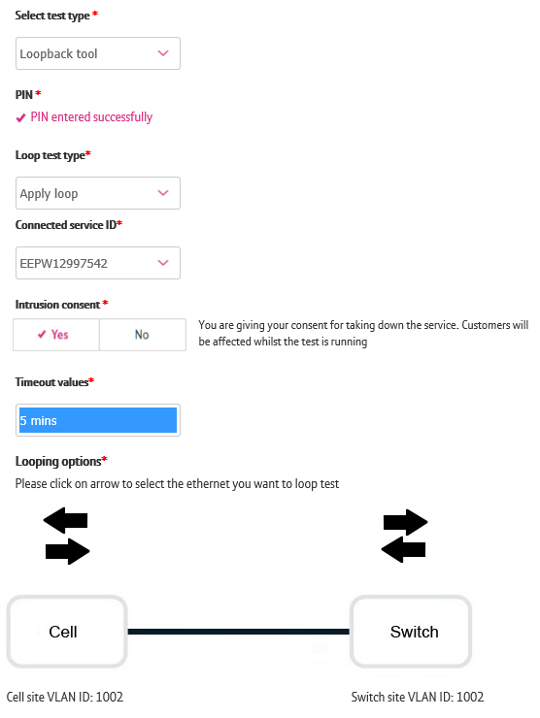
What diagnostic tests are available?
Loopback
You can apply and remove a loopback to help you diagnose and fault your service from the new Business Zone journey.
This is an intrusive action that allows you to apply a loop at a port or on a VLAN to send and receive traffic towards or from the BT network. This will help you identify if the root cause of the fault exists on the BT Network or with your equipment / setup.
Please note, by applying a loopback you will disconnect the service for your end Customer. As such, ONLY users with a PIN can apply loopbacks.
Once you apply the loop you need to also remove it to resume your end Customers service. This can also be done via the new diagnostics journey.

Slide 8
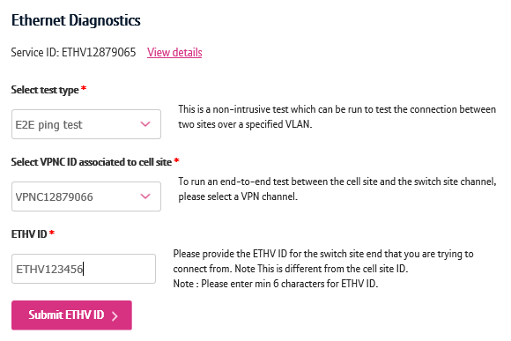
What diagnostic tests are available?
End to End Ping Test
You can carry out the End to End Ping Test for Mobile Ethernet (MEAS) circuits using the new diagnostics tool.
This test can be ran to check the connectivity between the Cell and Switch sites
To run this test, you’ll need the Etherflow VPN and ETHV ids of the service you wish to diagnose.

Slide 9
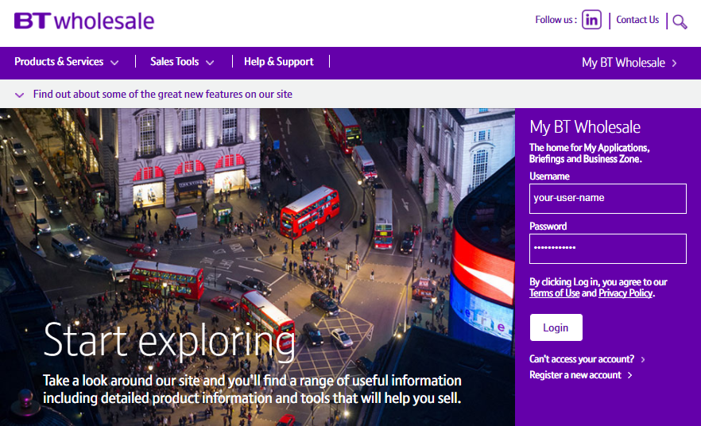
How to launch the diagnostics journey
Step 1. Login to BT Wholesale.com
To launch the diagnostics journey, go to www.btwholesale.com and login using your username and password.

Slide 10
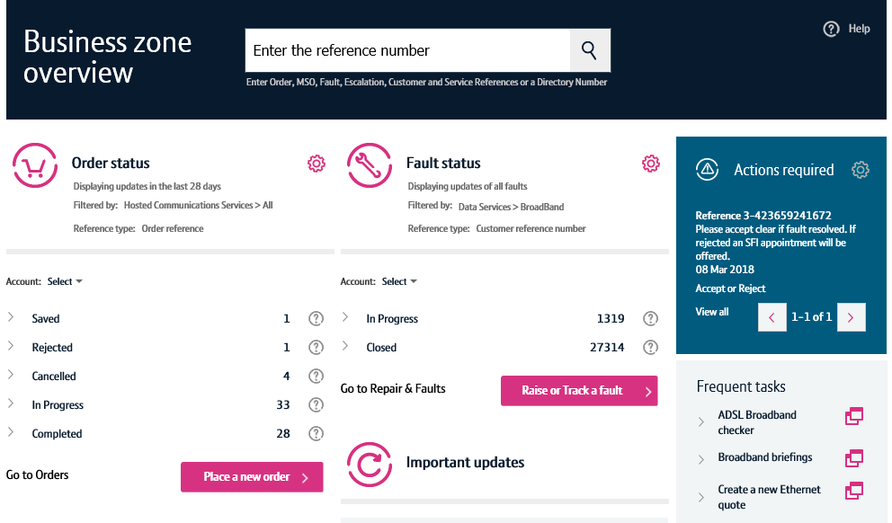
How to launch the diagnostics journey
Step 2. Search for your circuit
You’ll now see the Business Zone dashboard.
Please note, if you don’t see the Business Zone dashboard, you’ll need to contact your company administrator for access.
There are multiple ways to search for a circuit, but the easiest way is to enter the service ID (e.g. ETHC12345678) in the search field at the top of the screen.

Slide 11
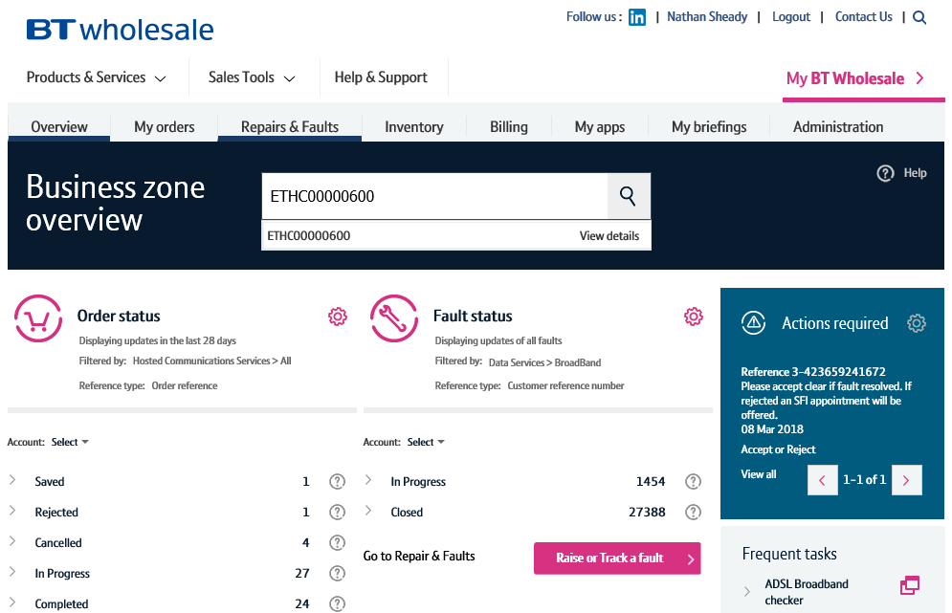
How to launch the diagnostics journey
Step 2. Search for your circuit
As you’re typing in the reference, the search will provide a list of assets matching your criteria.
Clicking the reference will show you the service quickview.
The view details option will take you to the view asset screen where you can see in-depth details of your service.
Clicking the magnifying glass will take you to the search results on Business Zone.
The fastest and easiest way to begin diagnosing a fault accessing the option from the quickview. So simply click on the reference.
3
1
2

Slide 12
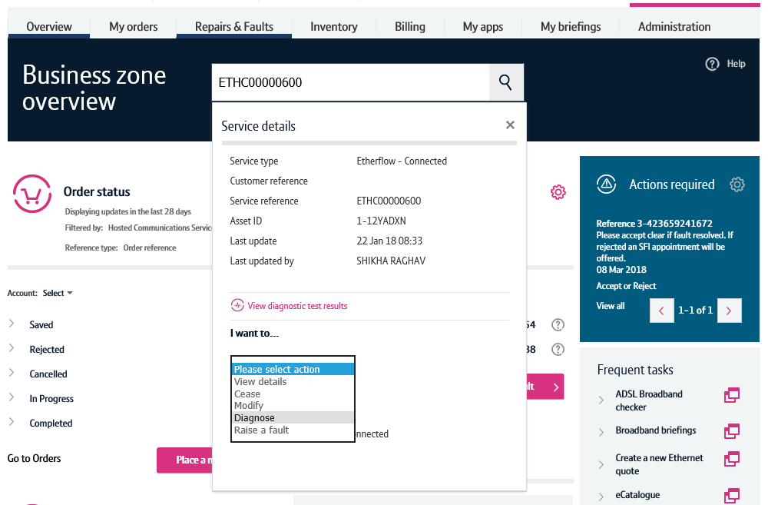
How to launch the diagnostics journey
Step 3. Diagnose action
Once the quickview is displayed, select ‘Diagnose’ from the dropdown.
This will now launch the diagnostics journey for this service.

Slide 13
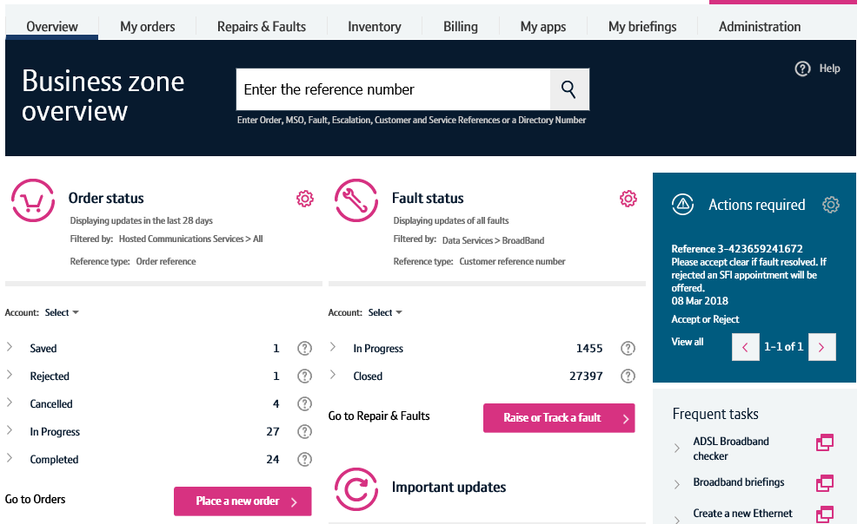
How to launch the diagnostics journey – alternative route
Step 1. Raise or Track a fault
An alternative way to launch the diagnostics journey can be carried out by clicking the ‘Raise or Track a fault’ button on the Business Zone overview page.

Slide 14
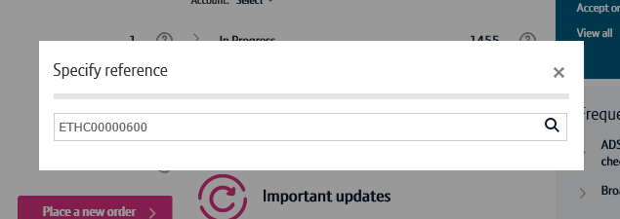
How to launch the diagnostics journey – alternative route
Step 2. Search for your service
Enter the service reference in the search field, then click the magnifying glass.

Slide 15
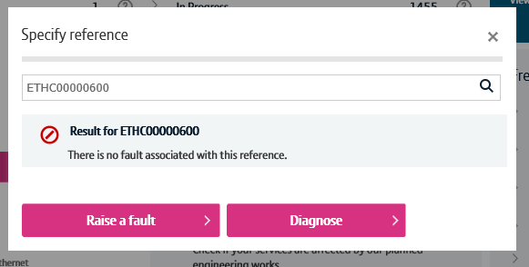
How to launch the diagnostics journey – alternative route
Step 3. Diagnose
Business Zone will now check to see if there’s any open faults on your service.
If there are, you’ll be presented with the fault reference and a shortcut to see the fault details.
We’ll also show you details of recent faults raised on your service to help you diagnose repeat faults.
If you wish to diagnose your service further, click the diagnose button.

Slide 16
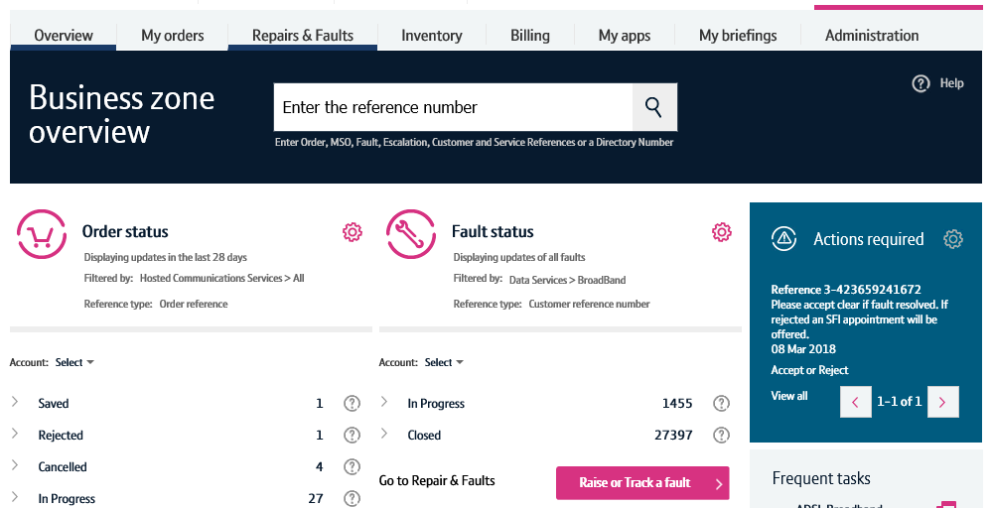
Viewing your diagnostic tests
The diagnostics dashboard
You can access previous and in-progress diagnostic tests via the diagnostics dashboard on Business Zone.
To access this, click ‘Repairs & Faults’ on Business Zone.

Slide 17
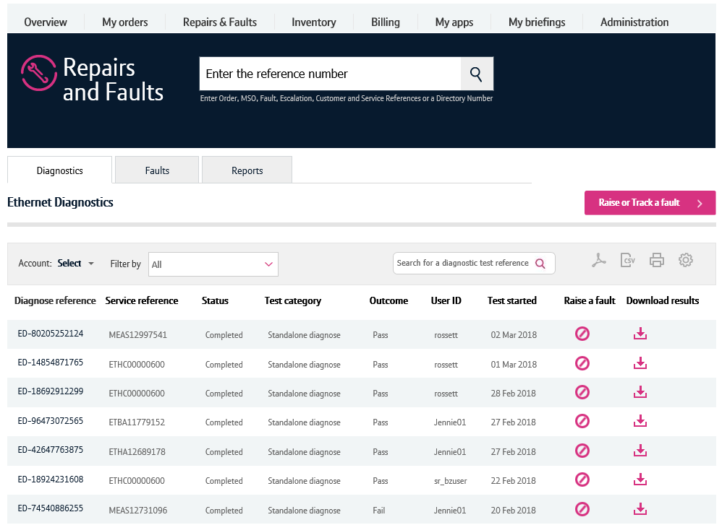
Viewing your diagnostic tests
The diagnostics dashboard
On the Repairs & Faults page, the diagnostics results can be accessed from the diagnostics tab
Here you can filter your results by account, status, product and dates when tests were ran. You can also use the search in this section to search for a specific test result.
The results are shown in the table below. Here you can see:
The diagnose reference
The service reference that the test was ran
The status of the test
What type of test was ran
The test outcome
The user ID of the person who ran the test
When the test was ran
You also have the option to raise a fault
And you can download the results as a PDF.
Please note, you can only see tests ran within the last two weeks on the diagnostics dashboard.
1
2
3

