Slide 1

Wholesale Mobile Connect
How to run an end to end ping test
BT Wholesale Online
V1
LEGAL NOTICE: The information contained in this briefing is confidential information as per your terms and conditions with BT. Please do not forward, republish or permit unauthorised access. The content is accurate at the time of writing and is subject to change.

Slide 2
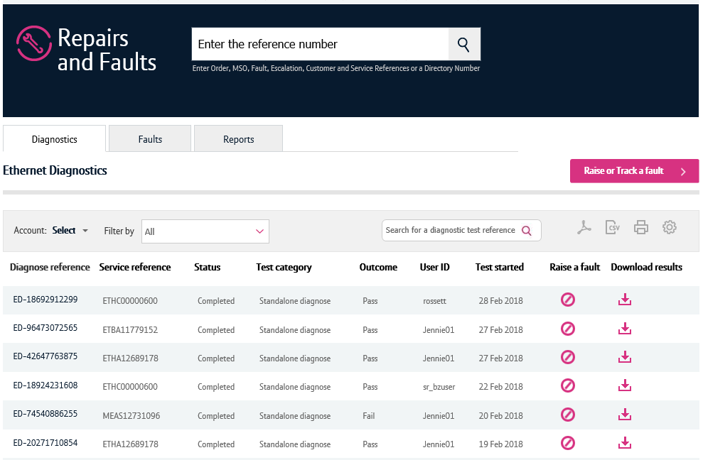
Contents
What’s in this User Guide?
p3 - Version Control
p4 - Introduction
p5 – How to launch the journey
p12 Running an E2E Ping Test
p15 Diagnostic test results

Slide 3
Version Control
Date | Change | Version
11/03/18 | User Guide Published. | 1

Slide 4
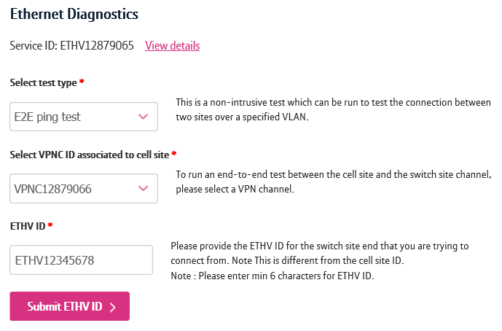
Introduction
End to End Ping Test
You can carry out the End to End Ping Test for Mobile Ethernet (MEAS) circuits using the new diagnostics tool.
This test can be ran to check the connectivity between the Cell and Switch sites
To run this test, you’ll need the Etherflow VPN and ETHV ids of the service you wish to diagnose.
The switch and cell sites that you’re testing must reside on the same VPN.

Slide 5
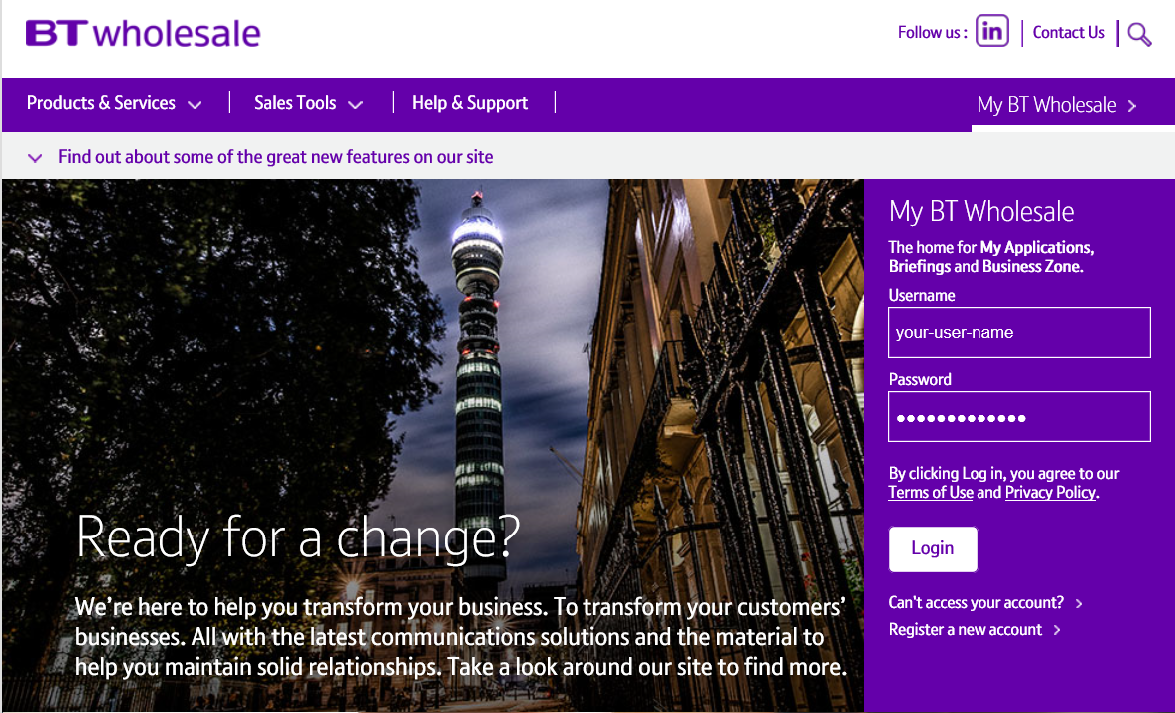
How to launch the diagnostics journey
Step 1. Login to BT Wholesale.com
To launch the diagnostics journey, go to www.btwholesale.com and login using your username and password.

Slide 6
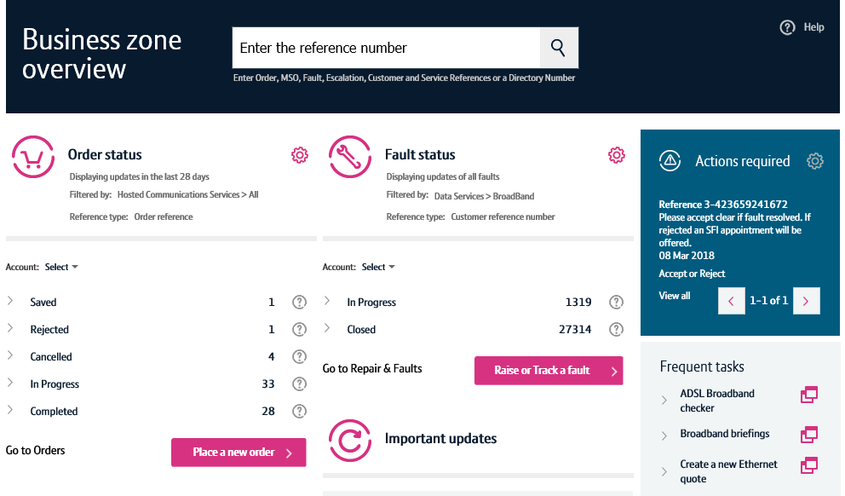
How to launch the diagnostics journey
Step 2. Search for your circuit
You’ll now see the Business Zone dashboard.
Please note, if you don’t see the Business Zone dashboard, you’ll need to contact your company administrator for access.
There are multiple ways to search for a circuit, but the easiest way is to enter the service ID (e.g. ETHV12345678) in the search field at the top of the screen.

Slide 7
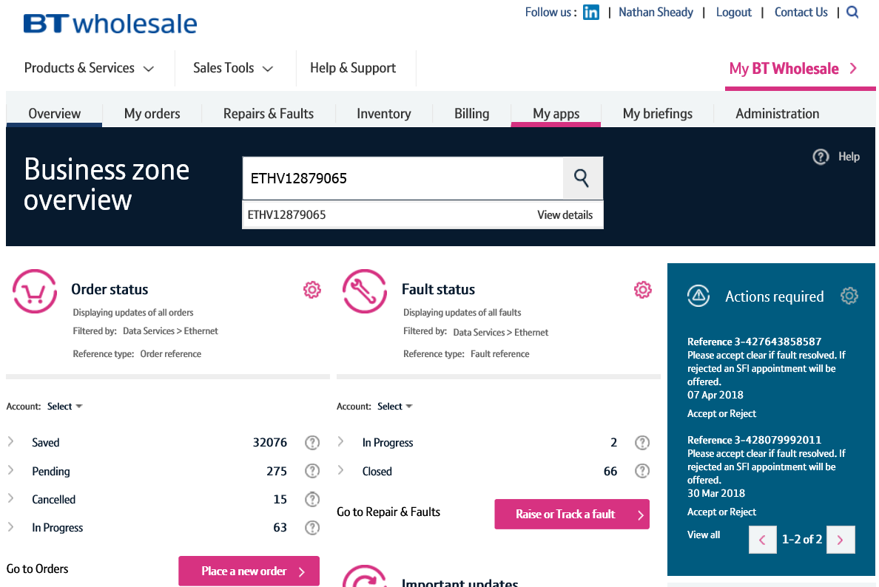
How to launch the diagnostics journey
Step 2. Search for your circuit
As you’re typing in the reference, the search will provide a list of assets matching your criteria.
Clicking the reference will show you the service quickview.
The view details option will take you to the view asset screen where you can see in-depth details of your service.
Clicking the magnifying glass will take you to the search results on Business Zone.
The fastest and easiest way to begin diagnosing a fault accessing the option from the quickview. So simply click on the reference.
3
1
2

Slide 8
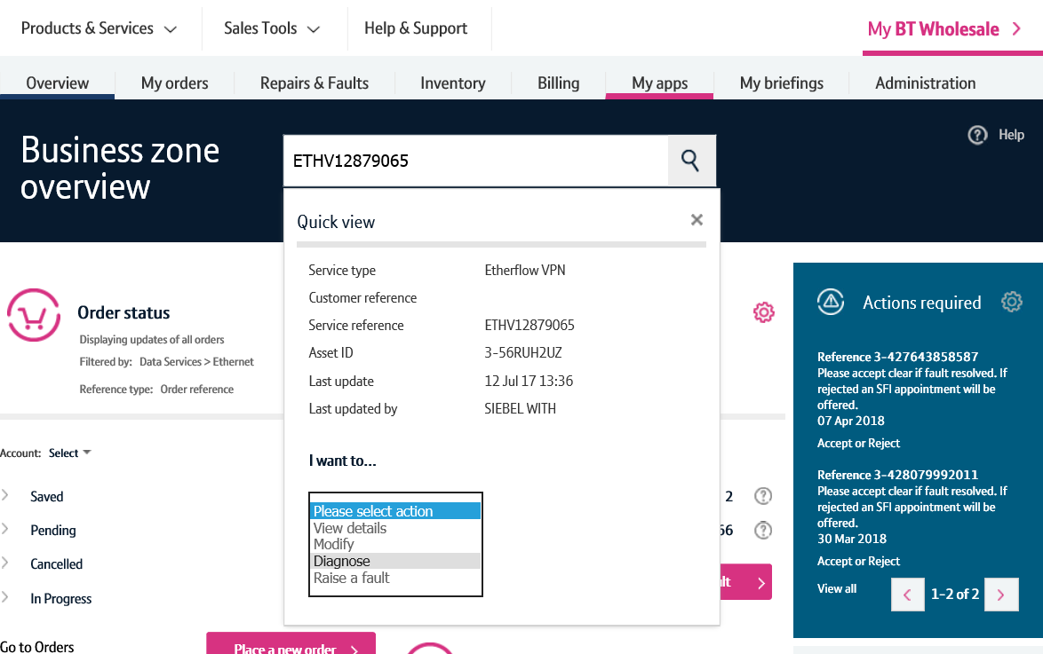
How to launch the diagnostics journey
Step 3. Diagnose action
Once the quickview is displayed, select ‘Diagnose’ from the dropdown.
This will now launch the diagnostics journey for this service.

Slide 9
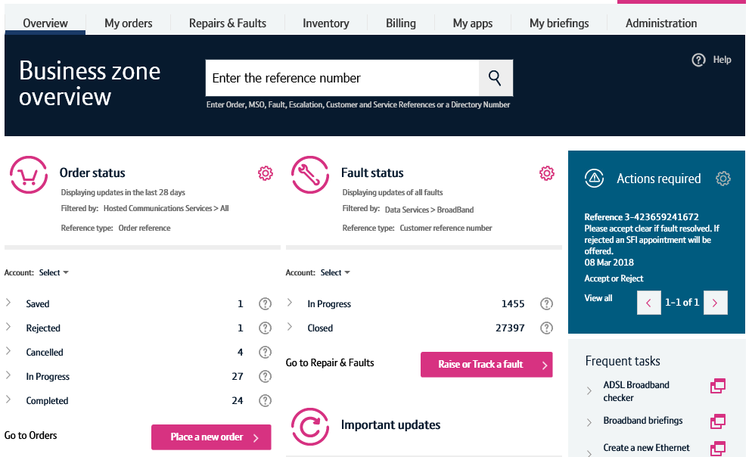
How to launch the diagnostics journey – alternative route
Step 1. Raise or Track a fault
An alternative way to launch the diagnostics journey can be carried out by clicking the ‘Raise or Track a fault’ button on the Business Zone overview page.

Slide 10
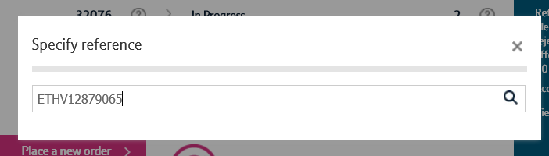
How to launch the diagnostics journey – alternative route
Step 2. Search for your service
Enter the service reference in the search field, then click the magnifying glass.

Slide 11
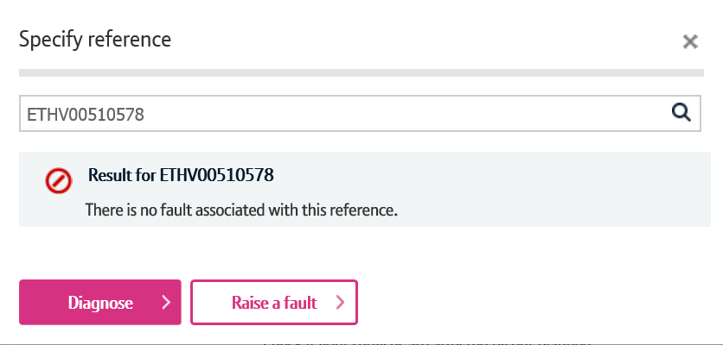
How to launch the diagnostics journey – alternative route
Step 3. Diagnose
Business Zone will now check to see if there’s any open faults on your service.
If there are, you’ll be presented with the fault reference and a shortcut to see the fault details.
We’ll also show you details of recent faults raised on your service to help you diagnose repeat faults.
If you wish to diagnose your service further, click the diagnose button.

Slide 12
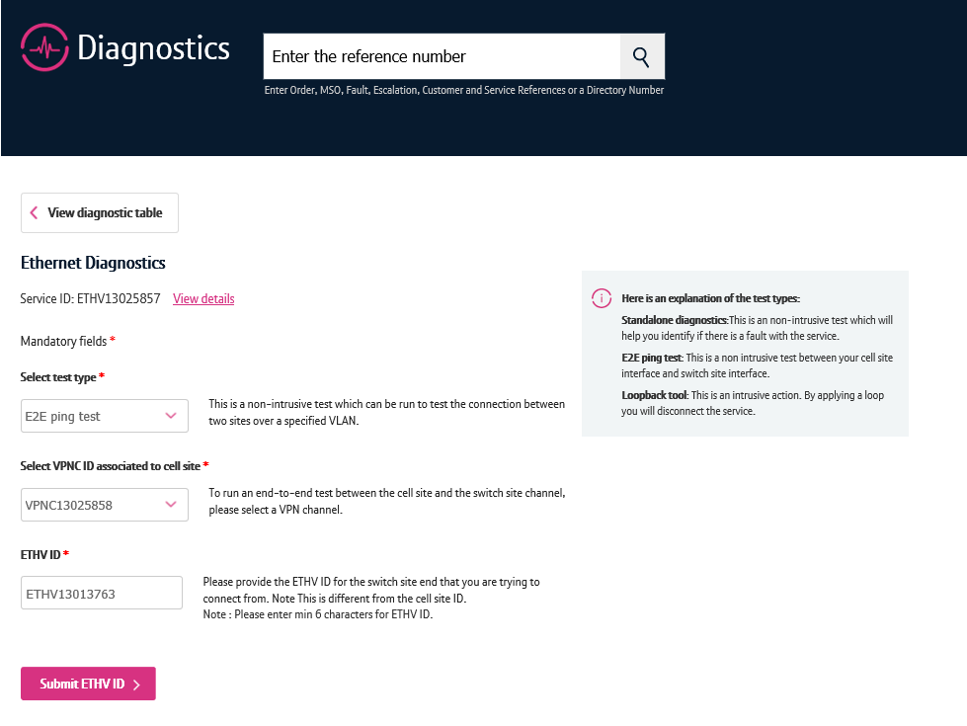
Running the end to end ping test
There’s a number of features on the diagnostics screen.
The view details option will show you details for the circuit such as the from and to address.
To run the test, first select E2E ping test from the dropdown.
Then select the VPN channel ID that you want to test
Enter the ETHV ID for the switch site your connecting from.
Click submit ETHV ID
A check will now take place to identify if the circuits you’ve used are valid. If they aren’t, you’ll be told.
1
2
3
4
5

Slide 13
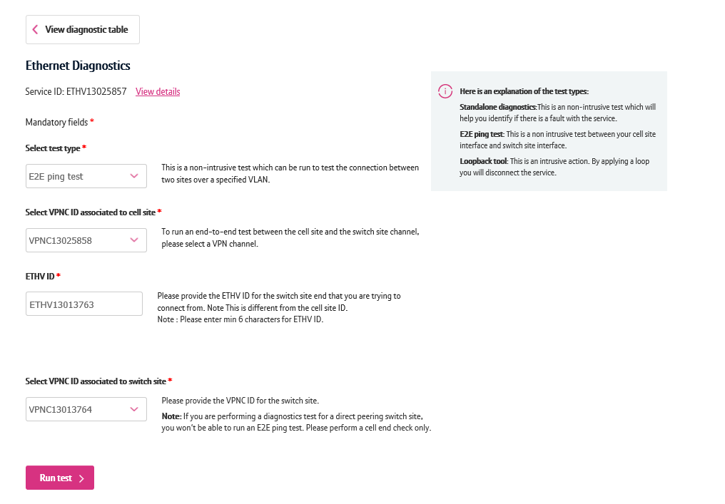
Running the end to end ping test
Once validation is complete, you’ll now be able to continue with the test.
Select the VPNC ID for the switch site that you wish to test.
Click ‘Run test’
Note: If you’re performing a diagnostics test for a direct peering switch site, you won’t be able to run an E2E ping test.
1
2

Slide 14
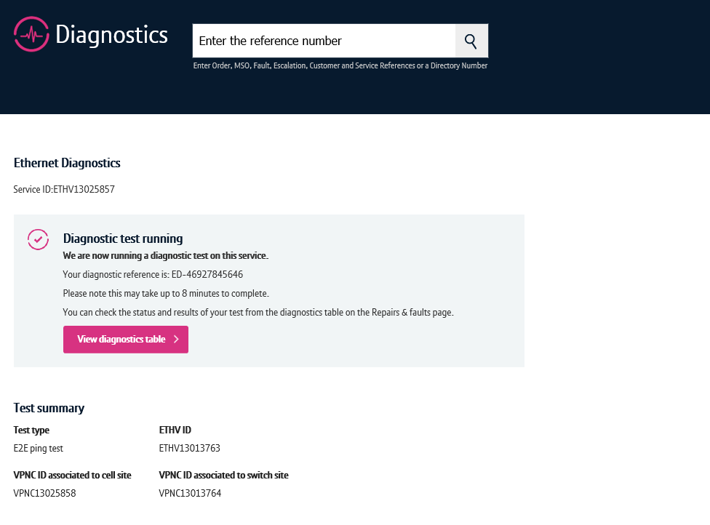
Running the end to end ping test
You’ll now receive a notification that the test is being ran.
To see the result, click ‘View diagnostics table’.

Slide 15
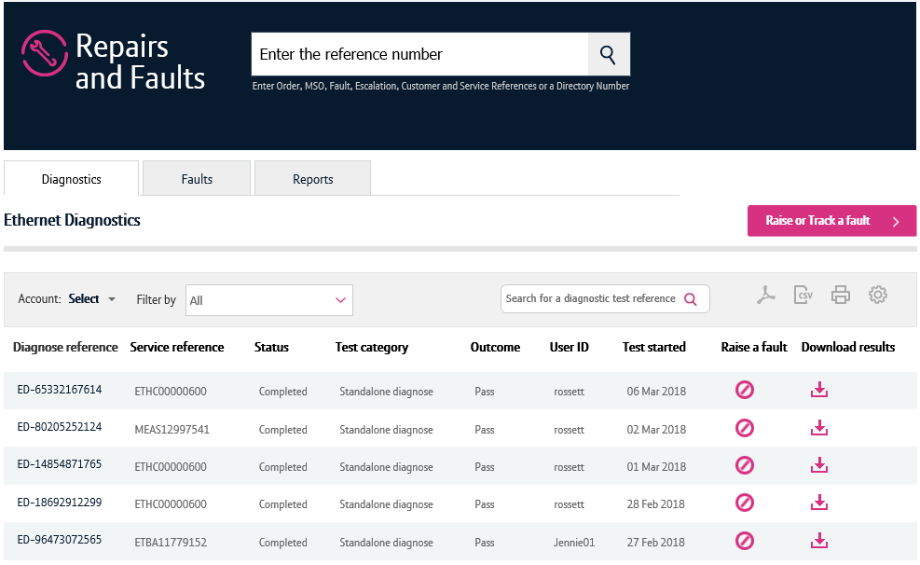
Diagnostic test results
The diagnostics table will show test results ran in the last 2 weeks.
Locate the test that you have just ran on the table. Note, the most recent tests are shown at the top of the table.
To see the results in more detail, click the diagnose reference.
ETHV13013763
E2E Ping

Slide 16
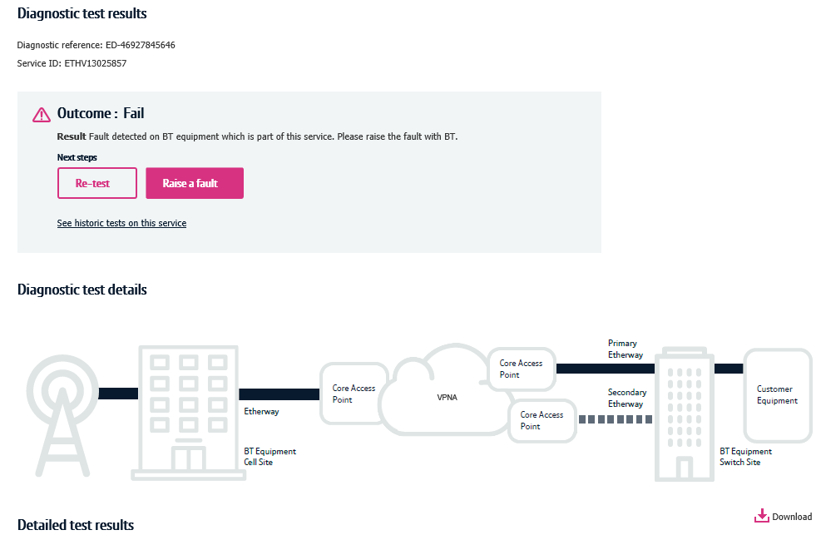
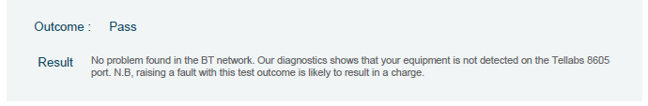
Diagnostic test results
1. Here you can see the test outcome.
Possible outcomes are:
Pass – Test ran successfully
Fail – Test failed
Time out/Premature Termination – The test failed to run
2. You can re-test the service here or raise a fault
3. The ‘See historic tests on this service’ option will take you to the diagnostics table with a filter applied showing only tests ran on this service.
4. The diagnostic test details section will show you details of any issues found as a result of the E2E Ping test.
5. You can download your E2E Ping test results as a PDF here.
6. If the test detects that no Customer Apparatus is connected to the Cell Site Gateway (CSG) customer port, but no problem is detected in the BT Network, the Overall test outcome will be a PASS with associated message displayed.
1
2
3
4
5
6

Slide 17
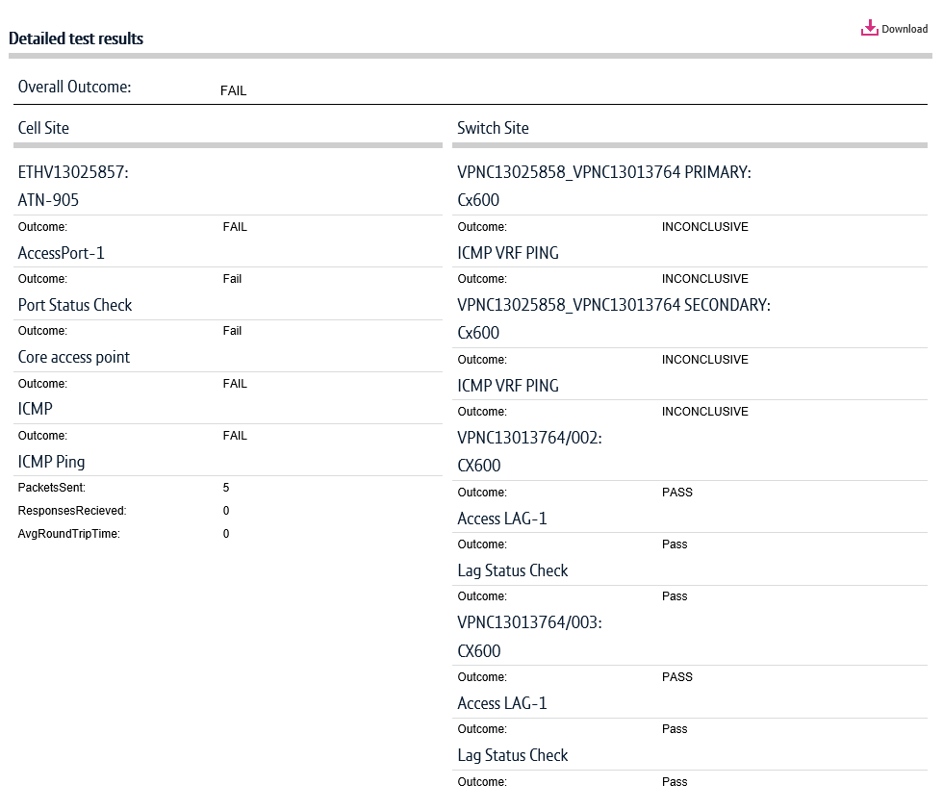
Diagnostic test results
Scrolling down the screen, you’ll be able to see further End to End Ping Test details.
The ICMP AvgRoundTripTime result (following a test of a Mobile Etherflow VPN service ETHV/VPNC) is a ping test outcome and as such not a conclusive test of delay.
If no customer apparatus is connected at the Cell Site Gateway(CSG), the ICMP outcome will show ‘fail’ (as per this image). This is because the E2E Ping test routes packets to the User Network Interface (Customer Port) of the CSG. If that port has no customer apparatus connected the port will be ‘down’ and the sent ping packets will fail to progress and will not be received.
1

