Slide 1
How to Modify a Broadband Service on Enhanced Eco+
Version 1
Notes:
Security classification options:
– Public
– Internal
– Confidential
– Highly Confidential

Slide 2
Contents
What’s in this User Guide?
Slide 3 – Version Control
Slide 4 – Overview
Slide 5 – How to Modify Your Service

Slide 3
Version Control
Date | Change | Version
December 21 | User Guide Published | 1

Slide 4
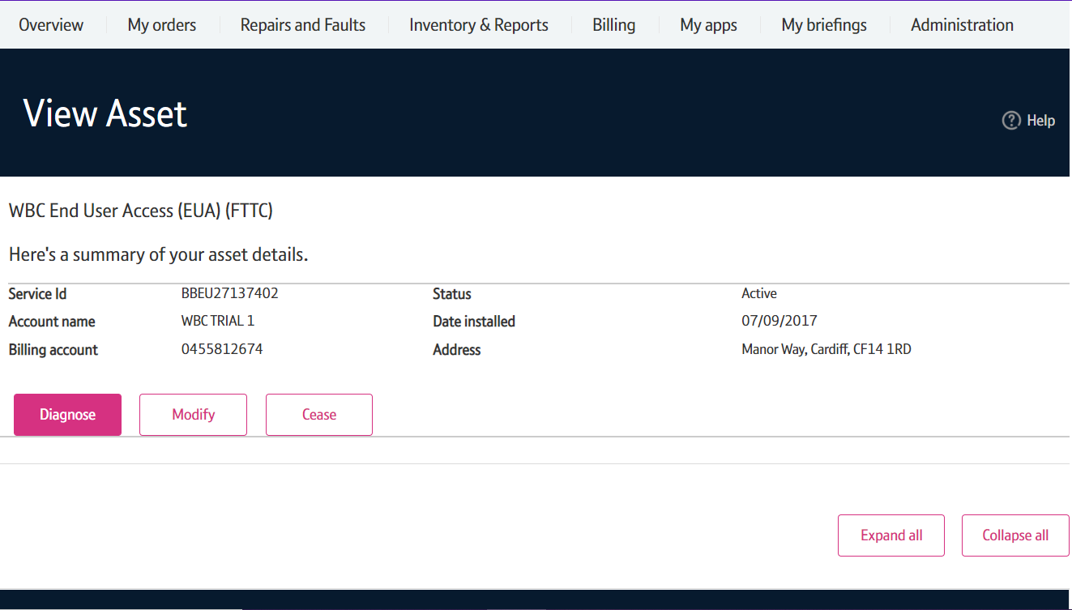
Overview
Once your service has been installed, you are able to modify various attributes as your Customer’s requirements may have changed since the original order was placed.
Charges and Contract Term impact
Modifying the service may reset the minimum contract term; for example if a new speed is selected, there will be a new contract terms for this.
Please visit our Service Provider Price List page on BTWholesale.com for a full breakdown of the costs.
Further information can be found in the relevant Product Handbooks

Slide 5
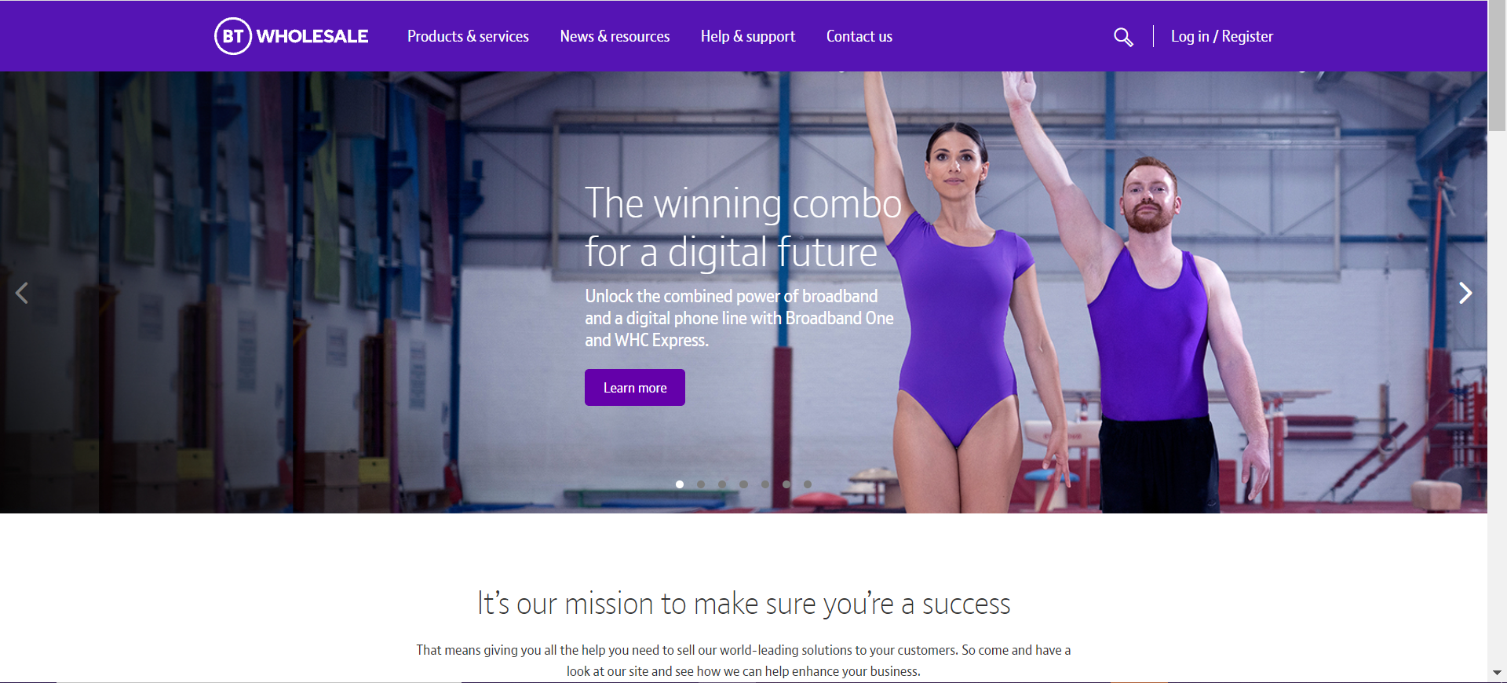
How to Modify Your Service
Step 1: Logging In
Go to www.btwholesale.com
Click on ‘Login/register’

Slide 6
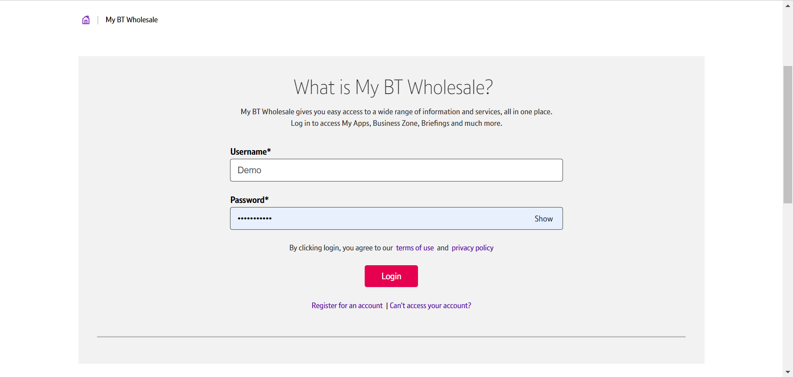
How to Modify Your Service
Step 1: Logging In
Enter your Username and Password.
Click on ‘Login’

Slide 7
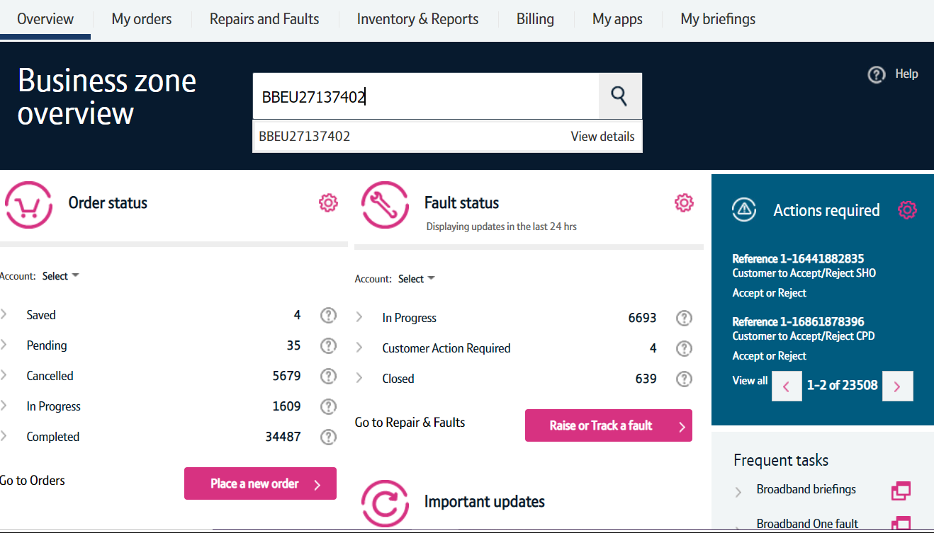
How to Modify Your Service
Step 2: Search for your Circuit
Once logged in, you’ll be taken to the Business zone.
If you aren’t taken to the Business zone, you’ll need to arrange access via your company administrator.
Use the Telephone Number or BBEU Number to search for your Service.
Press the arrow down key to see the view details
Click on ‘View details’.

Slide 8
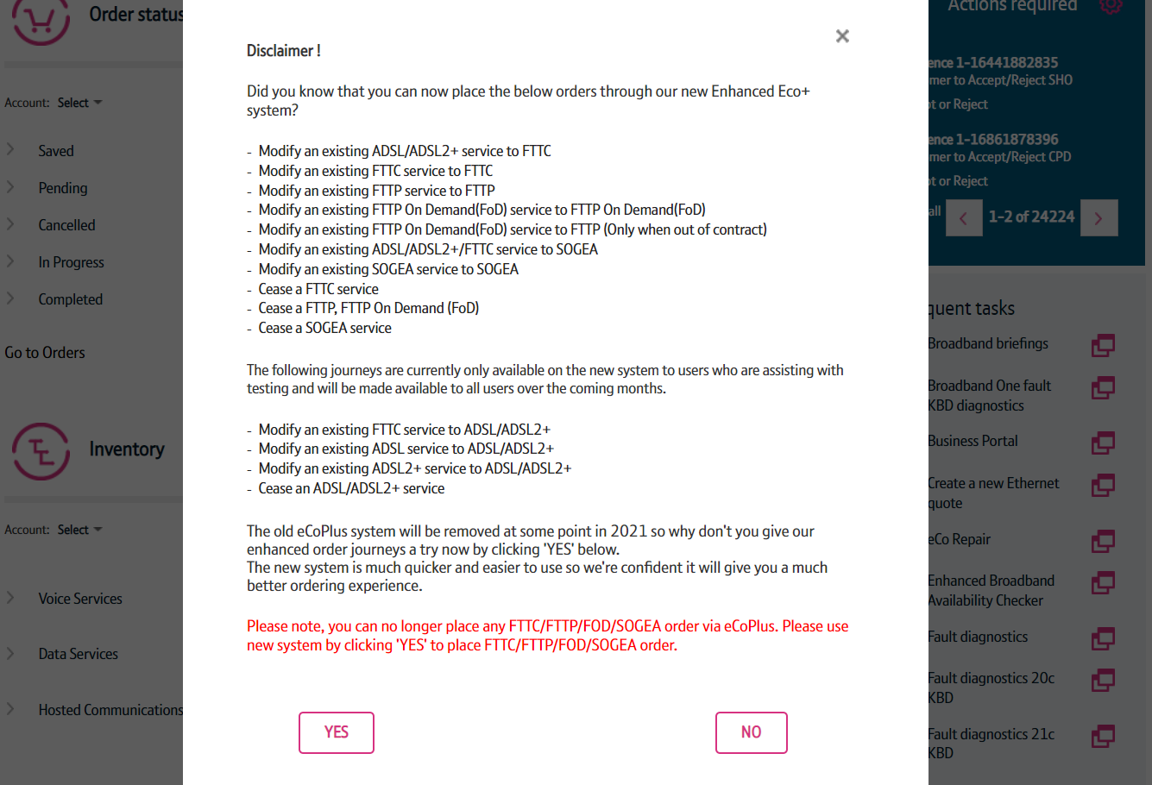
How to Modify Your Service
Step 2: Search for your Circuit
You may see a Disclaimer message pop up. This message may be changed from time to time following releases as we add more journeys to the new system.
From here you have to click on ‘Yes’ to go to the new version of the system.

Slide 9
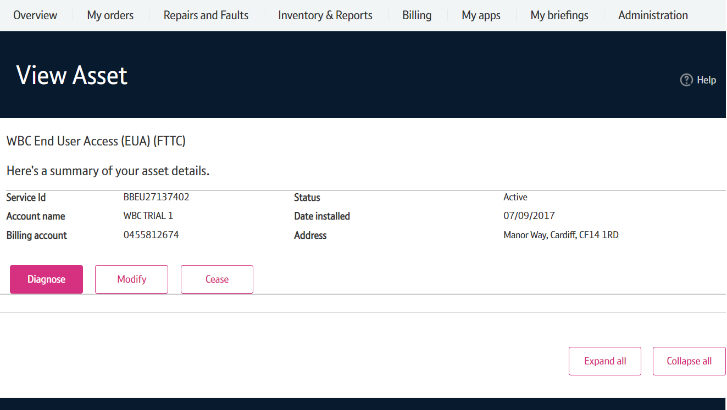
How to Modify Your Service
Step 3: Place the Modify Order
Click on ‘Modify’

Slide 10
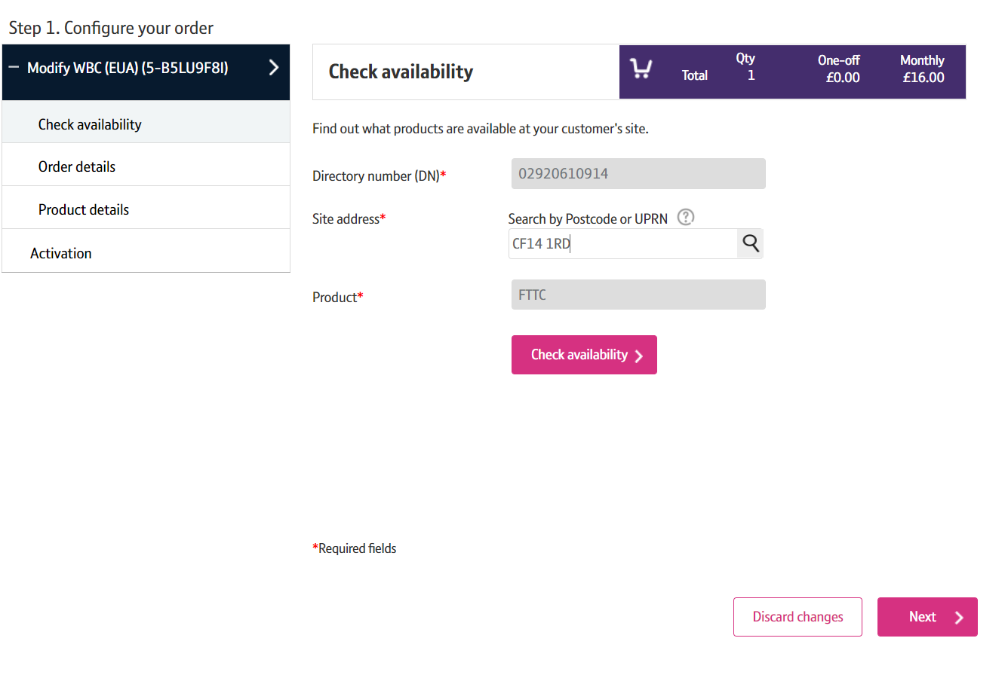
How to Modify Your Service
Step 4: Search for the Address
Enter the Post Code of the address associated with the asset.
Click on the magnifying glass.

Slide 11
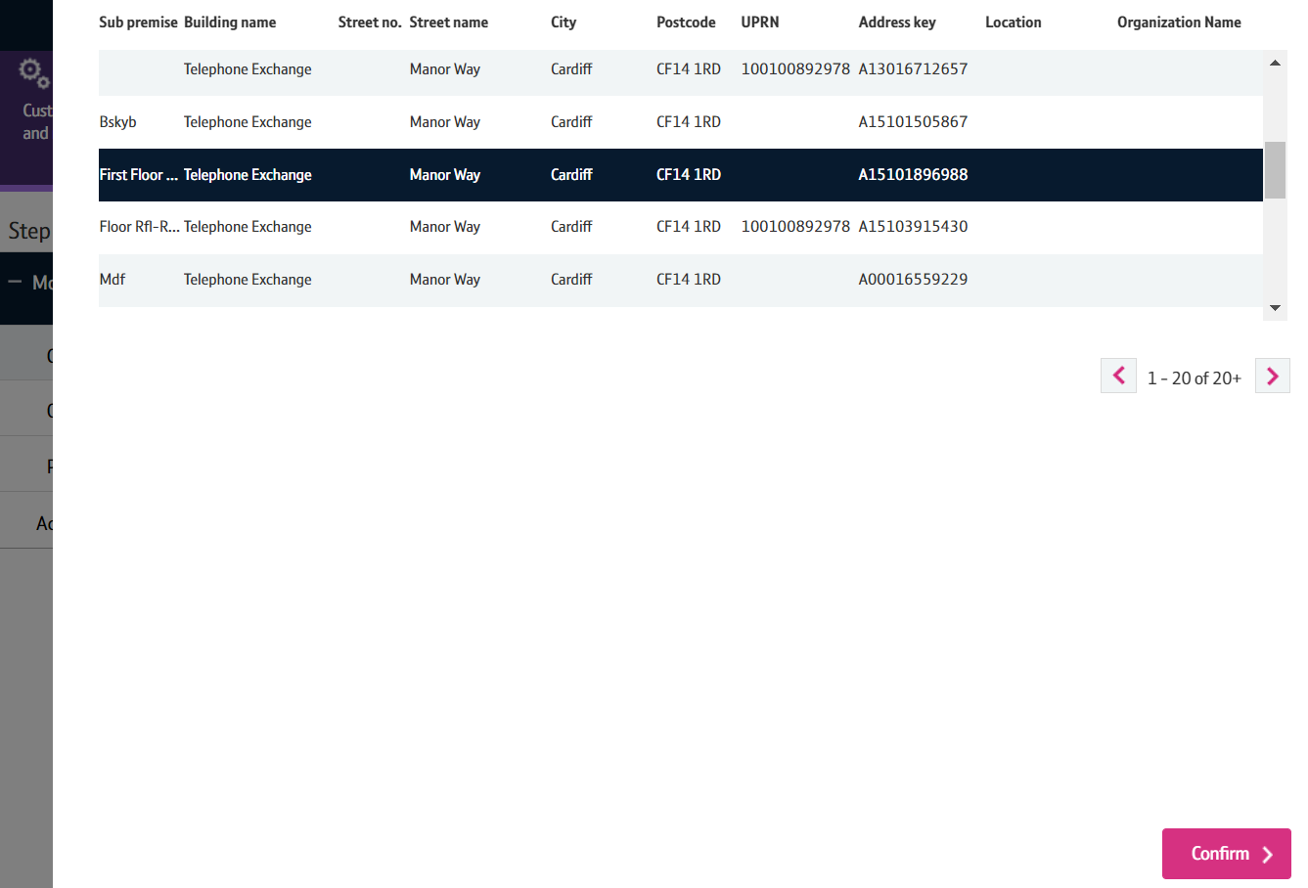
How to Modify Your Service
Step 4: Search for the Address
Select the address from the list.
Click on ‘Confirm’
Note: If there are more than 50 addresses for the postcode, you may need to go to the next page using the > at the bottom of the address list.

Slide 12
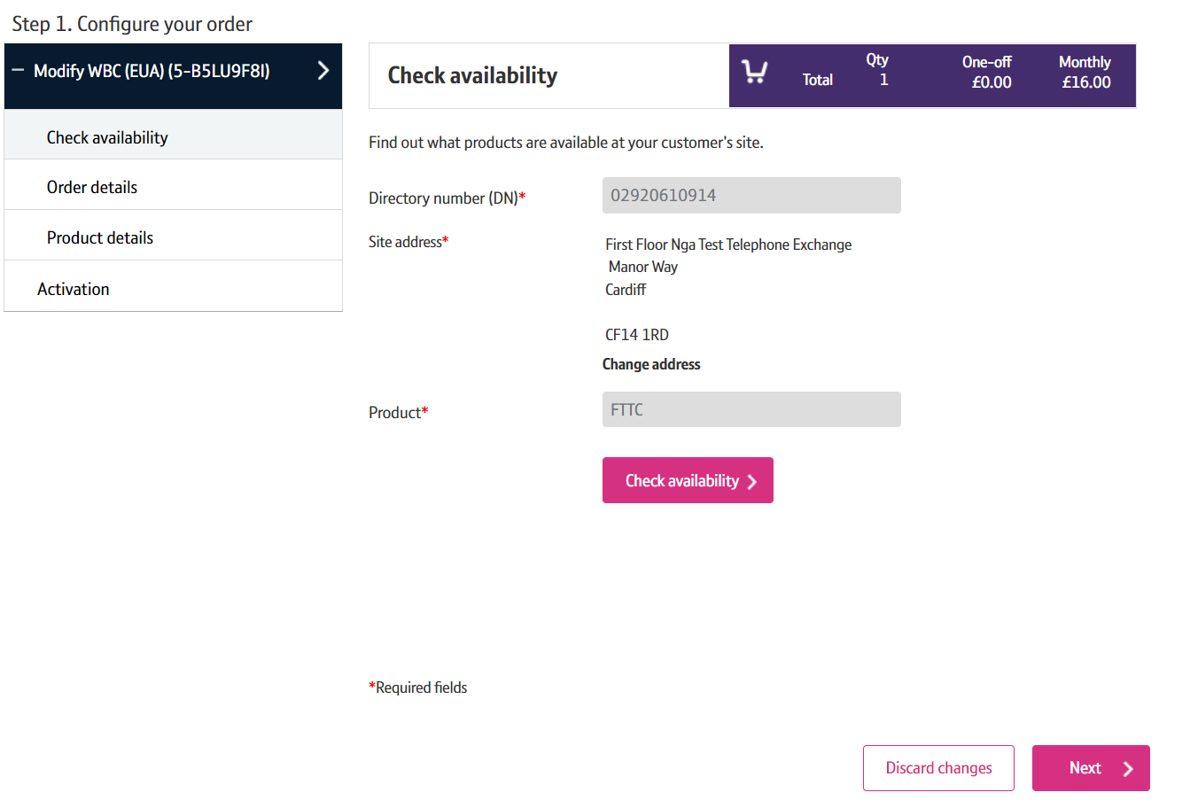
How to Modify Your Service
Step 5: Check Availability
Click on ‘Check Availability’

Slide 13
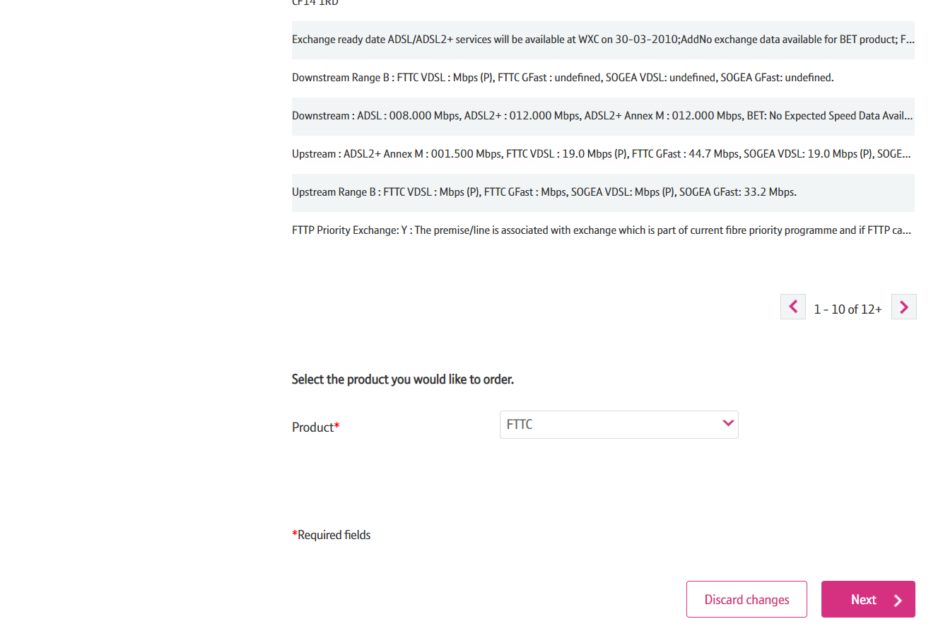
How to Modify Your Service
Step 5: Check Availability
The available products will be shown in the Results table should you wish to modify the product.
Click on ‘Next’

Slide 14
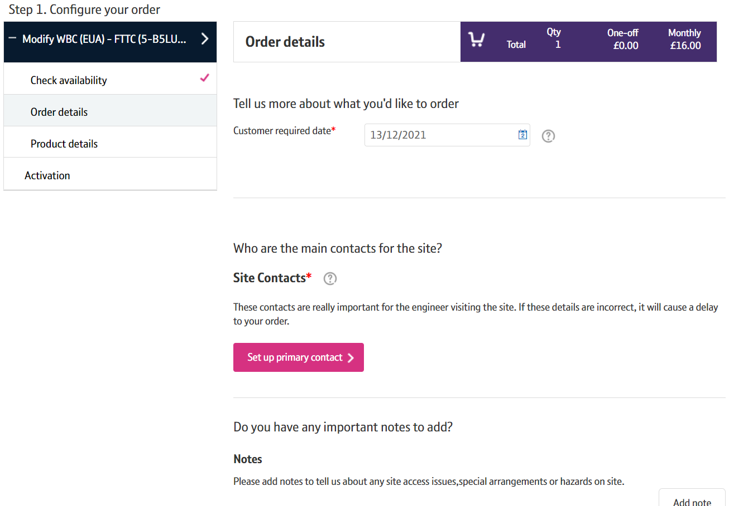
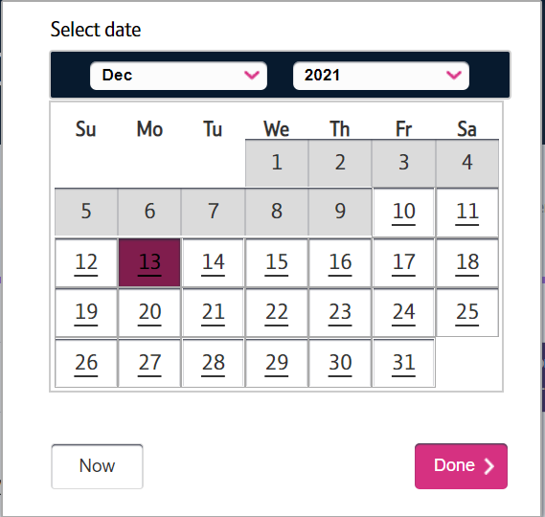
How to Modify Your Service
Step 6: Select the Customer Required Date
The first available date is automatically selected for you but if you require a future date please follow the steps below:
- Click on the Calendar Icon.
- Select the date you require from the table.
- Click on ‘Done’

Slide 15
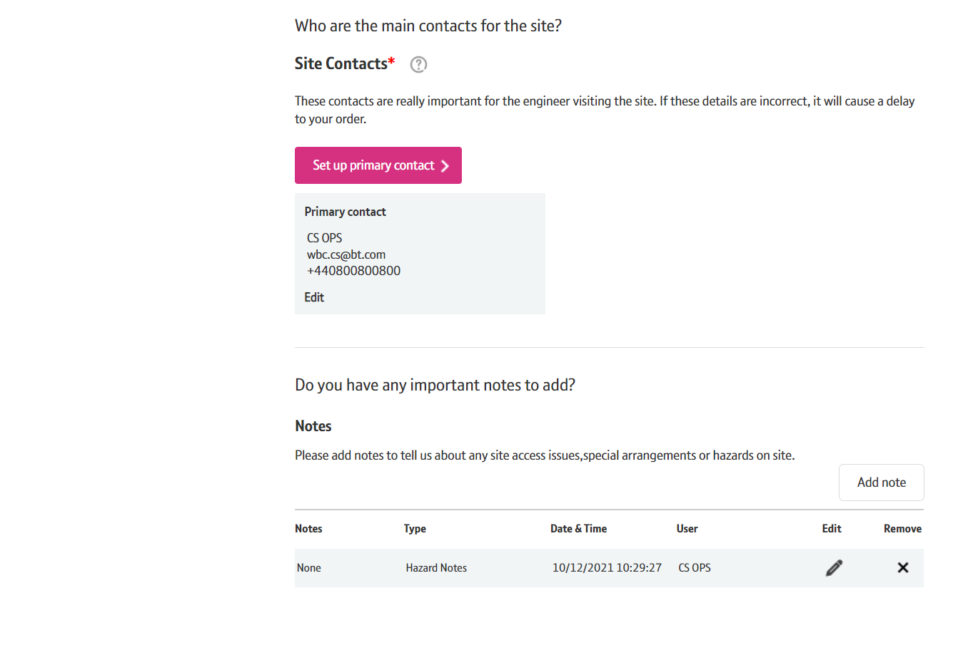
How to Modify Your Service
Step 7: Site Contacts and Hazard Notes
Click on ‘Setup Primary Contact’ and add contact details if there is none showing as set.
Click on ‘Add Note’ and select ‘hazard Notes’ in Notes Type to add your notes.
Note: The Hazard Notes may only apply to Fibre Products.

Slide 16
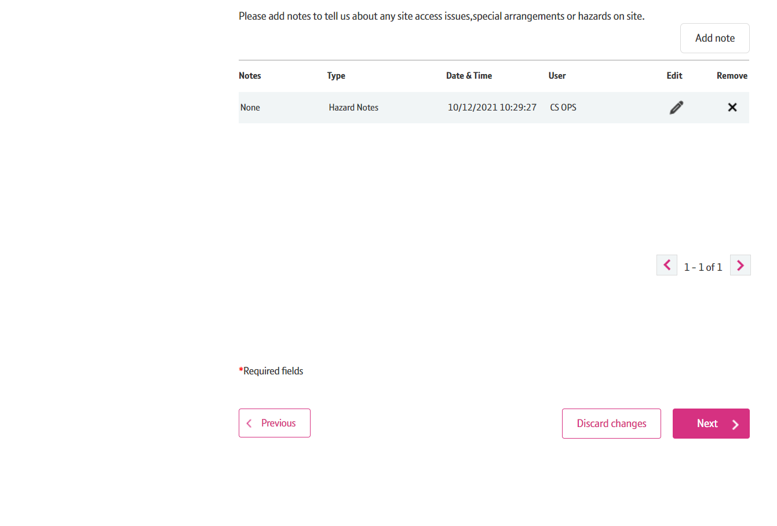
How to Modify Your Service
Step 8: Continue with the Modify Order
Scroll down the page.
Click on ‘Next’

Slide 17
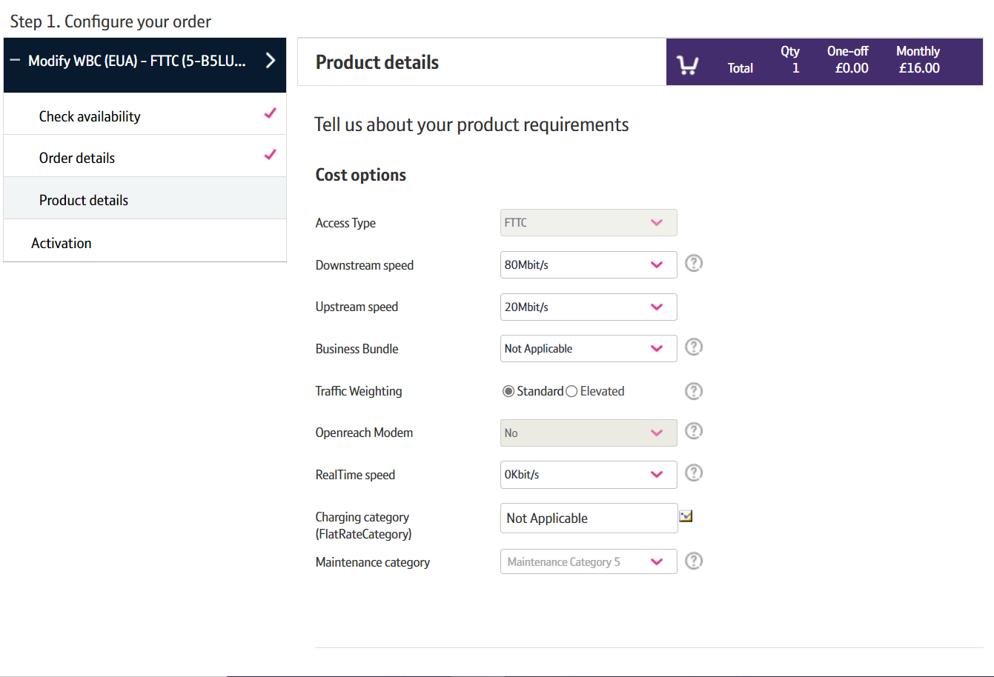
How to Modify Your Service
Step 9: Select the attributes you want to Modify
Not all of the options listed can be modified for an existing working line. For example Self Install and Openreach Modem are not applicable.
You can modify:
- Downstream/Upstream Speeds
- Bandwidth Bundle
- Traffic Weighting
- Real Time Speed
- Maintenance Category
You can select one, or multiple attributes to change against one order.

Slide 18
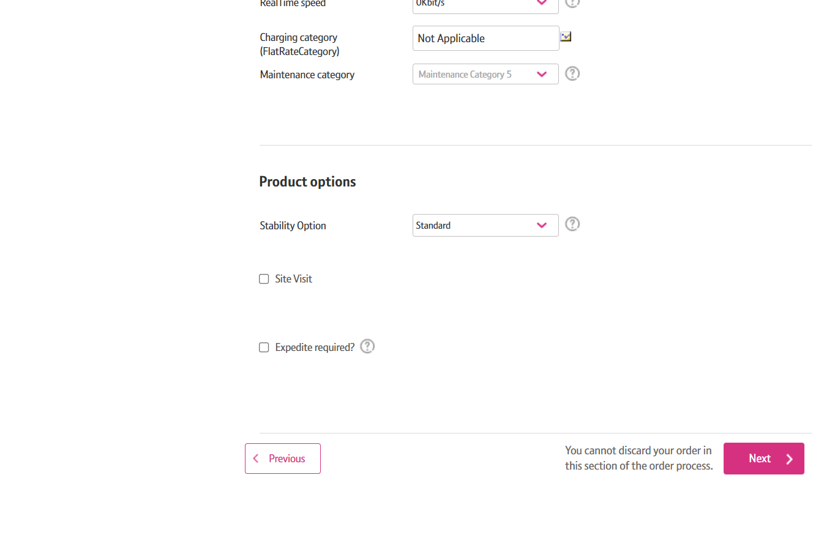
How to Modify Your Service
Step 9: Select the attributes you want to Modify
You can also modify:
- Stability Option

Slide 19
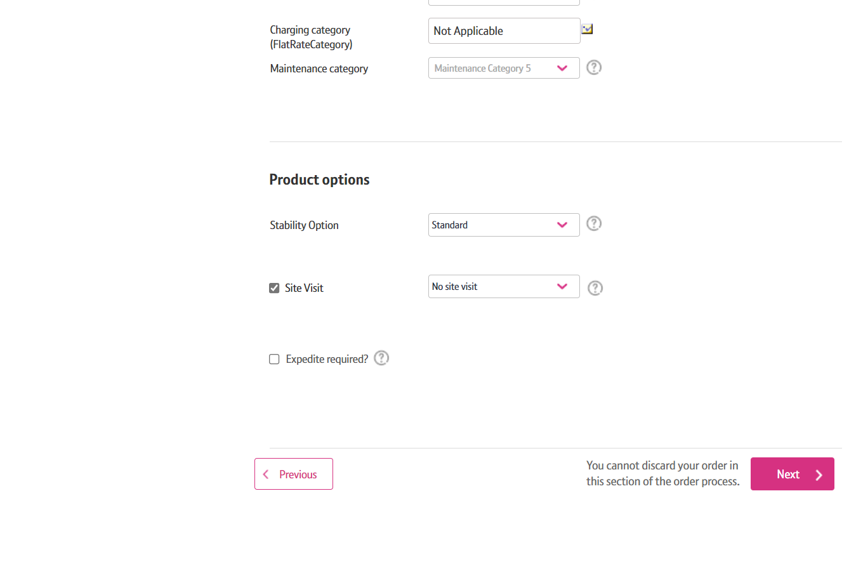
How to Modify Your Service
Step 10: Site Visit
For Fibre related product you will need to select ‘Site Visit’ and select ‘No Sit Visit’

Slide 20
How to Modify Your Service
Step 11: Continue with the Modify Order
Click on ‘Next’

Slide 21
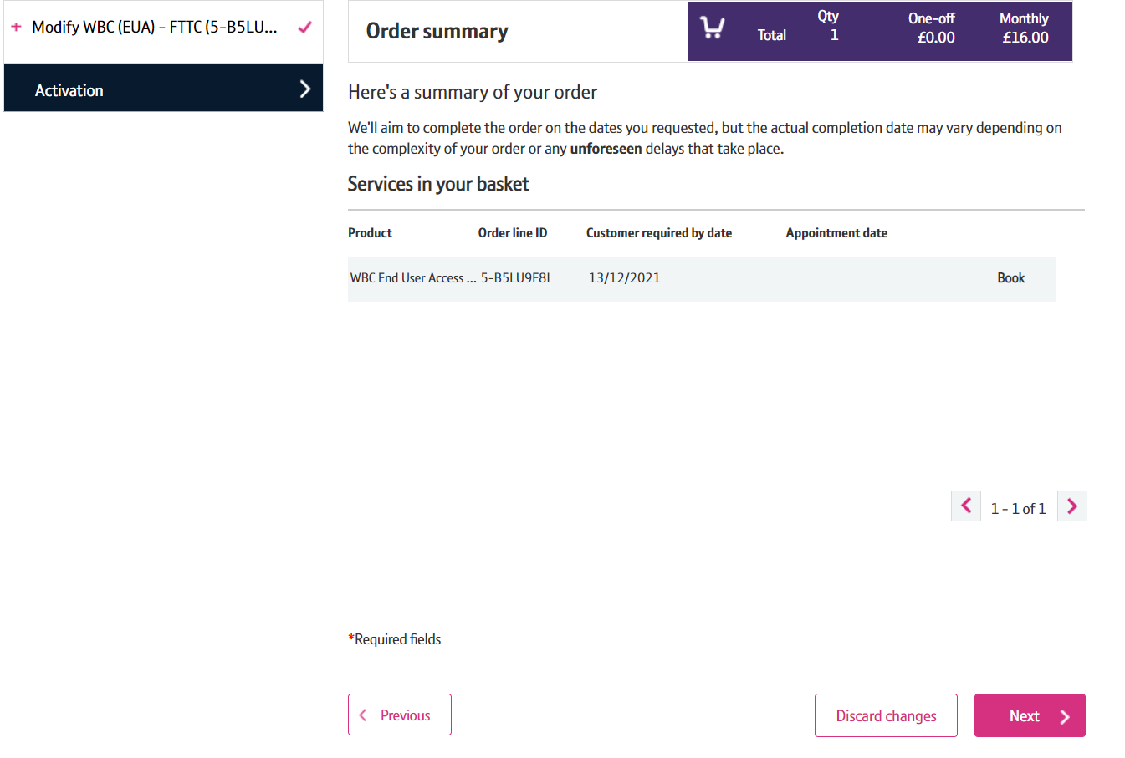
How to Modify Your Service
Step 12: Confirm and Submit
Click on ‘Next’

Slide 22
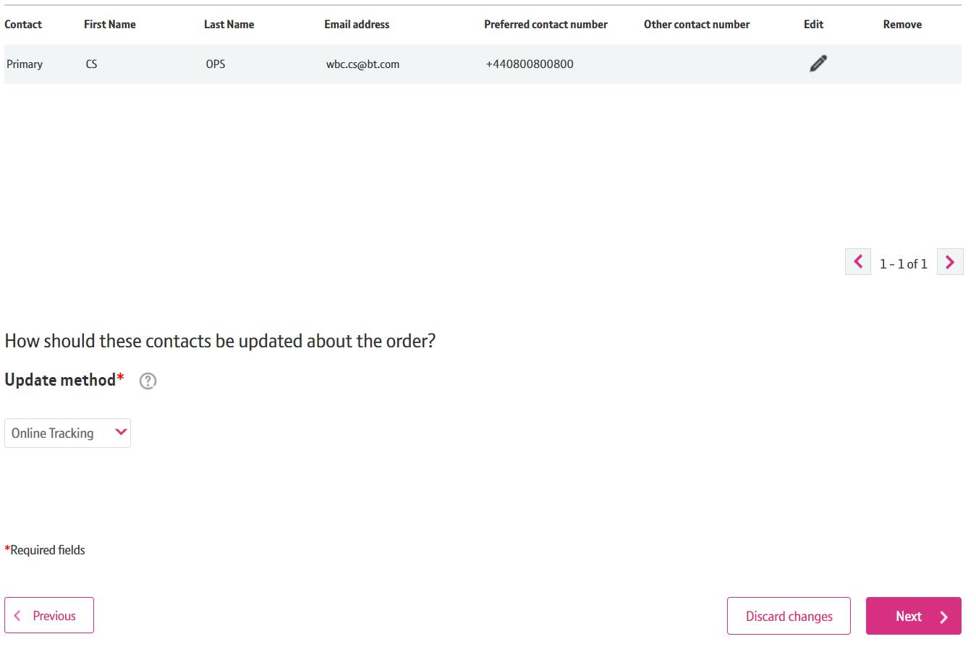
How to Modify Your Service
Step 12: Confirm and Submit
Select the Update Method – Online Tracking, Email, Critical KCI’s only
Click on ‘Next’

Slide 23
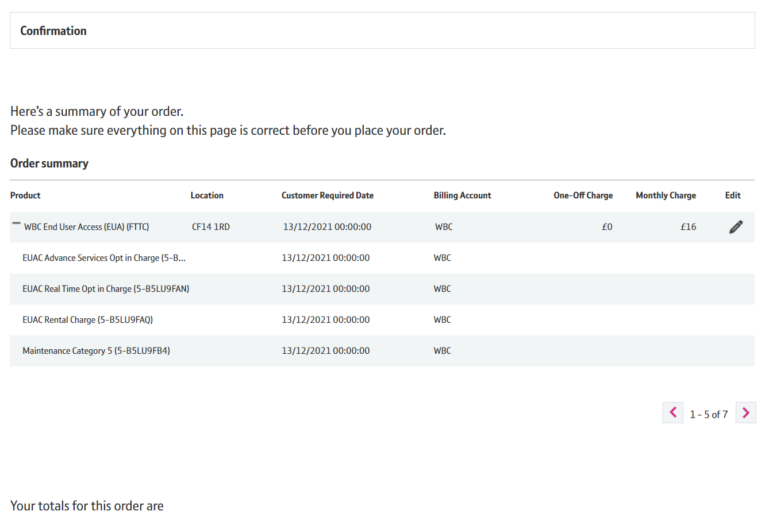
How to Modify Your Service
Step 12: Confirm and Submit
Check the Summary by clicking on the + sign to expand.

Slide 24
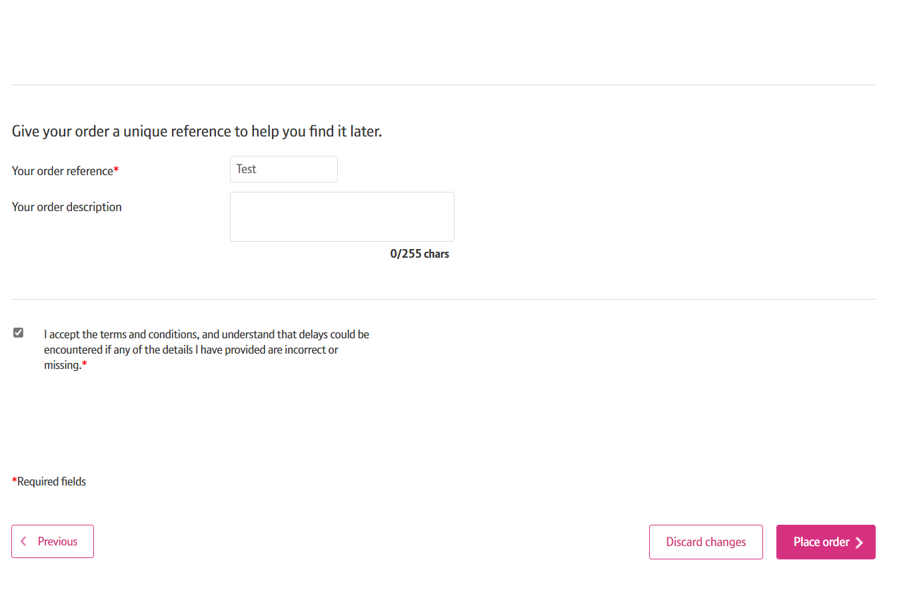
How to Modify Your Service
Step 12: Confirm and Submit
Enter your Order Reference.
Accept the Terms and Conditions by ticking the box.
Click on ‘Place Order’

Slide 25
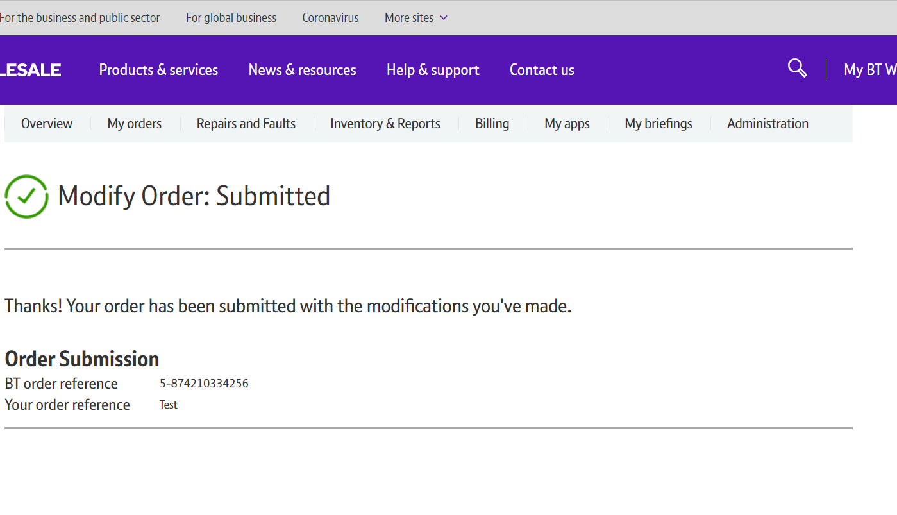
How to Modify Your Service
Step 13: Confirmation
Confirmation that your modify order has been placed.

