Slide 1
How to Cease a Broadband Service on Enhanced Eco+
Version 1
Notes:
Security classification options:
– Public
– Internal
– Confidential
– Highly Confidential

Slide 2
Contents
What’s in this User Guide?
Slide 3 – Version Control
Slide 4 – Overview
Slide 5 – How to Cease Your Service

Slide 3
Version Control
Date | Change | Version
December 21 | User Guide Published | 1

Slide 4
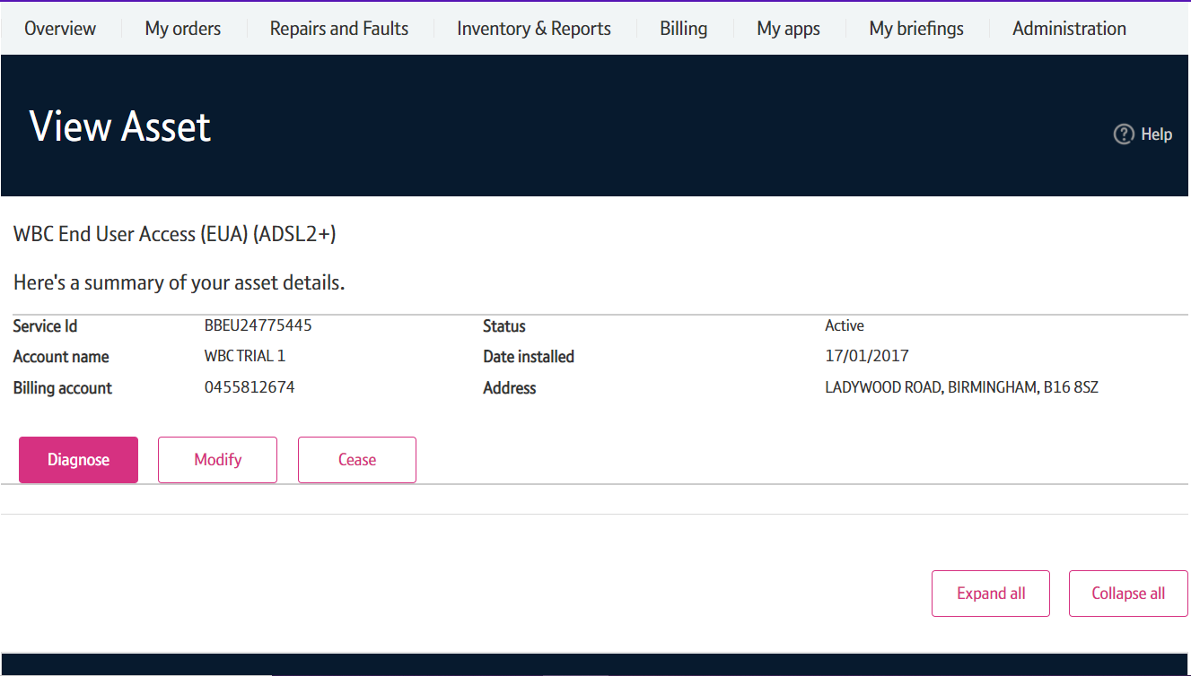
Overview
Ceasing an active service is simple few step process.
Cease Charges
There may be a charge associated with ceasing your service. A summary of any costs will be given before you submit your order.
Alternatively, please visit our Service Provider Price List page on BTWholesale.com for a full breakdown of costs.

Slide 5
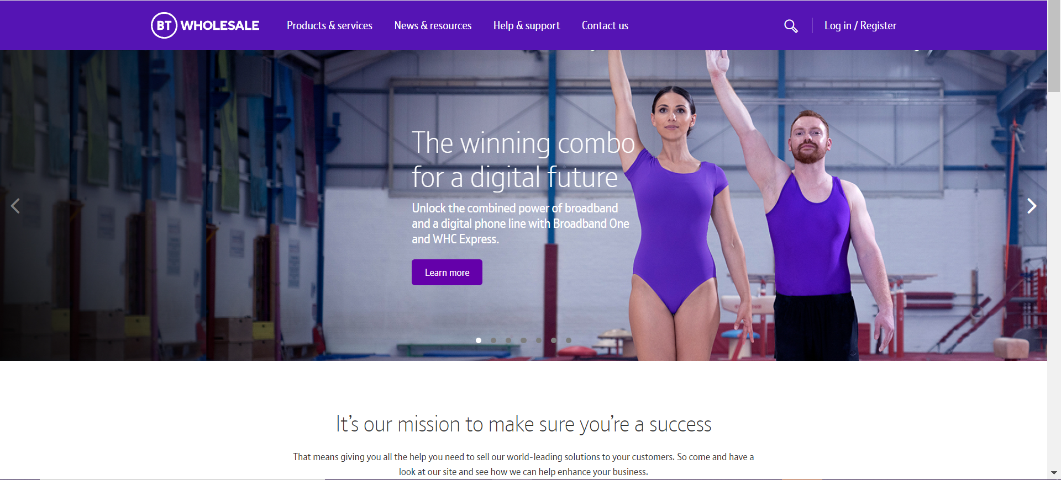
How to Cease Your Service
Step 1: Logging In
Go to www.btwholesale.com
Click on ‘Login/register’

Slide 6
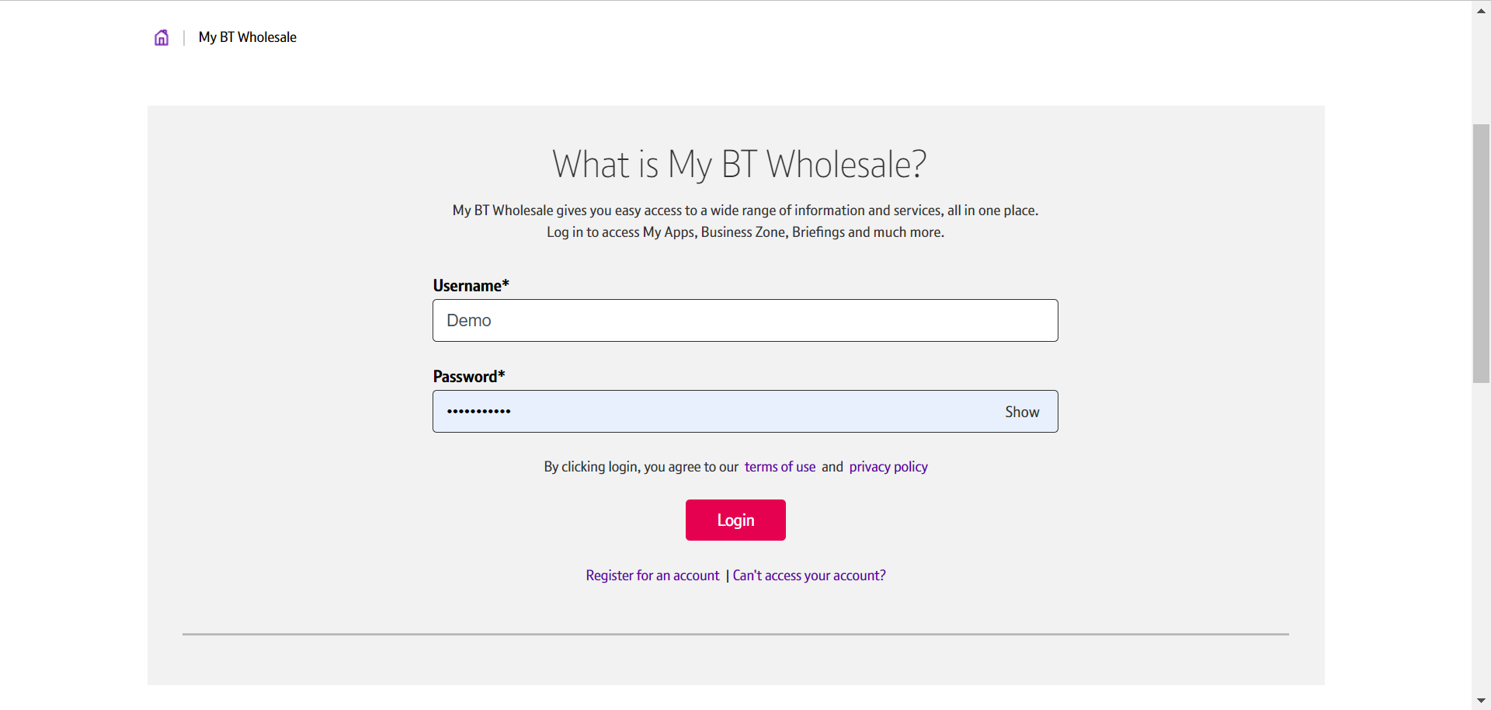
How to Cease Your Service
Step 1: Logging In
Enter your Username and Password.
Click on ‘Login’

Slide 7
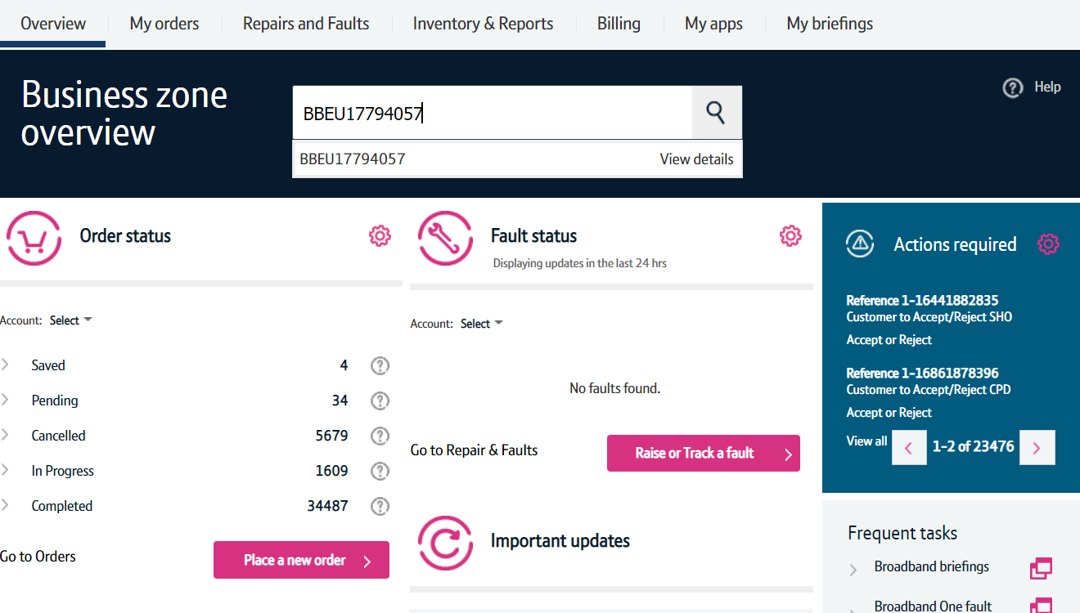
How to Cease Your Service
Step 2: Search for your Circuit
Once logged in, you’ll be taken to Business zone.
If you aren’t taken to Business zone, you’ll need to arrange access via your company administrator.
Use the Telephone Number or BBEU Number to search for your Service.
Press the arrow down key to see the view details
Click on ‘View details’.

Slide 8
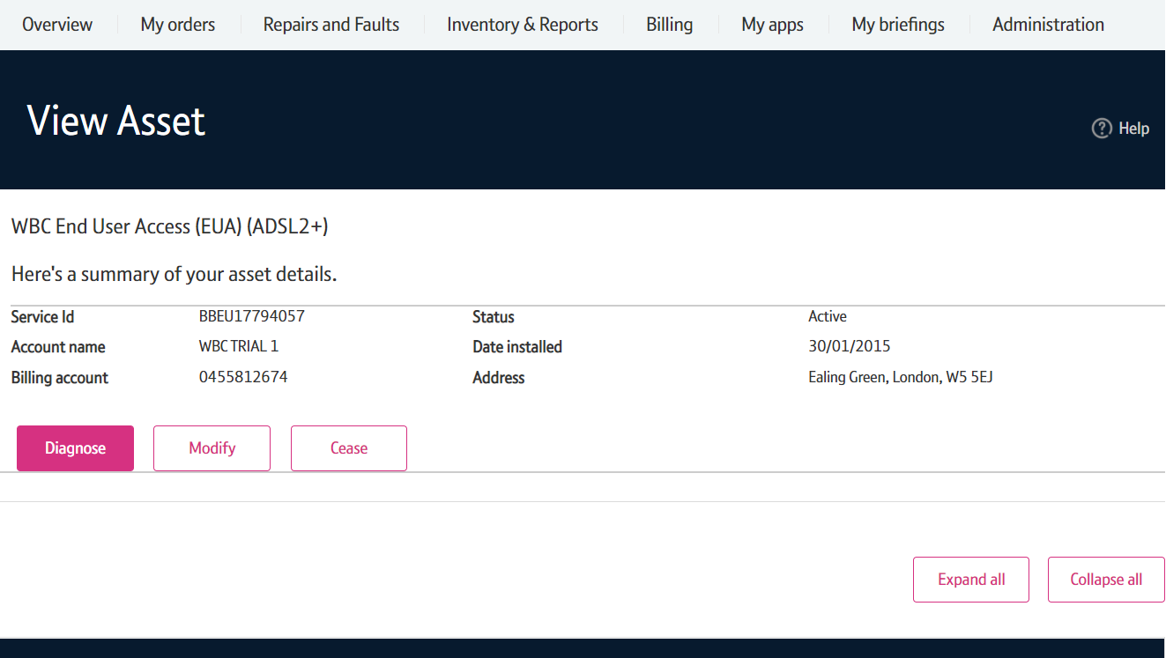
How to Cease Your Service
Step 3: Place the Cease Order
Click on ‘Cease’.

Slide 9
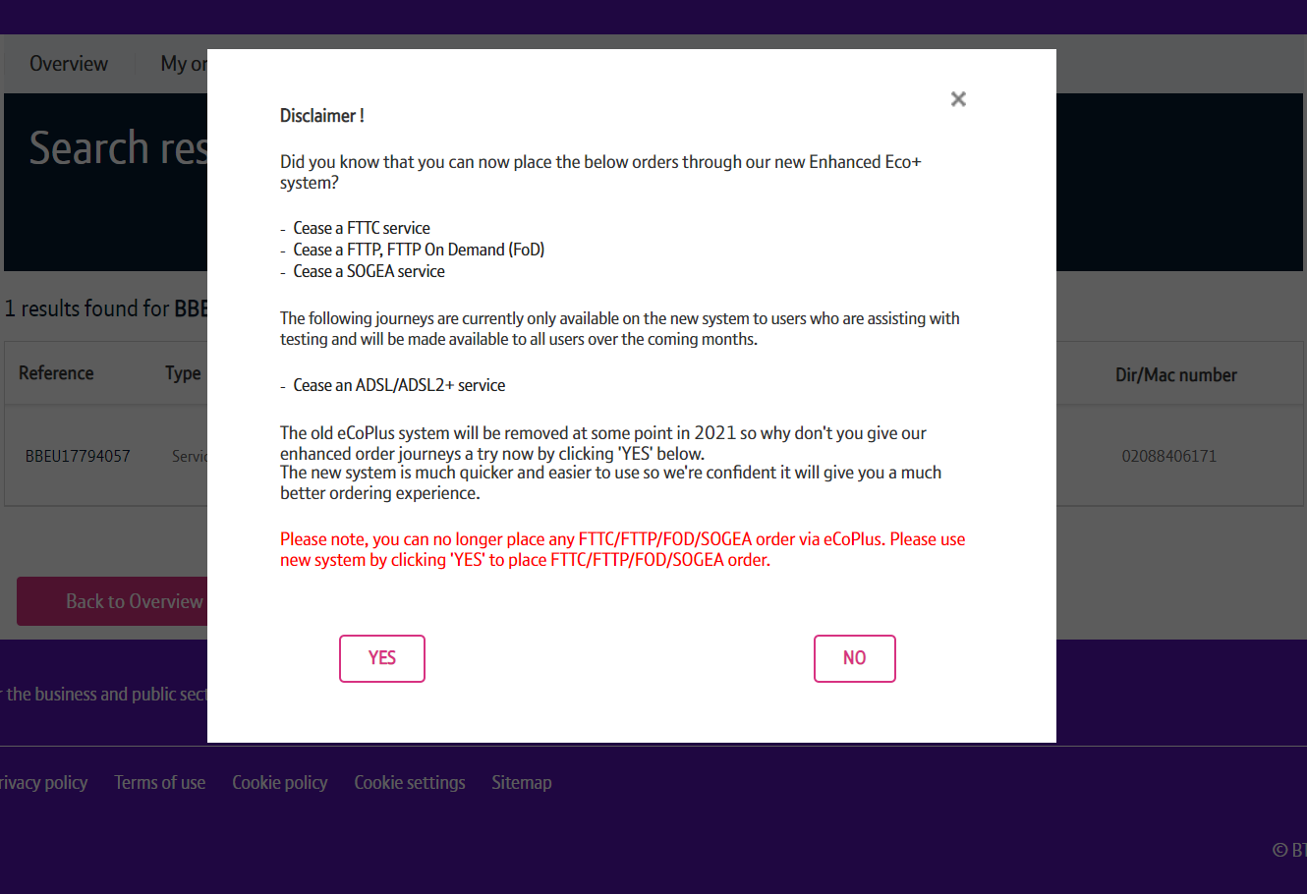
How to Cease Your Service
Step 3: Place the Cease Order
You may see a Disclaimer message pop up. This message may be changed from time to time following releases as we add more journeys to the new system.
From here you have to click on ‘Yes’ to go to the new version of the system.

Slide 10
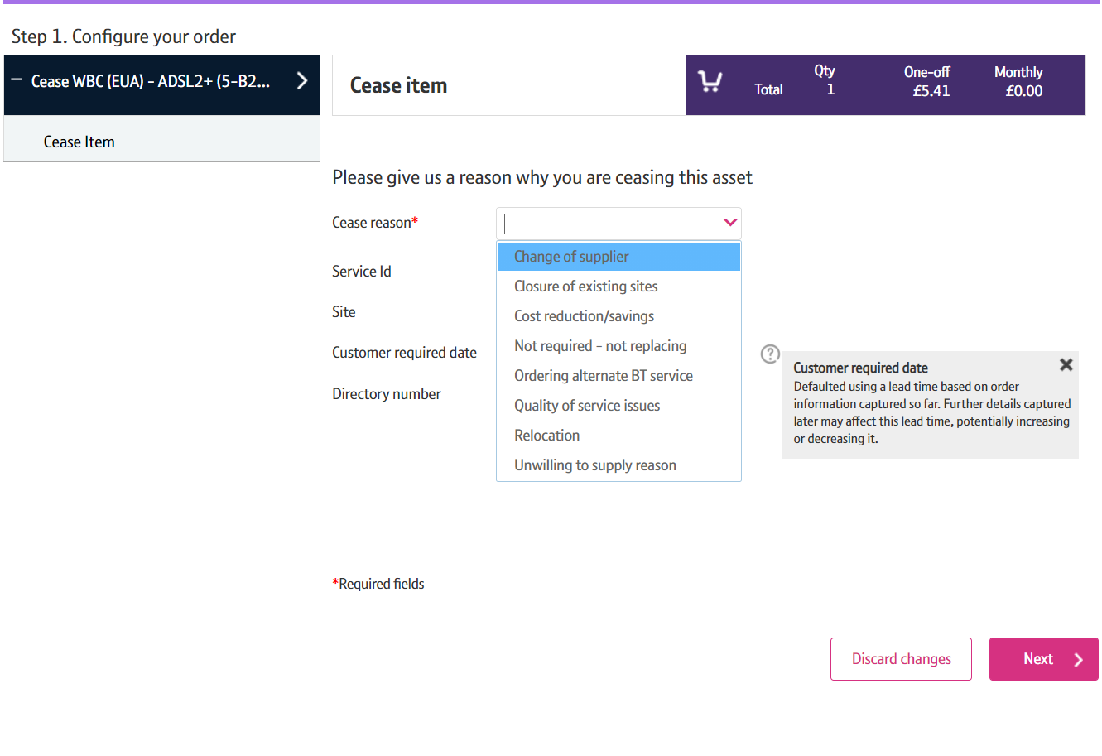
How to Cease Your Service
Step 4: Select the CRD and Cease Reason
Select a Cease Reason.

Slide 11
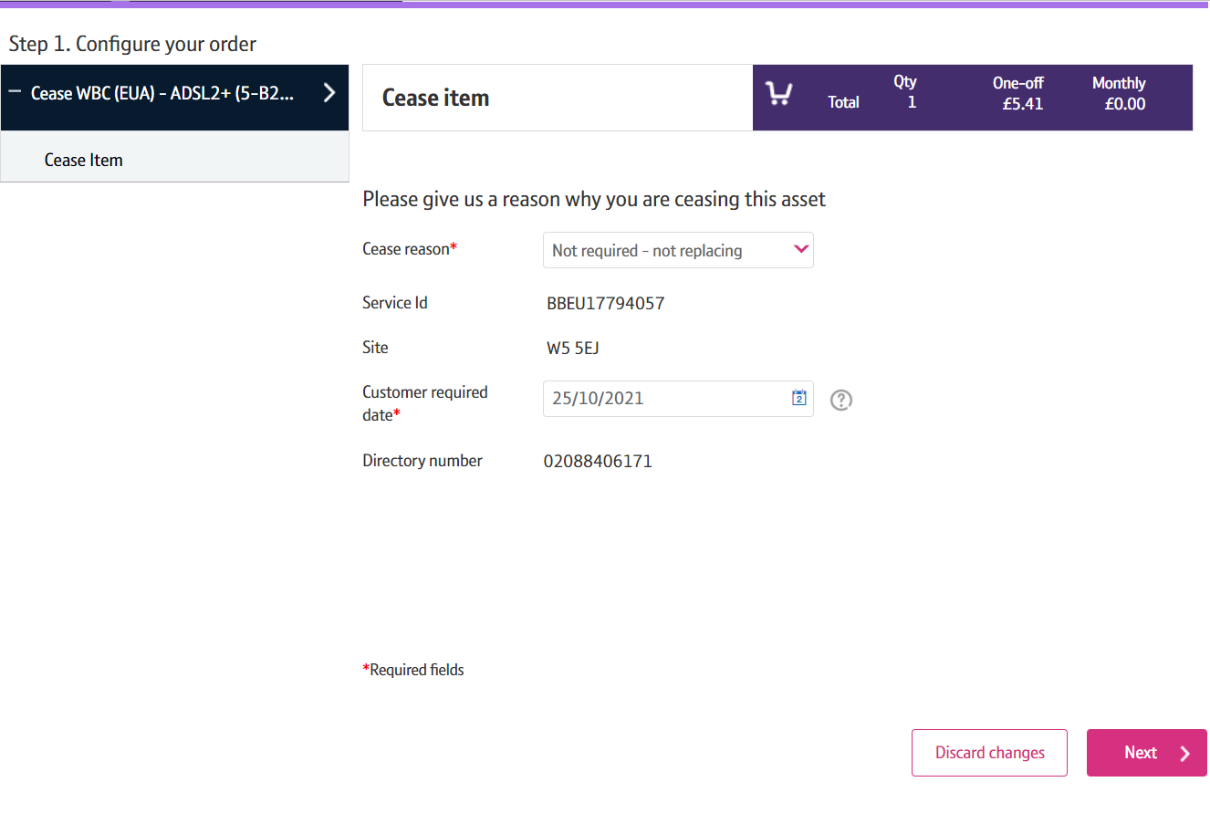
How to Cease Your Service
Step 4: Select the CRD and Cease Reason
Select the day you want to cease the service from using the calendar.
Click on ‘Next’

Slide 12
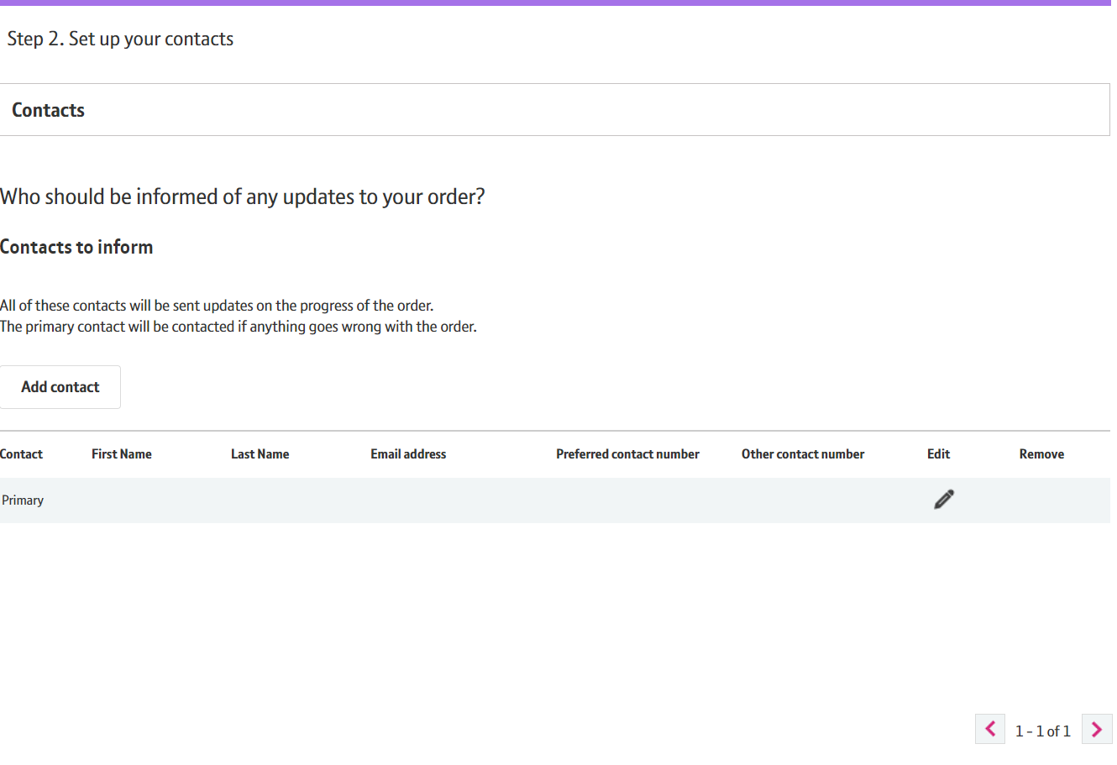
How to Cease Your Service
Step 5: Contact Details
You have the opportunity to edit existing contact details by clicking pencil icon or add additional contact by clicking ‘Add Contact’.

Slide 13
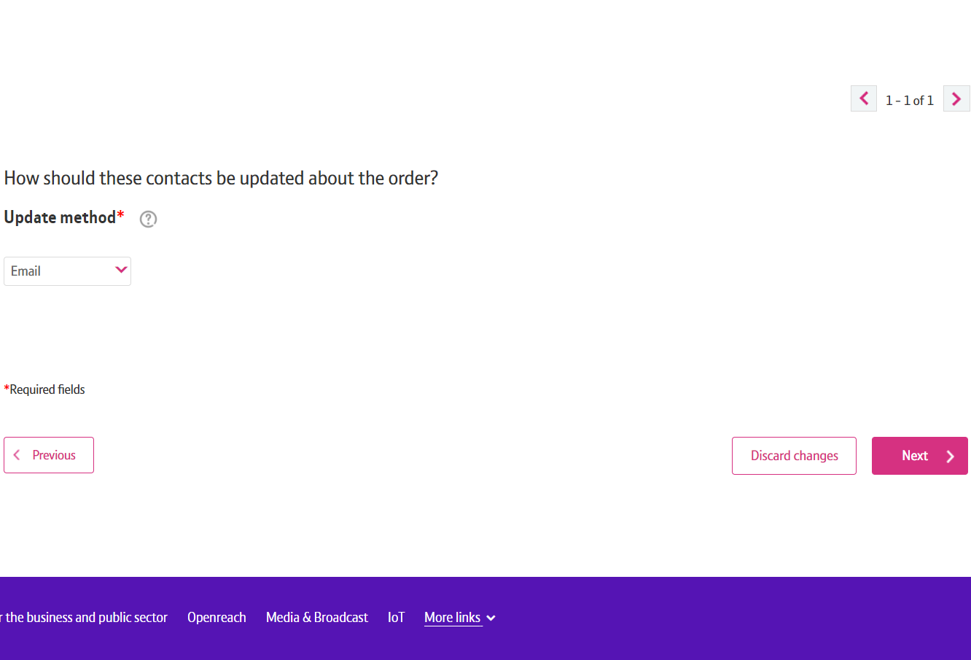
How to Cease Your Service
Step 6: Method of Contact
Scroll down the page.
Select how you want to be updated about your order.
Click on ‘Next’

Slide 14
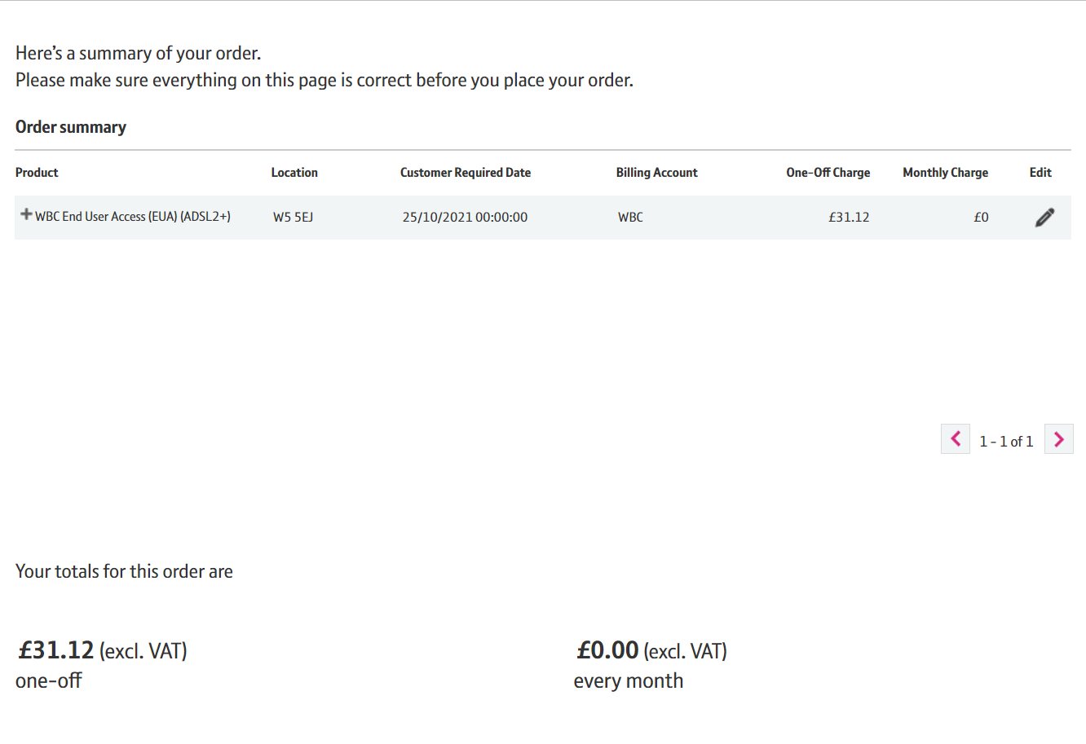
How to Cease Your Service
Step 7: Confirmation and Submission
Check the details under Order Summary. You can make changes by clicking on the ‘edit’ button.
The cost to cease the Service is also provided.

Slide 15
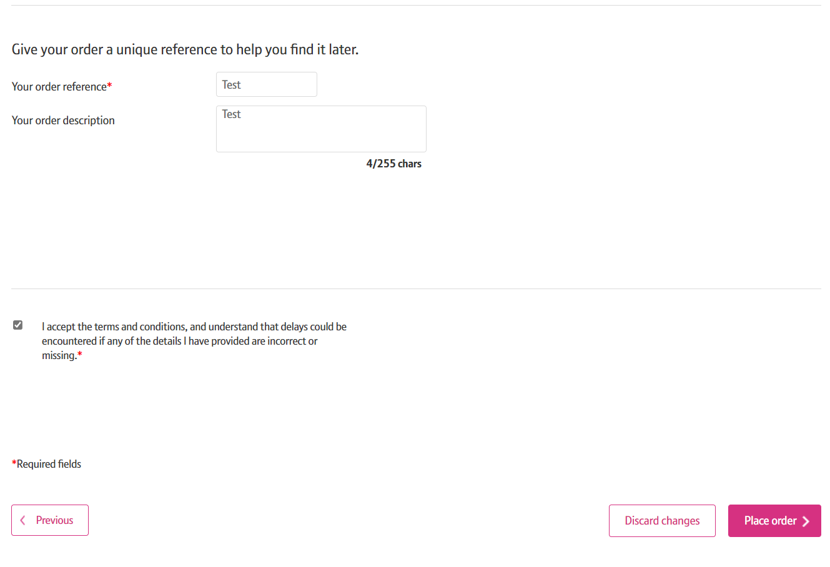
How to Cease Your Service
Step 7: Confirmation and Submission
Enter your order reference.
Accept the terms and conditions by ticking the box.
Click on ‘Place order’

Slide 16
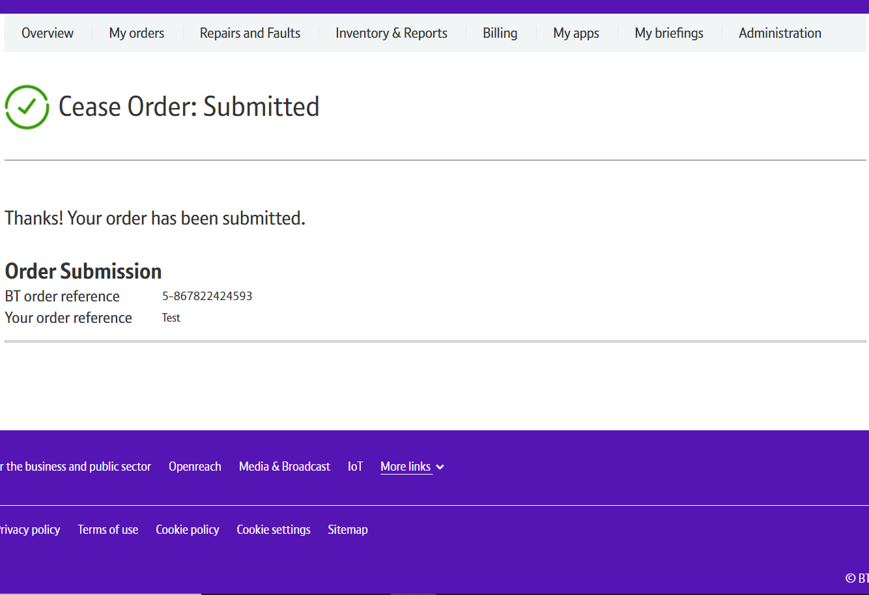
How to Cease Your Service
Step 8: Confirmation
Confirmation that your request has been placed.

