Slide 1
How to cancel a Broadband Order on Enhanced Eco+
Version 1
Notes:
Security classification options:
– Public
– Internal
– Confidential
– Highly Confidential

Slide 2
Contents
What’s in this User Guide?
Slide 3 – Version Control
Slide 4 – Overview
Slide 5 – How to Cancel Your Order

Slide 3
Version Control
Date | Change | Version
December 21 | User Guide Published | 1

Slide 4
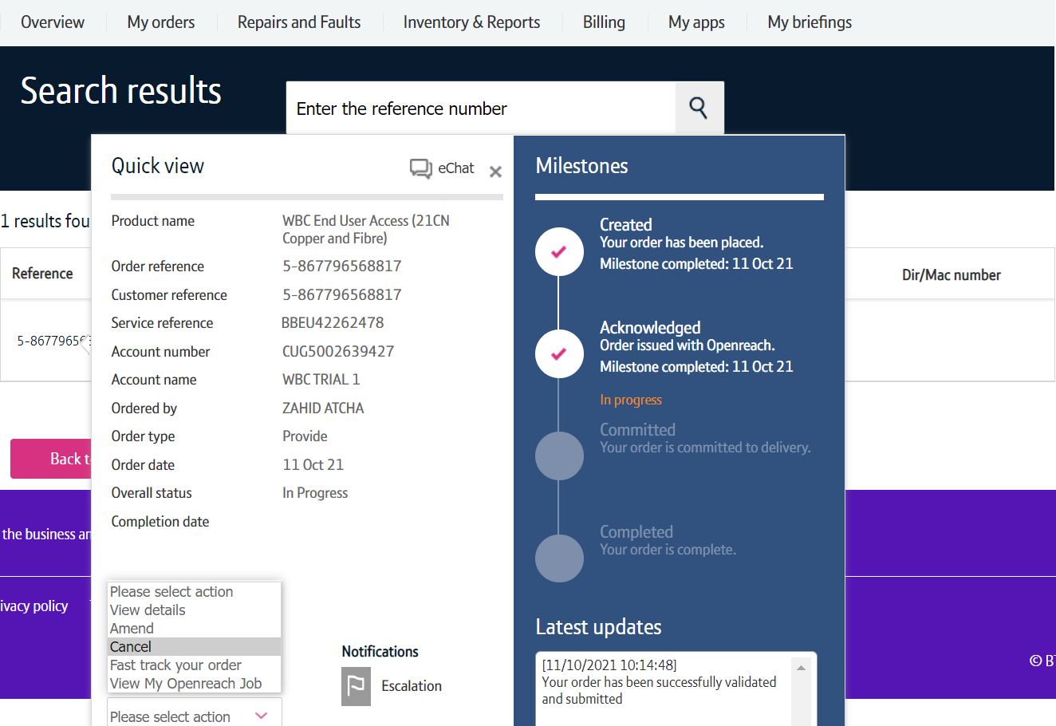
Overview
There are number of steps that needs to be performed in order for you to cancel your order.
Search for your order
First you’ll need to search for your order on My BT Wholesale. From here, you can instigate the cancellation.
Check to see if your order can be cancelled
We’ll then need to check that your order can be cancelled. Depending on how far your order has progressed. If your order can’t be cancelled, we’ll tell you.
Tell us why you’re cancelling the order
If your order can be cancelled, you’ll be taken to the cancellation journey. Here, you’ll need to tell us why you’re cancelling the order.
Cancellation charges
There may be a charge depending on the order type and the stage the order is at. Cancellation charges are listed in the WBC Price List .
The last point an order can be cancelled (know as the Point Of No Return or PONR) is 2pm on CRD-1.

Slide 5
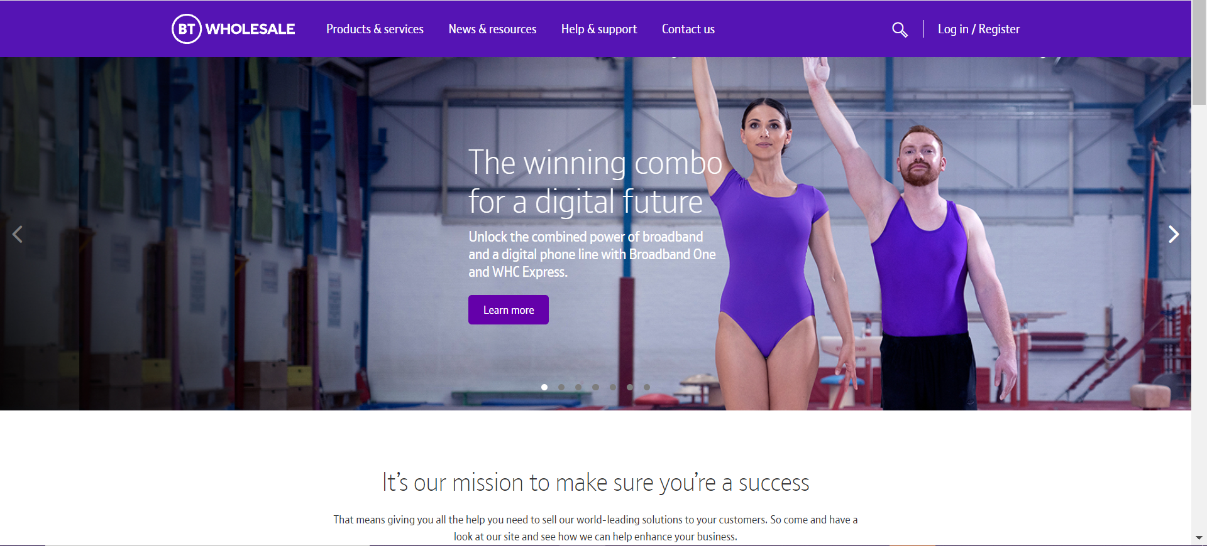
How to Cancel Your Order
Step 1: Logging In
Go to www.btwholesale.com
Click on ‘Login/register’

Slide 6
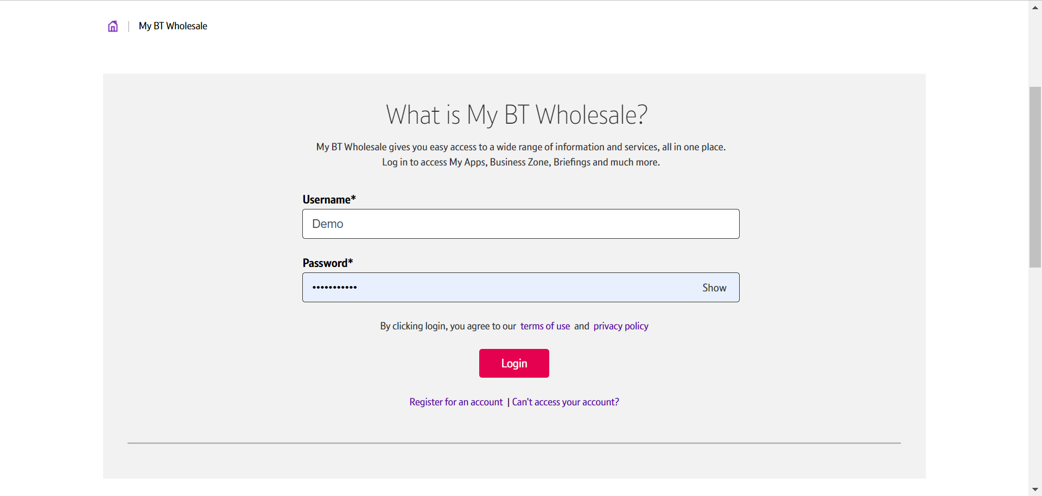
How to Cancel Your Order
Step 1: Logging In
Enter your Username and Password.
Click on ‘Login’

Slide 7
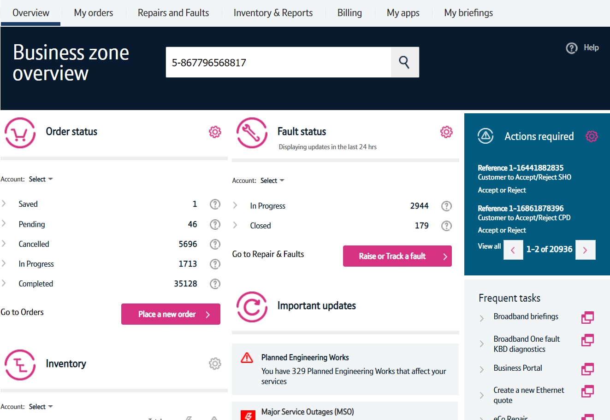
How to Cancel Your Order
Step 2: Search for your Order
Once logged in, you’ll be taken to Business zone.
If you aren’t taken to Business zone, you’ll need to arrange access via your company administrator.
Use the Order Reference, Telephone Number or BBEU Number to search for your open order.
Click on the magnifying glass.

Slide 8
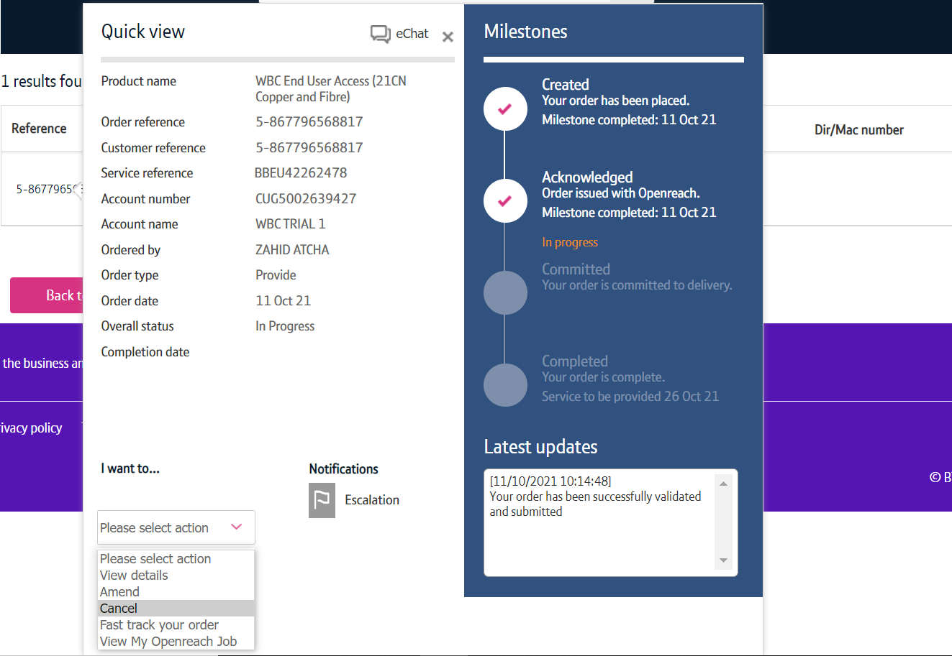
How to Cancel Your Order
Step 3: Place the Cancellation
In the ‘Please select action’ box, select ‘Cancel’.
Allow the page to refresh.

Slide 9
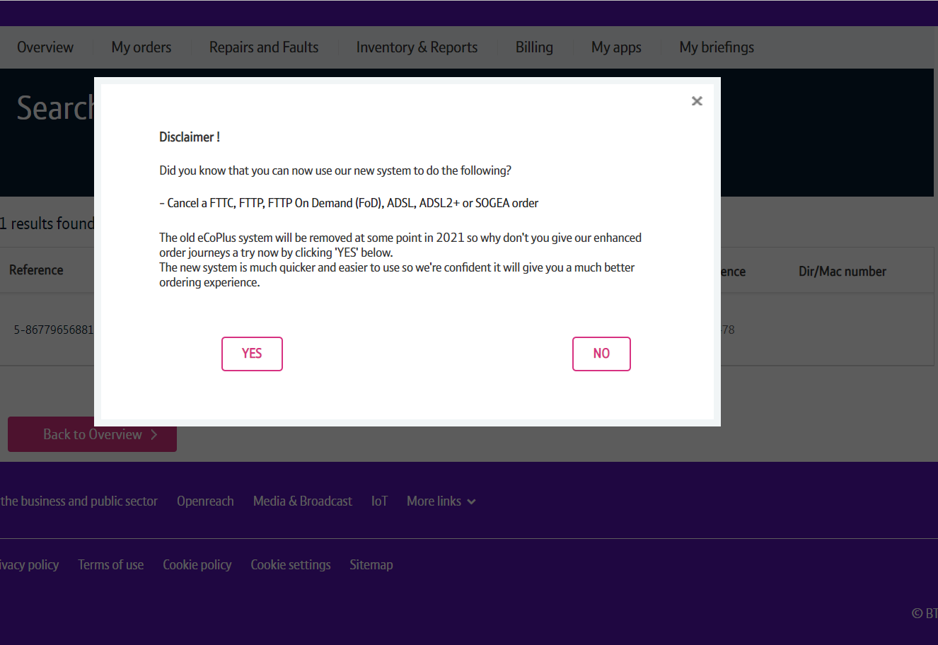
How to Cancel Your Order
Step 3: Place the Cancellation
You may see a Disclaimer message pop up. This message may be changed from time to time following releases as we add more journeys to the new system.
From here you have to click on ‘Yes’ to go to the new version of the system.

Slide 10
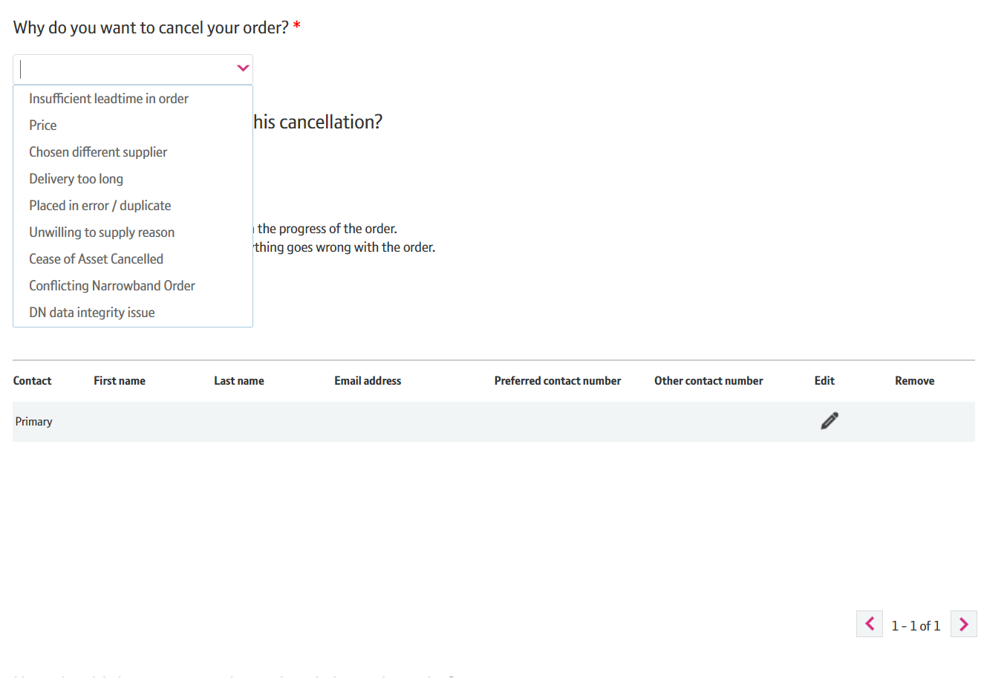
How to Cancel Your Order
Step 3: Place the Cancellation
Select a Cancellation Reason from the list.

Slide 11
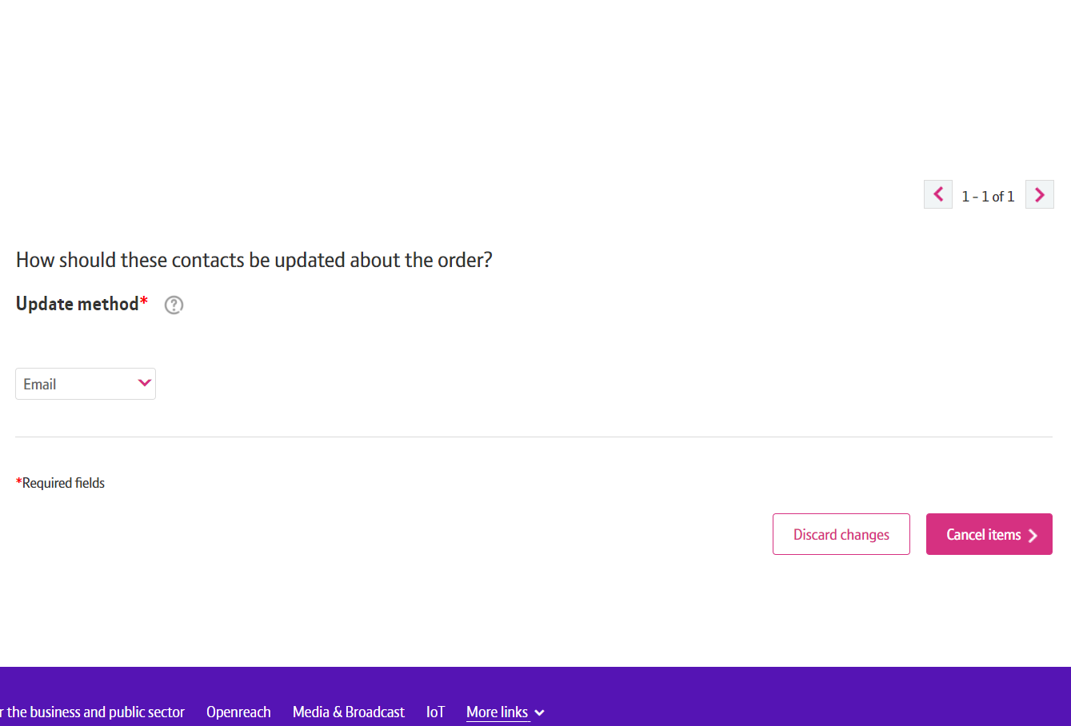
How to Cancel Your Order
Step 3: Place the Cancellation
Scroll down the page.
Select how you want to be updated about your order.
Click on ‘Cancel items’

Slide 12
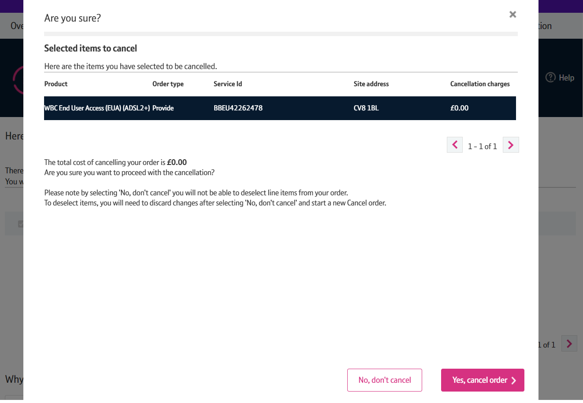
How to Cancel Your Order
Step 3: Place the Cancellation
You will be given the cost for cancelling your order.
Click on ‘Yes, cancel order’.

Slide 13
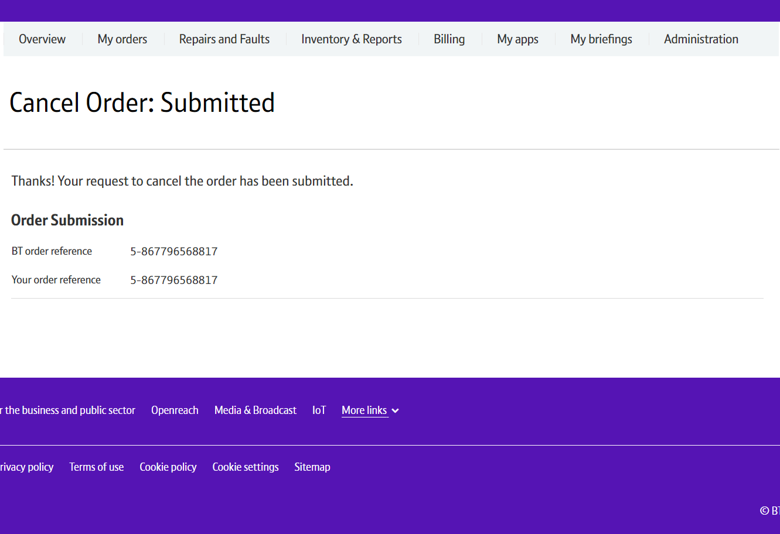
How to Cancel Your Order
Step 4: Confirmation
Confirmation that your request has been placed.

