Slide 1
How to place a SOGEA Provide Order with DN including Number Port/Transfer on Enhanced Eco+
Version 1
Notes:
Security classification options:
– Public
– Internal
– Confidential
– Highly Confidential

Slide 2
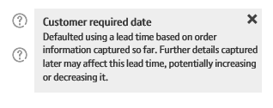
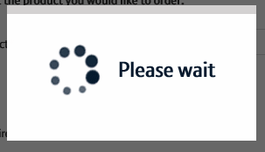
Enhanced Eco+ System Guidance
We’ve designed the Enhanced Eco+ system to be intuitive and easy to use. You will notice that the information you input is largely the same as the old system but has been streamlined.
Benefits of the new system:
Quicker – the page loading time is significantly less than the previous system making it quicker to place your order. We’ve also streamlined the input needed so there are fewer clicks needed.
Helpful guidance - we’ve introduced Tool Tips against some of the order parameters. These are to help you understand what the parameter is for, the options that are available and how that will impact the service we provide. Simply click on the ? Icons.
Thinking time – when the system is progressing to the next page there is a clear symbol that tells you the page it updating. This will avoid the issues you had on Eco+ when the page was refreshing but you didn’t know that!

Slide 3
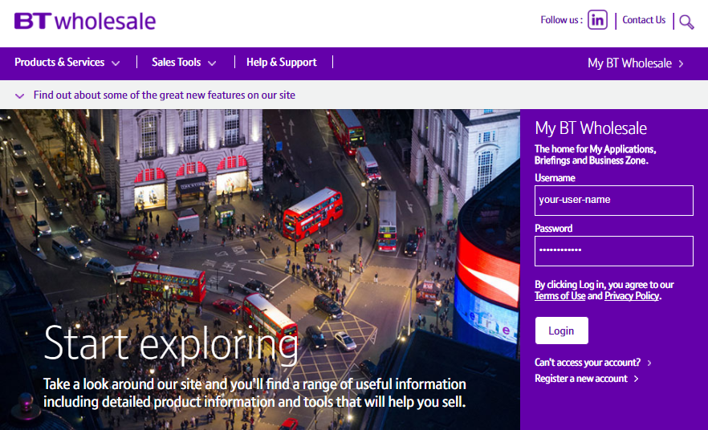
How To Place a SOGEA Provide Order with DN and Number Port/Transfer
Step 1: Logging In
Go to www.btwholesale.com
Enter your Username and Password
Click ‘Login’

Slide 4
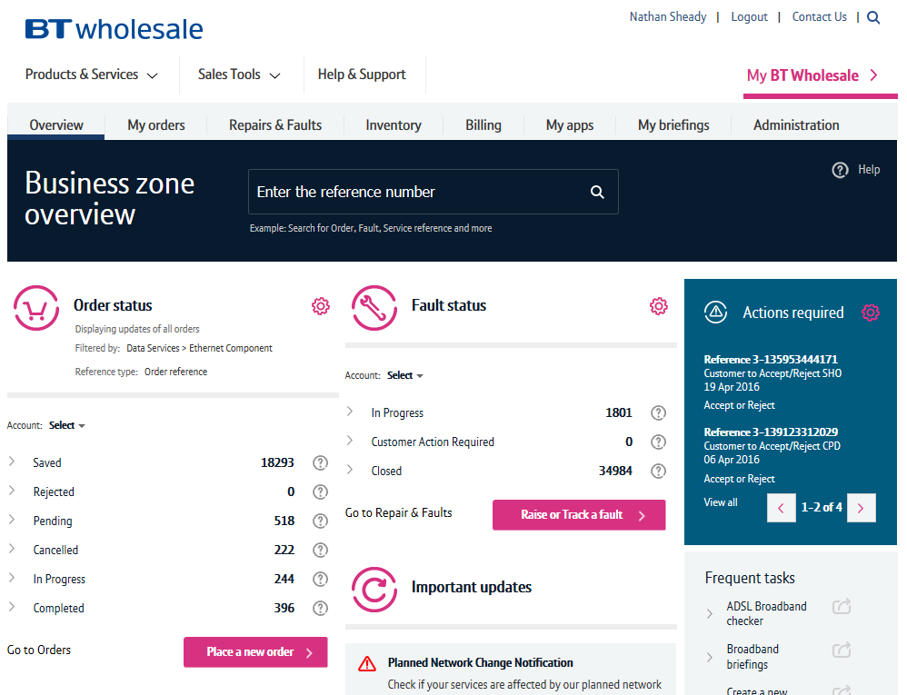
How To Place a SOGEA Provide Order with DN and Number Port/Transfer
Step 2: Accessing the journey
Once logged in, you’ll be taken to Business zone.
If you aren’t taken to Business zone, you’ll need to arrange access via your company administrator.
To access the new journey:
Click ‘Place a New Order’

Slide 5
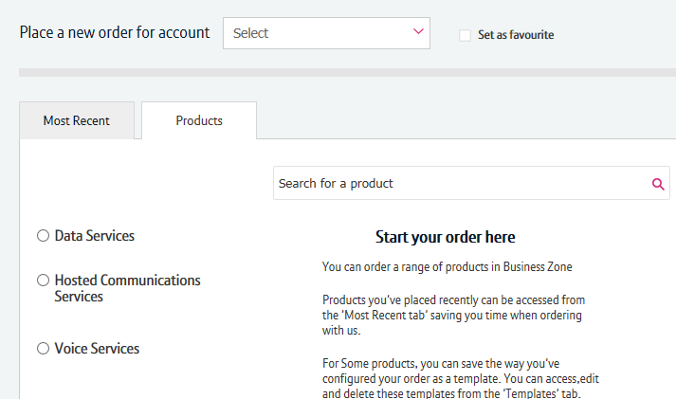
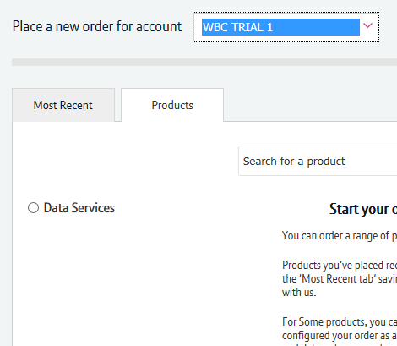
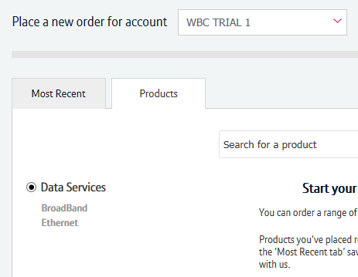
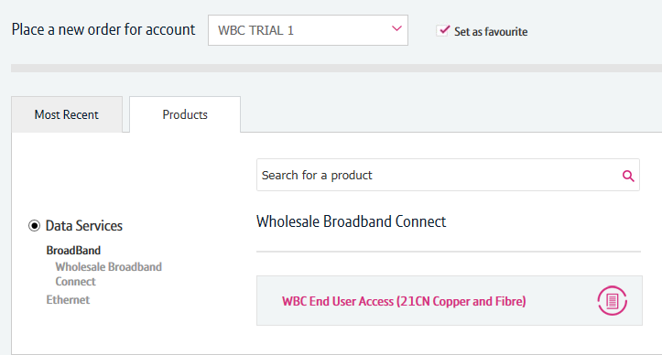
How To Place a SOGEA Provide Order with DN and Number Port/Transfer
1
2
Step 3: Accessing the journey
If you have multiple accounts associated with your user id, you’ll need to select the applicable account from the dropdown.
If you have multiple accounts, select the account from the drop down menu. Tick the ‘Set as favourite’ box if you want this to be your default account
Click ‘Data Services’.
Click ‘Broadband’.
Select ‘WBC End User Access (EUA)’.
If you have performed these steps previously then the product will be listed on the ‘Most Recent’ tab
3
4
5

Slide 6
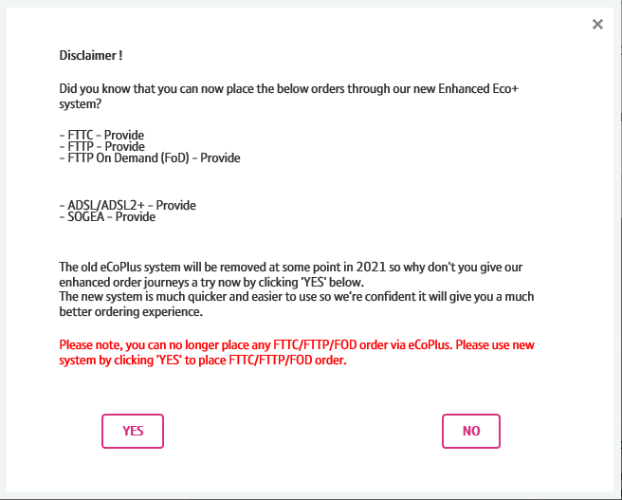
How To Place a SOGEA Provide Order with DN and Number Port/Transfer
Step 4: Accessing the journey
You’ll see a Disclaimer message pop up. This message may be changed from time to time following releases as we add more journeys to the new system.
From here you have to click “Yes” to go to the new version of the system.
6

Slide 7
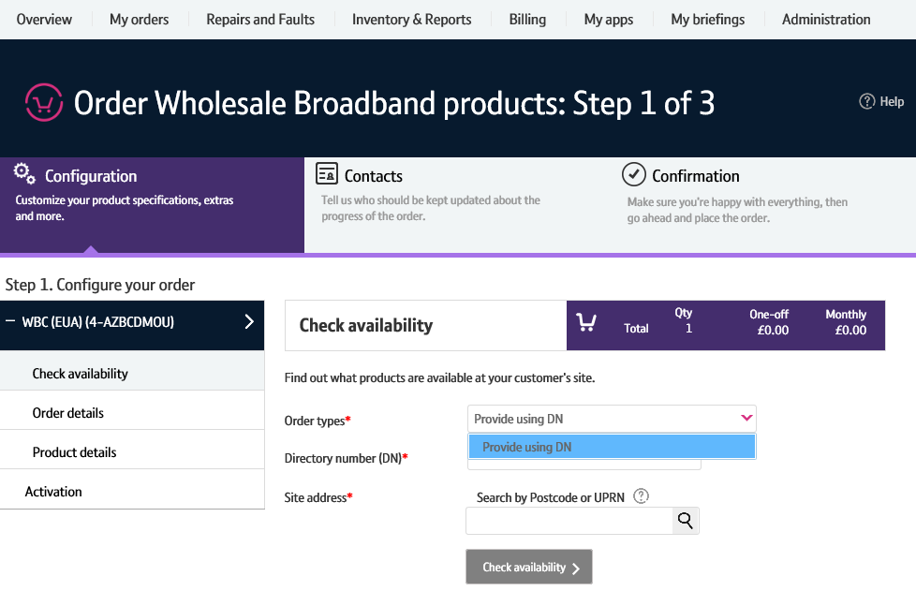


How To Place a SOGEA Provide Order with DN and Number Port/Transfer
Step 5: Select the Order Type
Select ‘Provide using DN’
1

Slide 8
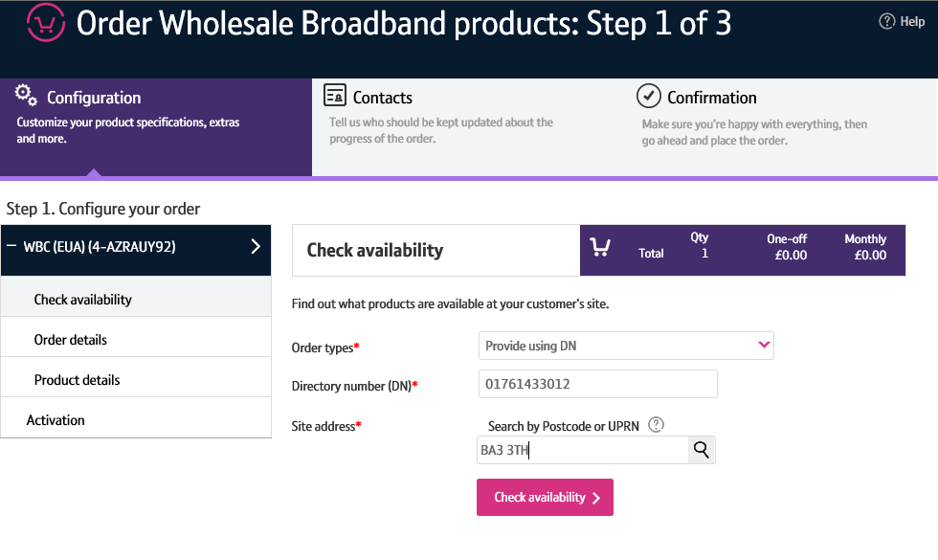



How To Place a SOGEA Provide Order with DN and Number Port/Transfer
Step 6: Select the Address
Enter the Directory Number
Enter the Postcode
Press the magnifying glass to look up the full address
You can continue without selecting the full address however we recommend selecting the full address for accuracy on the order.

Slide 9
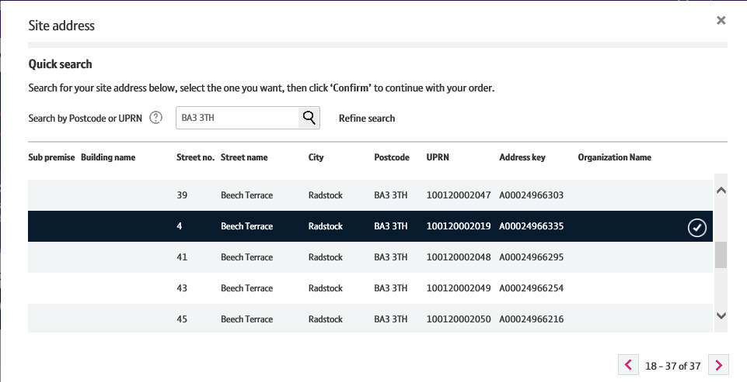


How To Place a SOGEA Provide Order with DN and Number Port/Transfer
Step 7: Select the Address
Select the address from the list (Ensuring that a god Address Key has been selected. This always starts with an A)
Select ‘Confirm’ at the bottom of the page
Note: Use the scroll bar to see all addresses. Only 5 will show in the box.

Slide 10
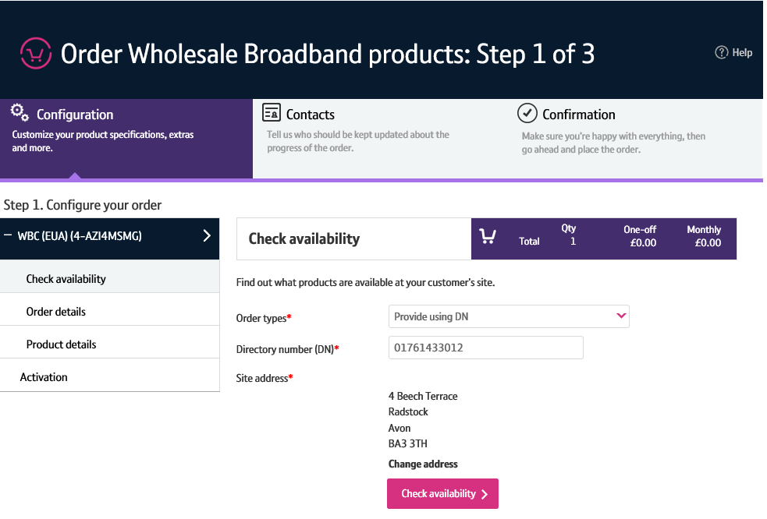
How To Place a SOGEA Provide Order with DN and Number Port/Transfer
Step 8: Check Availability
1. Click on ‘Check Availability’

Slide 11
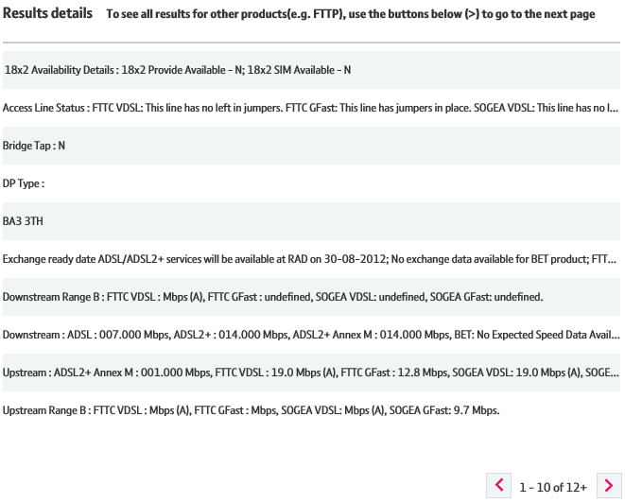
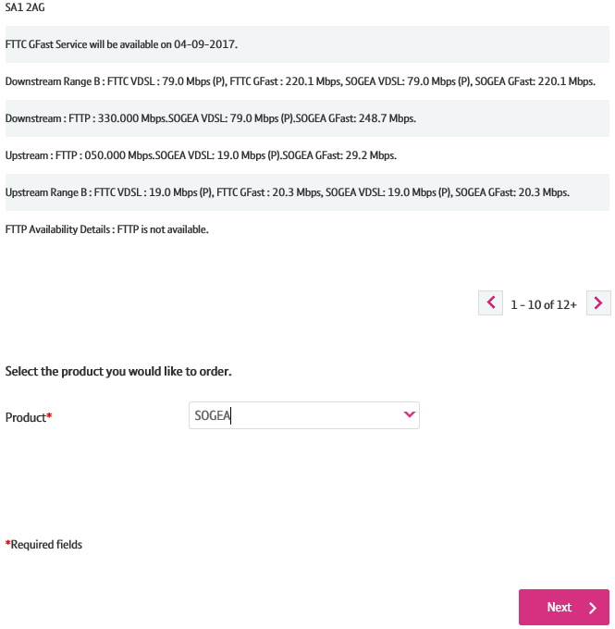

How To Place a SOGEA Provide Order with DN and Number Port/Transfer
Step 9: Check Availability & Product
The available products will be shown in the Results Details table.
On the Product drop down select ‘SOGEA’
Click ‘Next’

Slide 12
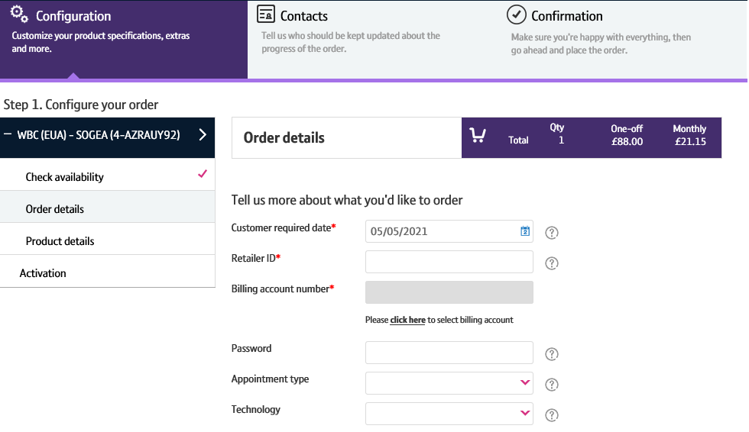






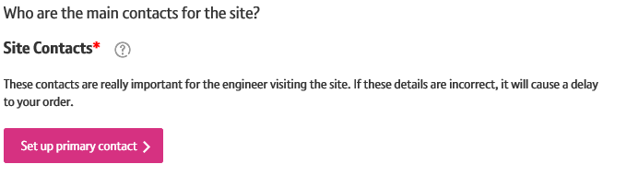

How To Place a SOGEA Provide Order with DN and Number Port/Transfer
Step 10: Order Details
Customer Required by Date - will default to the standard lead time for the product and order type. If you want a date in the future, use the calendar icon to select the date you want.
Retailer ID – this is you RID ID supplied by Ofcom
Billing Account - use the click here link to select your billing account number
Password - optional
Appointment type – IMPORTANT leave blank if you require a standard All Day (non-chargeable) appointment.
    If you want a chargeable AM/PM or More Focused Appointment slot pick the option from the list
Technology = ‘VDSL’ or ‘Gfast’
Site Contacts – select ‘set up primary contact’ to enter the details

Slide 13
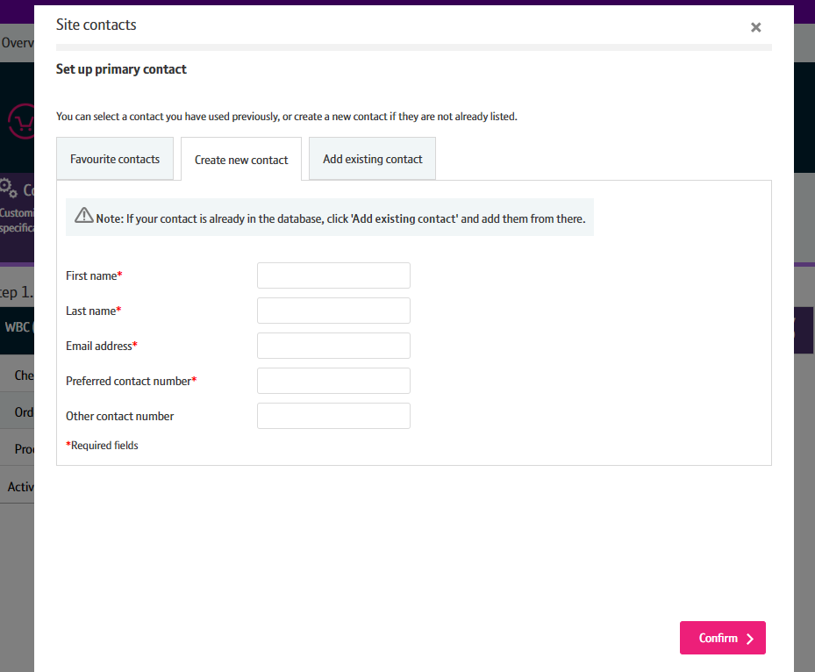
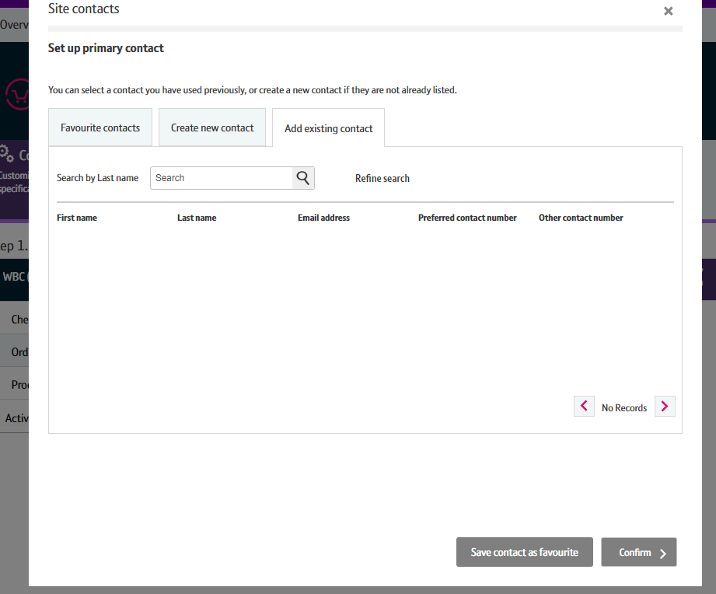
How To Place a SOGEA Provide Order with DN and Number Port/Transfer
Step 11: Order Details
From here you can Create a New Contact. If you have a contact you use frequently, you can save their details as a Favourite contact to stop you having to enter the details every time.
Select ‘Confirm’ once you have entered all the details.
If you wish to change this after you have selected Confirm, you can go back and amend the details using an Edit option that will appear on the previous screen.

Slide 14
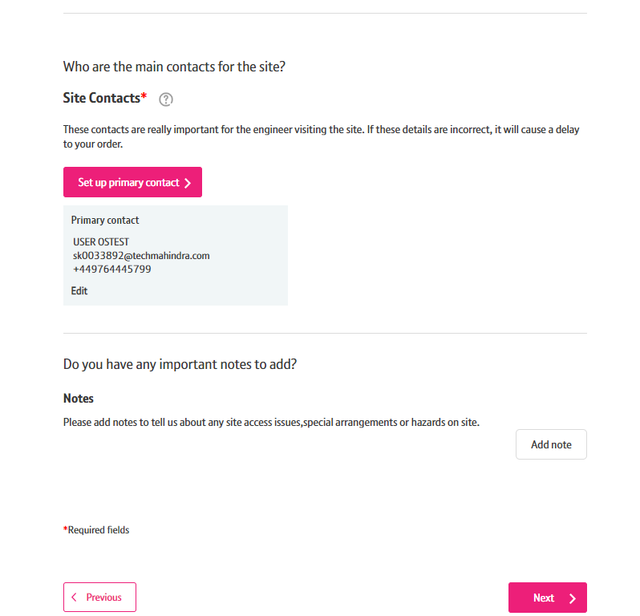

How To Place a SOGEA Provide Order with DN and Number Port/Transfer
Step 12: Order Details
You can now add any notes to your order that may be important by clicking the Add note button. This is not a mandatory parameter.
You can add Hazard notes, Site Visit notes and Special Arrangement notes. Please ensure that the maximum characters used for any note added is 60 characters.
Once saved you will be given the option to Edit or Remove the notes if you wish to.
1. Click on Next

Slide 15
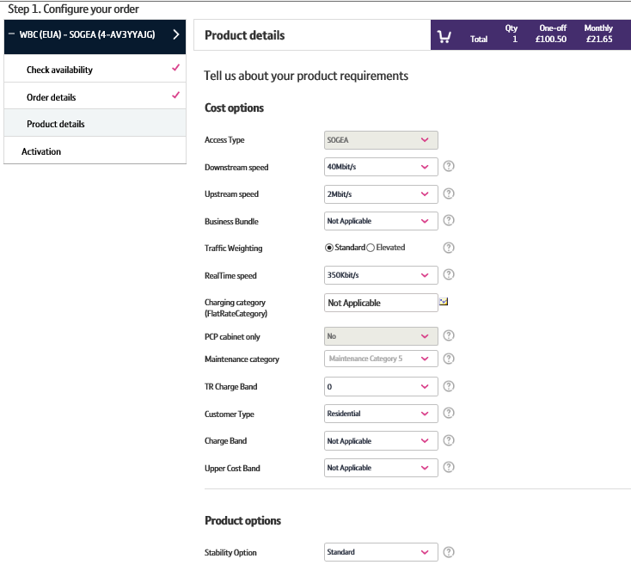











How To Place a SOGEA Provide Order with DN and Number Port/Transfer
Step 13: Produce Details
Use the Tools tips at the side of each category if you need help to
understand the option you need to select.
1. Downstream Speed – Select the speed you require
2. Upstream Speed – Select the speed you require
3. Business Bundle – refer to the product handbook for further
Details. Combines Traffic Weighting and Maintenance Category Combinations.
4. Traffic Weighting – Options Standard or Elevated
5. Real time speed – Usually set to 0
6. Charging Category - Usually not applicable
7. Maintenance Category:
- Category 5 = 40 hour repair
- Category 4 = 20 hour repair
- Category 14 = 7 hour repair
8. Time related charge band
9. Customer Type – Business Or Residential
10. Charging Category
11. Upper cost Band - usually not applicable
12. Stability Option - Choose standard
9

Slide 16
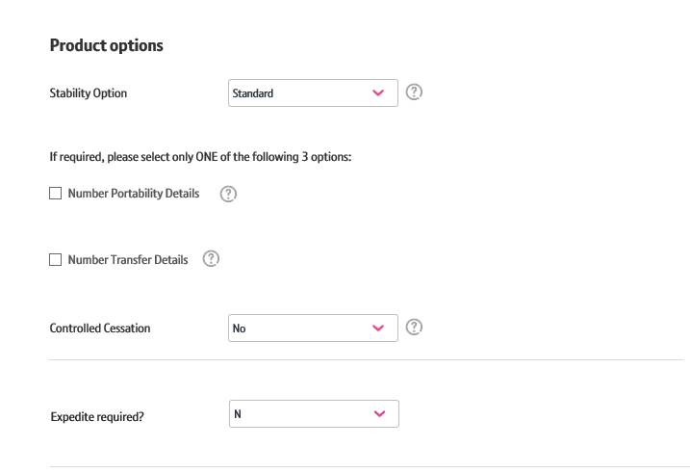

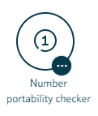
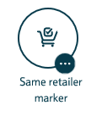
How To Place a SOGEA Provide Order with DN and Number Port/Transfer
Step 14: What is an integrated Number Port and Number Transfer?
Number Port is used where the CP that currently owns the WLR service is different from the CP who will provide the VOIP service.
Number Transfer is used where the CP that currently owns the WLR service is the same CP that will provide the VoIP service
You can only use the integrated port or transfer options if the number is in a BT number range. If the WLR number is not in the BT range then you will need to use the stand alone number port option.
Before considering undertaking either a number port or a number transfer as part of a SOGEA order, we strongly recommend that the CP undertakes the number portability check, to ascertain if the number is suitable for porting. This can be done in XML, or direct via the Dialogue service on the Openreach portal.
As part of migration to SOGEA, Openreach offers shorter lead times for ‘same retailer’ migrations and the 10 working days industry lead time for ‘change of retailer’ migrations
When providing SOGEA from another working service where the CP already owns the WLR/MPF, it is mandatory to use the Openreach provided Dialogue Service ‘Same Retailer Marker’ to ensure Openreach accept the order and apply the shorter lead time.
Exceptions where the integrated number port/transfer can’t currently be used
Hosted voice is currently incompatible please follow the stand alone process.
Working line take over this is currently incompatible please follow the stand alone process.
The Openreach tools to check if a number can be ported, and to set the Same Retailer Marker are as below ;

Slide 17
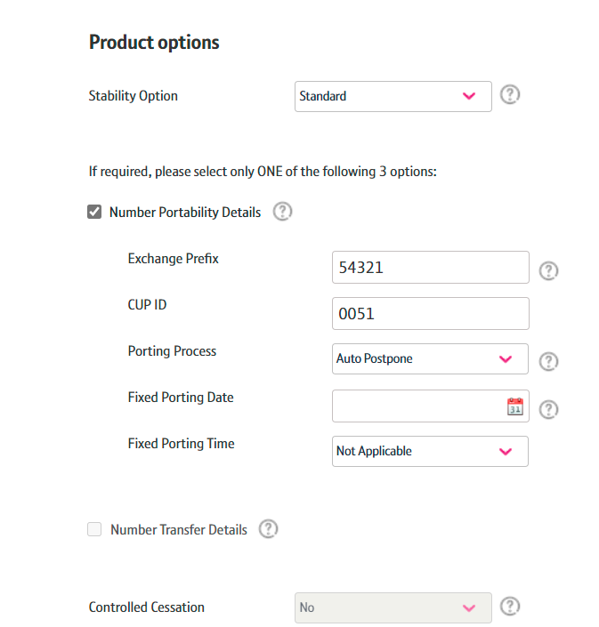







How To Place a SOGEA Provide Order with DN and Number Port/Transfer
Step 15: Product Details
Use the Tool tips at the side of each category if you need help to understand the option and what you need to select.
1. Number Portability Details – Select this if you don’t own the WLR (if you do own the WLR you need to select Number Transfer Details)
2. Exchange Prefix – This is the 6 digit code
3. CUP ID – This is the ID given to the voice provider by Ofcom
4. Porting Process;
- Fixed - the number port will happen on the specific date chosen
- Auto Postpone (Recommended) – the number port will happen only after the Number Export Activation Dialogue service is called. We recommend using this option as the number port will automatically align to the dates on the SOGEA order for the Broadband should there be a delay on the Broadband
5. Fixed Porting Date – only required if you have selected the “Fixed” option on the previous step.
6. Fixed Porting Time – only required if you have selected the “Fixed” option on step 4
7. Number Transfer Details - select this if you own the WLR service already
8. Controlled Cessation – this option can only be used if you are not porting or transferring the existing DN. It allows the existing WLR/MPF service to be active for a few days following the completion of the SOGEA order. This option should be No if you’ve selected a Number Port or Transfer.

Slide 18
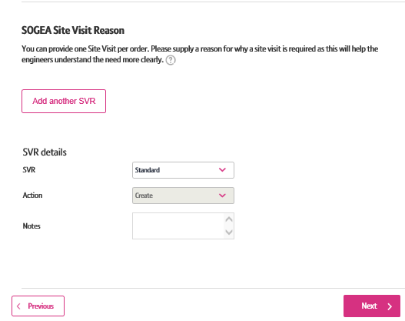
How To Place a SOGEA Provide Order with DN and Number Port/Transfer
Step 16: Product Details
Use the Tool tips at the side of each category if you need help to understand the option and what you need to select.
Site Visit Reason – For the managed install select either Standard or Premium
2. Notes – To add notes for the engineer
3. Select ‘Next’

Slide 19
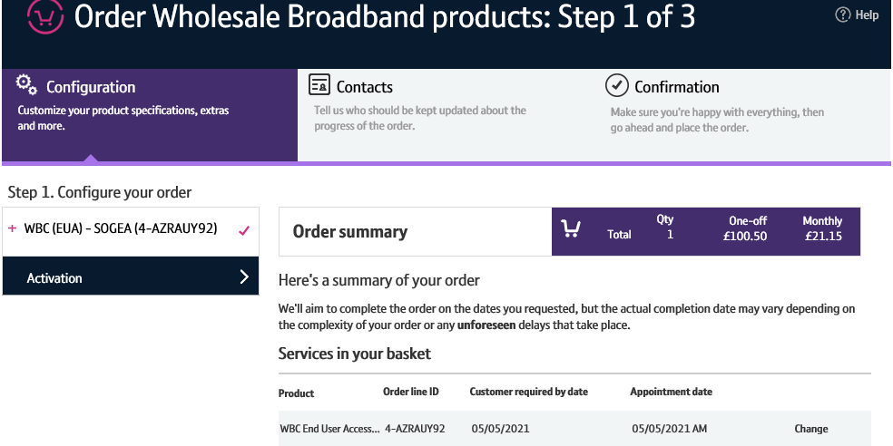
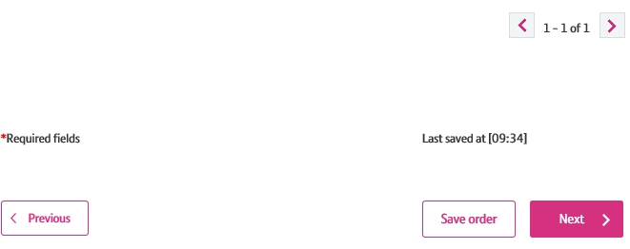
How To Place a SOGEA Provide Order with DN and Number Port/Transfer
Step 17: Order Summary
Your order is summarised confirming the selected CRD and appointment date and the costs.
If you want to change the appointment date or time you can select the “Change” option.
When you are happy, select ‘Next’

Slide 20
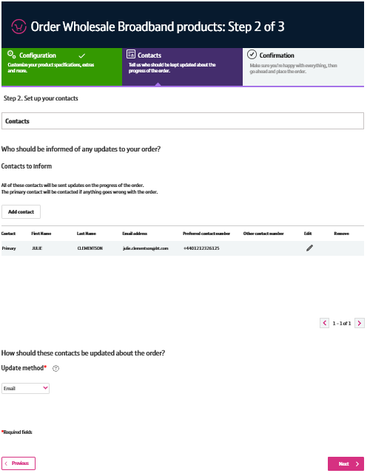


How To Place a SOGEA Provide Order with DN and Number Port/Transfer
Step 18: Order Contacts
You can now add the details of who you want to be kept up-to-date on the progress of the order.
Your details will be automatically populated from your BTWholesale.com account details. You can edit these if needed.
You can also add any additional contacts.
You can also choose how you want to be updated; Email, Online Tracking or Critical emails only.
Click ‘Next’
2
3
4
20

Slide 21
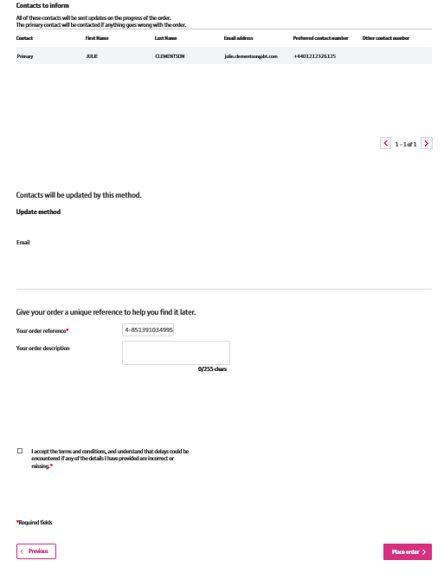



How To Place a SOGEA Provide Order with DN and Number Port/Transfer
Step 19: Order Contacts
You can now add the details of who you want to be kept up-to-date on the progress of the order.
This is your order reference.
You can also add your own order description.
You need to accept the terms and conditions with a tick in the box.
Click ‘Place Order’
2
4
21

Slide 22
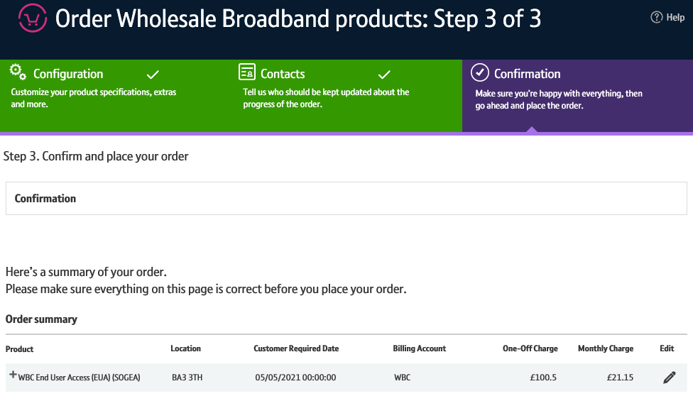
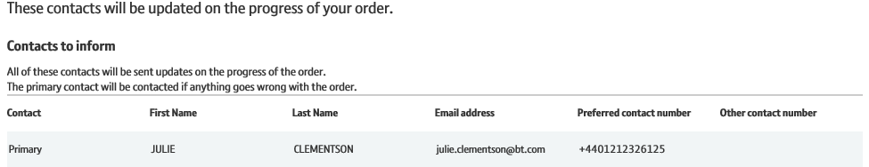
How To Place a SOGEA Provide Order with DN and Number Port/Transfer
Step 20: Confirmation
This screen summarises your order before submission. You can use the Edit option or the Previous box at the bottom of the page if you need to make any changes.
The following details are confirmed:
1. What product you have ordered and the options you have selected.
2. Who needs to be kept updated on the progress of the order and how.
22

Slide 23
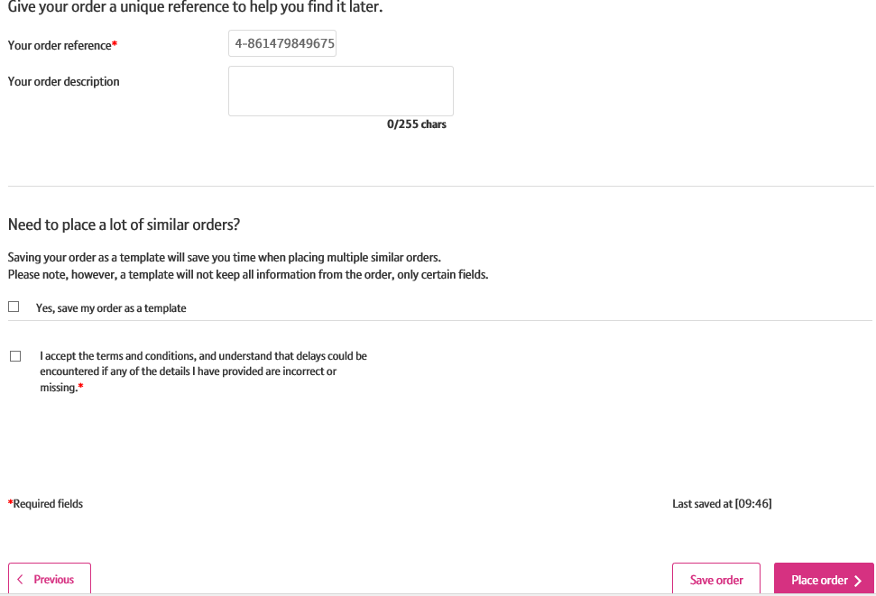



How To Place a SOGEA Provide Order with DN and Number Port/Transfer
Step 21: Confirmation continues
This screen summarises your order before submission. You can use the Edit option or the Previous box at the bottom of the page if you need to make any changes.
The following details are confirmed:
1. You can also add your own order reference and description
2. Select the tick box to accept the Terms and Conditions
3. Select ‘Place order’
23

Slide 24
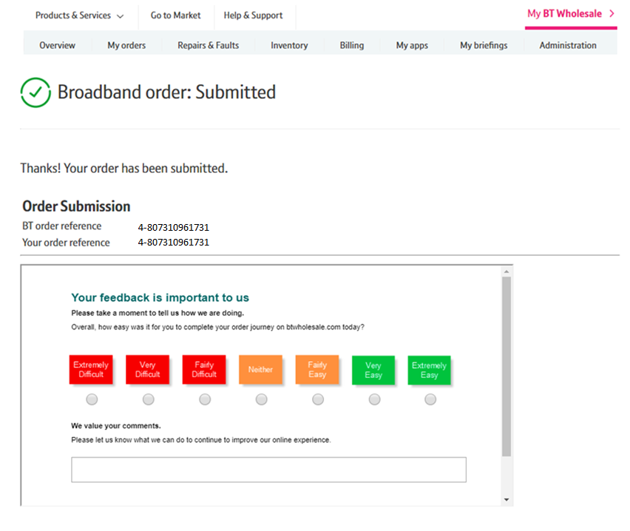
How To Place a SOGEA Provide Order with DN and Number Port/Transfer
Step 22: Confirmation
Final confirmation that your order has been submitted successfully and what your BT Wholesale order reference is.
Please fill in the survey to tell us how easy it was to submit your order. We’re always looking to improve the systems so your feedback is really valuable to us.
24

